Slide 1
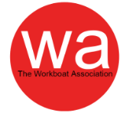
Safety Management Systems
Past, present and future
Simon Jinks
Safe Maritime Operations in Aquaculture Conference Inverness 12-13 October 22

Slide 2
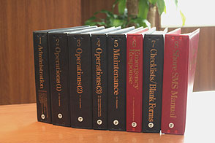
Safety Management System
What is it?
Means a structured and documented system enabling company personnel to implement effectively the company safety and environmental policy.
Notes:
Ref: ISM Code §1.1.43

Slide 3
Main SMS objectives
Provide a standard for the safe management and operation of ships and for prevention of pollution.
Ensure safety at sea
Prevention of human injury or loss of life
Avoidance of damage to the environment and property

Slide 4
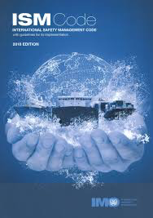
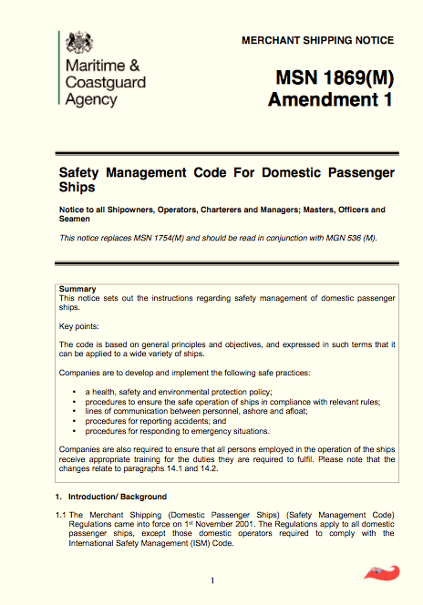
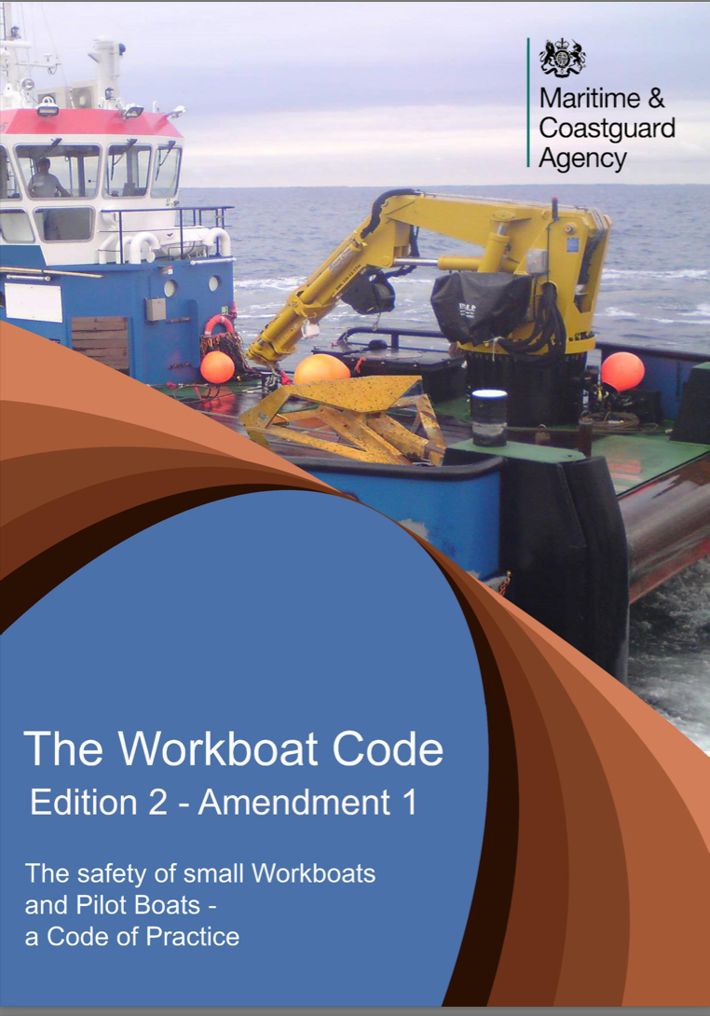
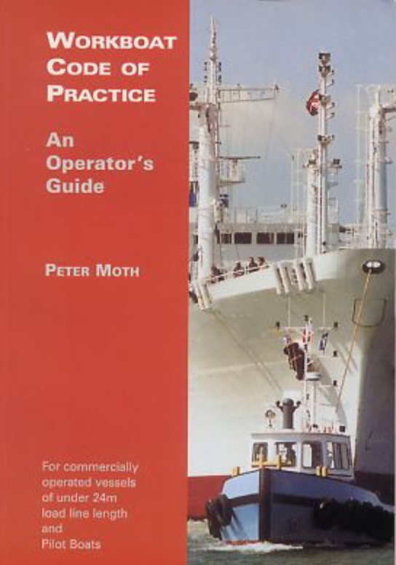
ISM, DSM and the codes

Slide 5


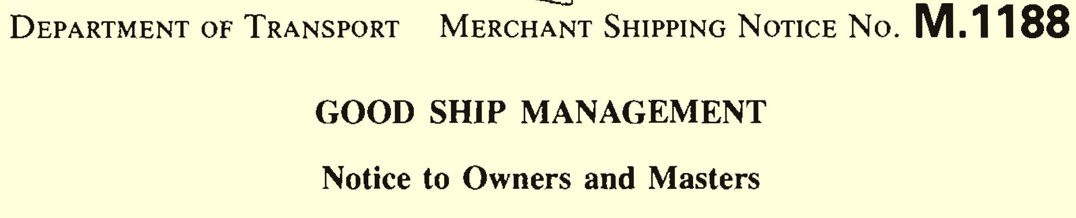
International Safety Management Code
Full Title:
The International Code for the Safe Operation of Ships and for Pollution Prevention
Adopted 1993 and made mandatory in 1998
Notes:
Adopted 1993 as Resolution A.741(18), and made mandatory by SOLAS Ch IX on 1st July 1998

Slide 6
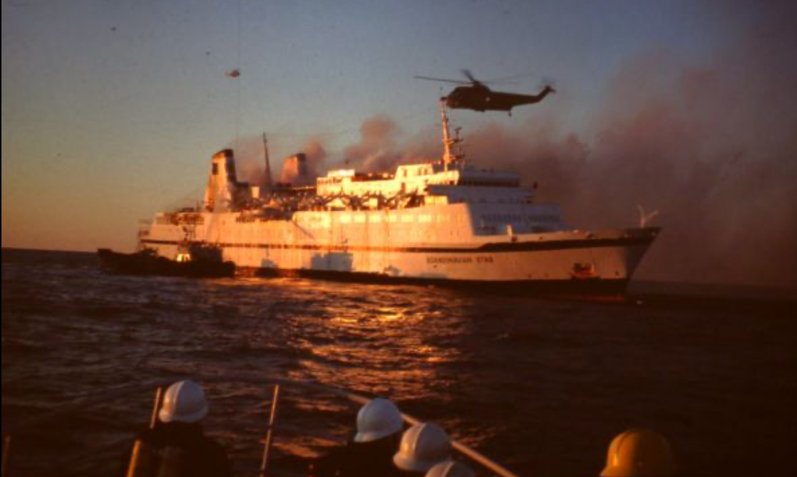
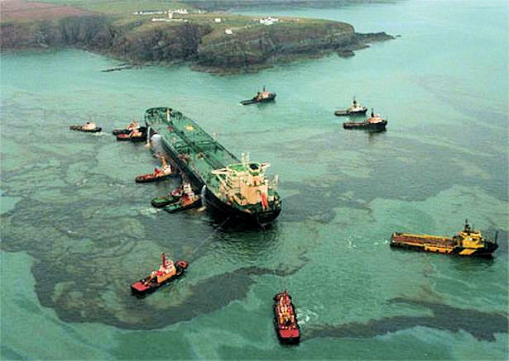
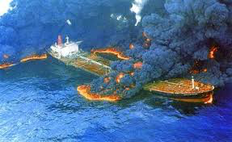
Evolution of ISM
Scandinavian Star– Baltic (90) - 159 dead
No drills, lack of common languange
Sea Empress – Milford Haven (96)
72000 ton crude, bridge team management
Exxon Valdez - Alaska (89)
10 million gallons – alcohol, procedures
Notes:
Several high-profile marine accidents during the late 80s & 90s highlighted shortcomings in the both the shoreside and shipboard management of the ships
Scandinaviam Star Sweden 1990 159 people killed lack of common language, no drills
Exxon Valdez Alaska 1989 10 million gallons Alcohol, procedures
Sea Empress Milford Haven 1996 72000 tons of crude oil Human error, bridge team management

Slide 7
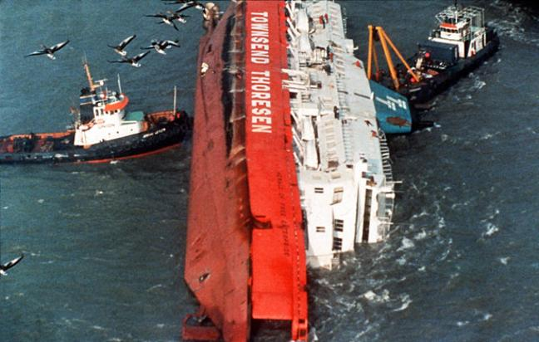
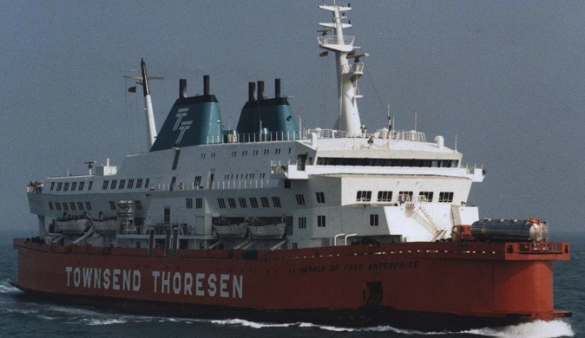
Key instigator…
March 6th, 1987
Herald of Free Enterprise
193 Dead
Notes:
Sailed from Zeebrugge trimmed by the head and with the bow doors still open. Flooding on the vehicle decks.
Herald of free enterprise North Sea 1987 193 people drowned Sloppy & complacent
Amendments to SOLAS:
- Emergency Equipment Lockers
Damage stability review
Water on deck alarms
CCTV coverage
Shell door Indicator lights
Transverse flood barriers on vehicle decks
Downflooding precautions
Development of ISM Code, and amendments to SOLAS – Ch. IX
Led to the formation of the MAIB in 1989.

Slide 8
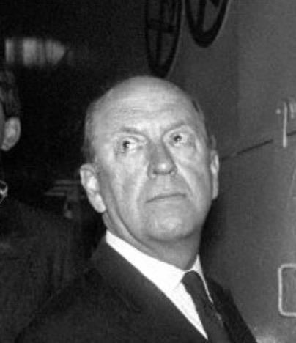
Severe criticism
Mr Justice Sheen, in his inquiry into the loss of the Herald of Free Enterprise, when describing the management …..
“the disease of sloppiness”;
“… a staggering complacency”
“The Board of Directors must accept a heavy responsibility for their lamentable lack of directions. Individually and collectively they lacked a sense of responsibility.”
Notes:
Full Quote:
“The Board of Directors did not appreciate their responsibility for the safe management of their ships. They did not apply their minds to the question: What orders should be given for the safety of our ships? The directors did not have any proper comprehension of what their duties were. There appears to have been a lack of thought about the way in which the HERALD ought to have been organised for the Dover/Zeebrugge run. All concerned in management, from the members of the Board of Directors down to the junior superintendents, were guilty of fault in that all must be regarded as sharing responsibility for the failure of management. From top to bottom the body corporate was infected with the disease of sloppiness.”
He refers to the pre-cursor of the ISM Code – M 1188, entitled Good Ship Management, issued by DfT in July 1986 (later superseded in 1990 by MSN 1424, and then in 1998 by MGN 40)
It states: The efficient and safe operation of ships requires the exercise of good management both at sea and ashore . . . . The overall responsibility of the shipping company requires the need for close involvement by management ashore. To this end it is recommended that every company operating ships should designate a person ashore with responsibility for monitoring the technical and safety aspects of the operation of its ships and for providing appropriate shore based back-up . . . . Stress is placed upon the importance of providing the Master with clear instructions to him and his officers. The instructions should include adequate Standing Orders. There: should be close co-operation and regular and effective communication in both directions between ship and shore.”

Slide 9
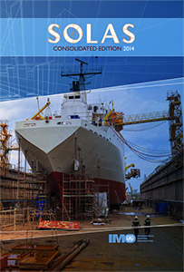
SOLAS
Introduced following the Titanic
Addresses ship safety, cargo, construction & equipment
Applies (generally) to ships on international voyages

Slide 10
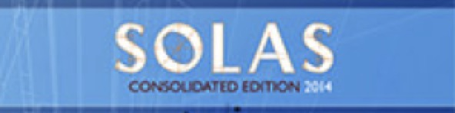
Chapters
General provisions
Construction/stability
Fire protection
Life Saving Appliances
Radio communications
Safety of Navigation
Carriage of cargoes
Carriage of DG
Nuclear ships
Management of safe operation of ships (ISM)
High Speed Craft
Enhancements to safety and security (ISPS)
Safety for bulk carriers
Notes:
A new Chapter IX was adopted in 1994 and accepted on 1st January 1998
This chapter applies to ships, regardless of the date of construction, as follows:
passenger ships including passenger high-speed craft, not later than 1 July 1998;
oil tankers, chemical tankers, gas carriers, bulk carriers and cargo high-speed craft of 500 gross tonnage and upwards, not later than 1 July 1998; and
other cargo ships and mobile offshore drilling units of 500 gross tonnage and upwards, not later than 1 July 2002.*
This chapter does not apply to government-operated ships used for non-commercial purposes.
N.B. Again, it only applies to ships on International Voyages. Hence, domestic ships not covered.

Slide 11
ISM
SOLAS IX mandated
The International Management Code for the Safe Operation of Ships and for Pollution Prevention
Applies to
Passenger ships
High speed passenger ships
Cargo ships & tankers ≥ 500 gt
On international voyages

Slide 12
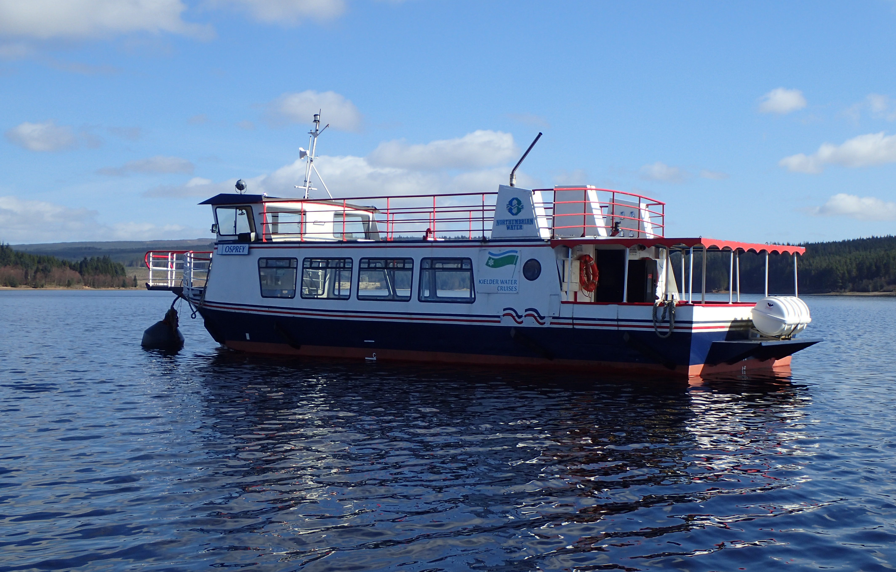
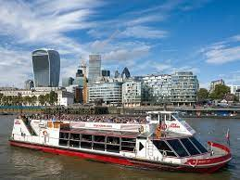
However…
SOLAS IX applies to ships on international voyages…
…so…, did not apply to vessels on domestic voyages.

Slide 13
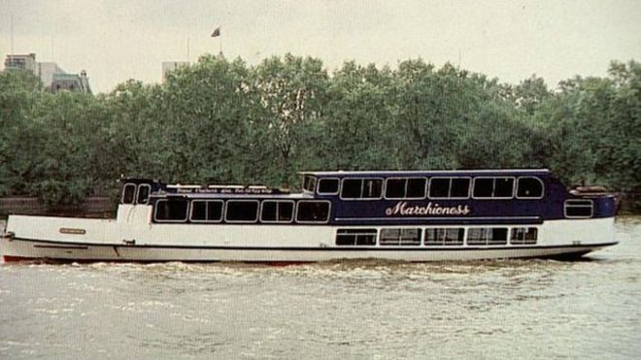
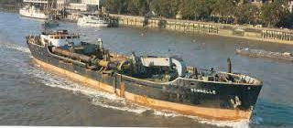
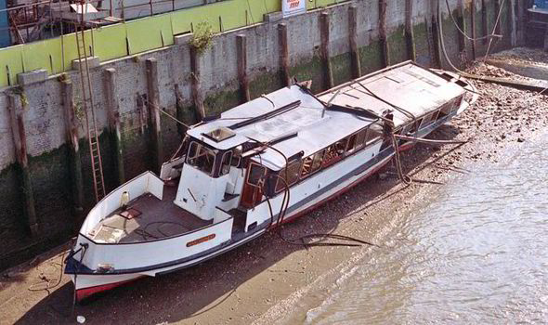
And then…
Marchioness
&
Bowbelle
August 20th, 1989
51 Dead
Notes:
In collision with the dredger Bowbelle in the vicinity of Southwark Bridge on the Thames.
Marchioness Thames 1989 51 people drowned Visibility, local regulations, training & general safety
MAIB Report:
Review of the BML system
Recommendations for passenger carrying qualifications
Recommended a tiered system of qualification for BML depending upon operating area
Regulation of working hours
Marking of sterns of passenger vessels (PLA Reg. 9) and lighting of bows (PLA Reg. 29)
Led to the signalling system in use through the bridges over the Thames
Laid the foundations for the incorporation of a DPA into the ISM & DSM Codes (initially recommended in M1188 published July 1986 – before HoFE & Marchioness!!)

Slide 14
In 2001 - DSM
Domestic Safety Management
(MSN 1869 & MGN 536 as ammended)
Follows principles of ISM - applied to
Domestic Passenger Ships
Small Seagoing Passenger Ships (<24m)
Non mandatory application to -
MCA/WA Workboat Code (<24m)
Large Yachts, LY3 (≥ 24m <500GT)
Notes:
Extract from the Explanatory memo to SI No 680/2010 – Passenger Ships Safety Code for UK Cat Waters
Section 2. Background
The passenger ship MARCHIONESS and dredger BOWBELLE collided on the Thames on the 20th August 1989. As a result a number of inquiries and investigations were undertaken:
Marine Accident Investigation Branch (MAIB) investigated the circumstances surrounding the collision immediately following the incident;
the Hayes Inquiry reported to Parliament in July 1992;
in April 1995, a coroner’s inquest returned a verdict of unlawful killing in 43 of the 51 deaths;
the Thames Safety Inquiry led by Lord Justice Clarke from August 1999, presented the report to Parliament in February 2000;
a subsequent Formal Investigation also conducted by Lord Justice Clarke during 2000/2001; and
Department for Transport launched a FSA of Domestic Passenger Ships, followed by more detailed research which concluded in March 2005.
Numerous recommendations came from each inquiry/investigation. The concluding report from the Thames Safety Inquiry noted that there had already been a significant number of improvements to safety on the Thames by that time. However, it was considered that a more comprehensive review of all the safety standards needed to be undertaken for these ships.

Slide 15
SMS Objectives - company
Safe practices
Emergency
preparation
Risk assess
Regulatory compliance
Best practice

Slide 16
ISM Code
Part A:
1. Objectives, Application, Functional requirements
Safety & Environmental Protection Policy
Company Responsibilities & Authority
Designated Person
Master’s Responsibilities & Authority
Resources & Personnel
Shipboard Operations
Notes:
Initiate group discussion on each chapter heading, and look in depth at the salient points of each
2. – Definition of SMS – refer back to 1.1
3. – Note: “define” and “document”, plus adequate resources and support.
4. – DPA: “access to highest level of management”, responsibility to monitor safety & pollution-prevention aspects of the operation.
5. – All levels of management must “buy-in” to the SMS. Leadership qualities required. Not afraid of paperwork. Attention to detail. CLEAR STATEMENT OF AUTHORITY.
6. – Proper qualifications. Training & familiarisation. Procedures for crew to receive information on SMS. Working language PLUS languages understood by crew. Communications – places onus on the Master to assess the proficiency of each crew member in the working language of the ship.
7. – Shipboard operations. Continuing on from 1.4.2: round robin of class to define some of the more common operations for which procedures will be required.

Slide 17
ISM Code
Part A:
Emergency Preparedness
Analysis of NCs, accidents & hazardous occurrences
Maintenance of ship & equipment
Documentation
Company verification, review & evaluation
Notes:
Initiate group discussion on each chapter heading, and look in depth at the salient points of each
8. – Round robin of class to define the emergency situations most likely to be encountered. Requirement under SOLAS III/29 for Master’s to have a Decision Support System on the Bridge.
9. – Recap on definitions of NCRs, discuss accidents, hazardous occurrences and near misses. MGN 564 – definitions of accident & incidents. ARF 1. MSC-MEPC.7/Cic.7 – Near Miss reporting.
10 – Critical equipment & PM procedures. Redundancy of equipment.
11 – Checklists for …? Round robin of class to identify records required to be kept. Retain for minimum of 3 years.
12 – Annual Internal Audits. Check: effectiveness, CAs completed, compliance.

Slide 18
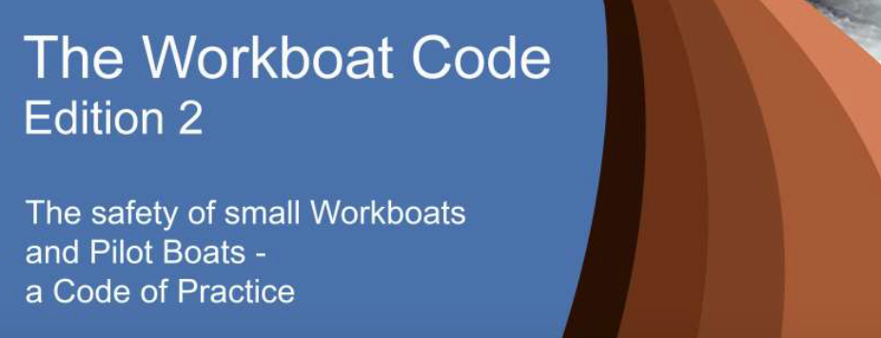
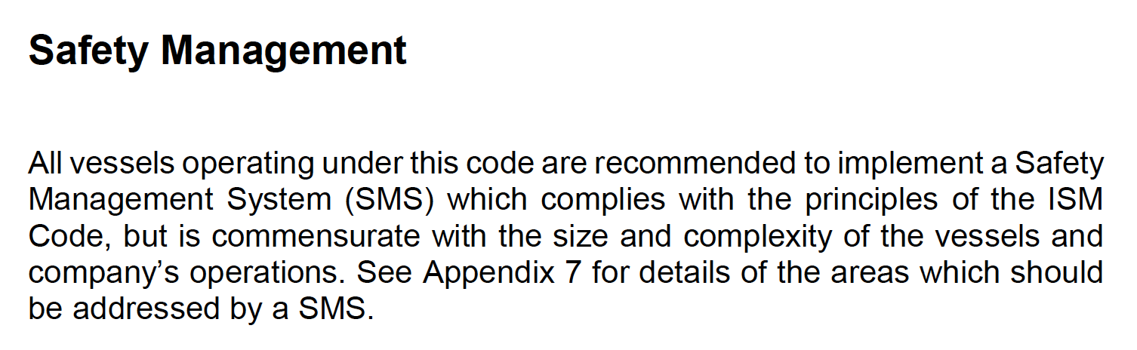

Slide 19
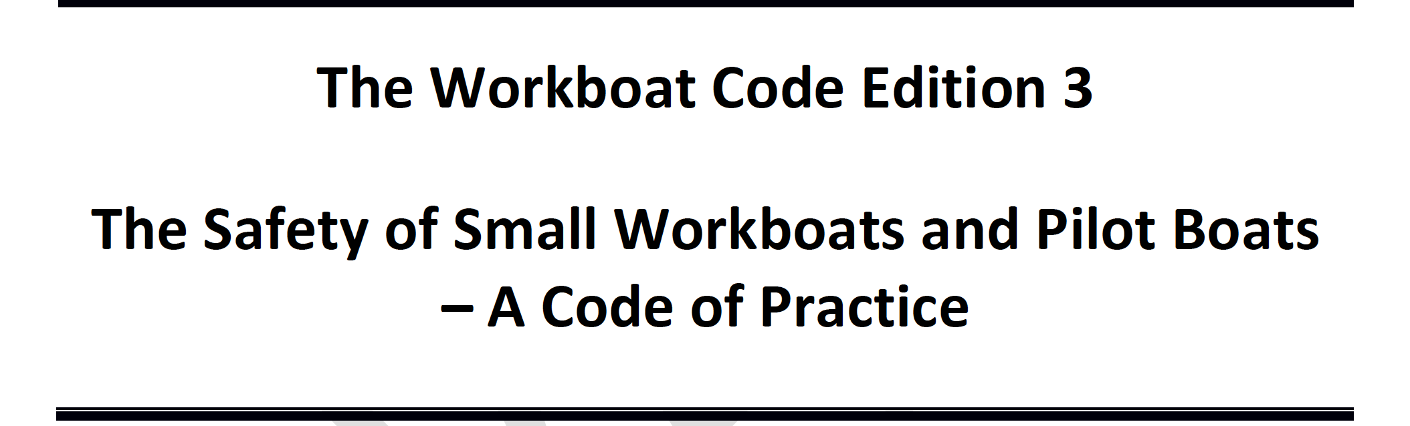
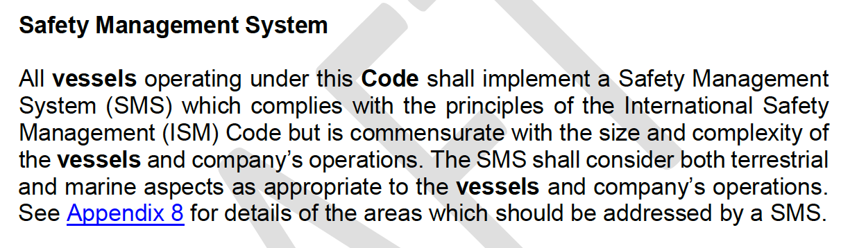

Slide 20
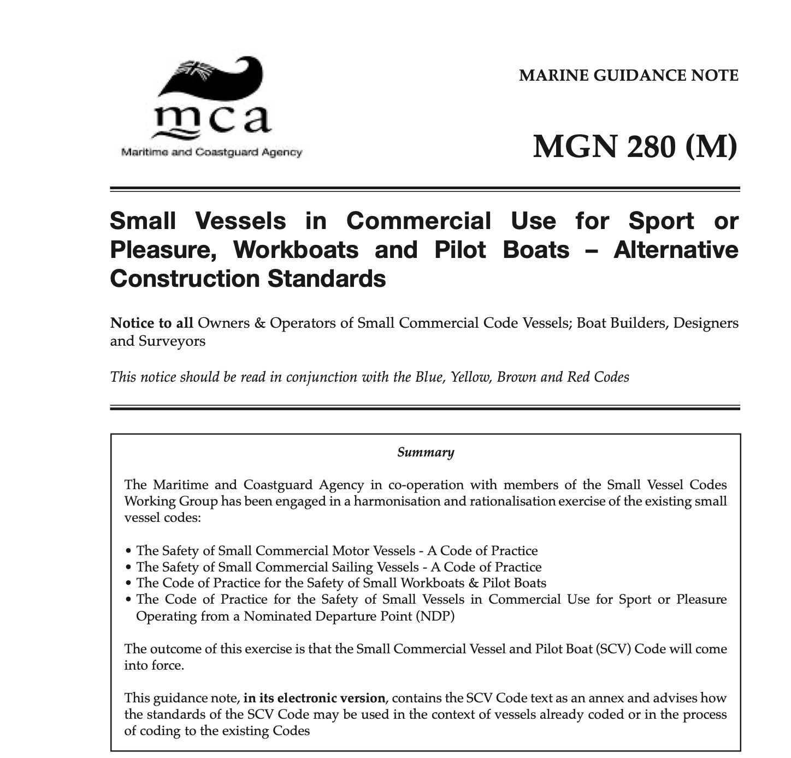
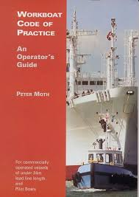
Do we already need a SMS?
ISM vs MGN 280
Notes:
Group working
Give out ISM and DSM to each and look at the similarities.
Give page and section numbers for ISM 2018 and MSN 1869

Slide 21
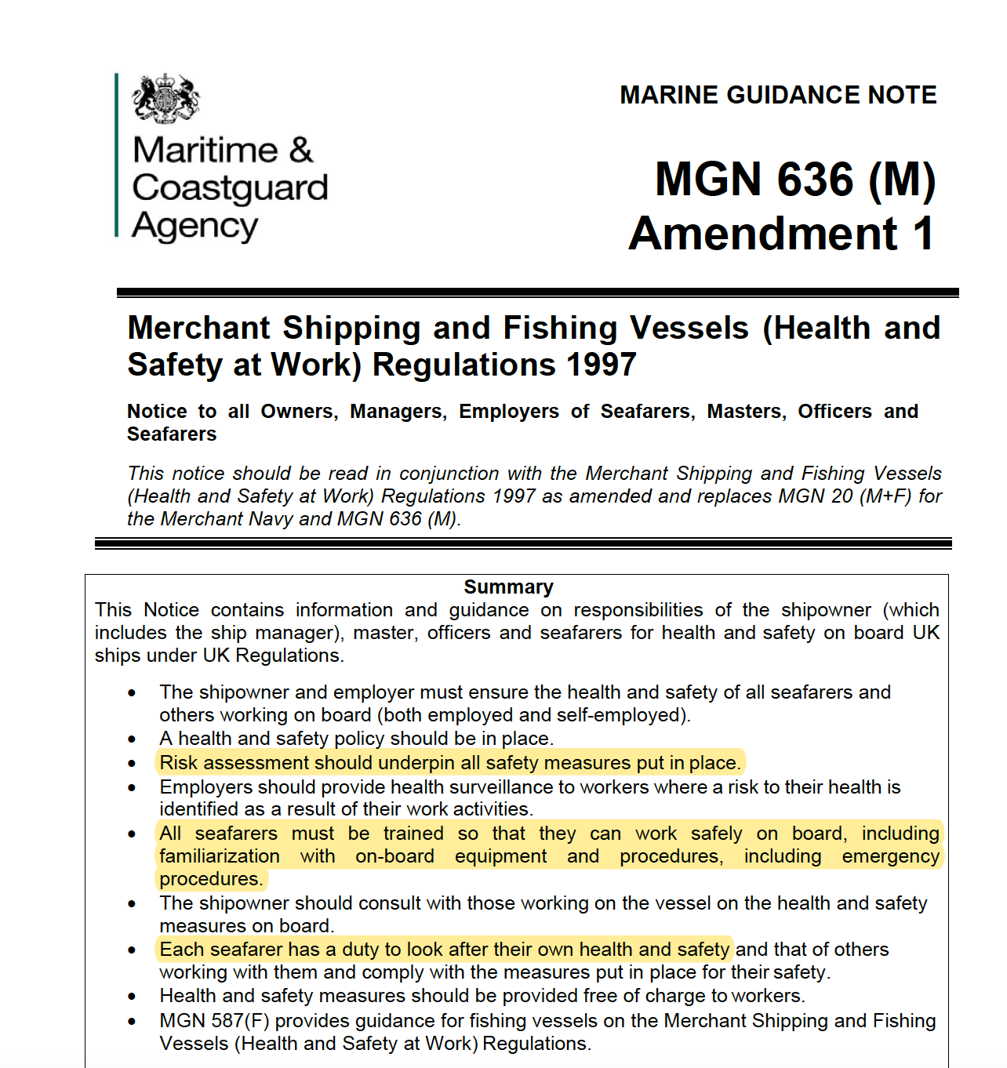
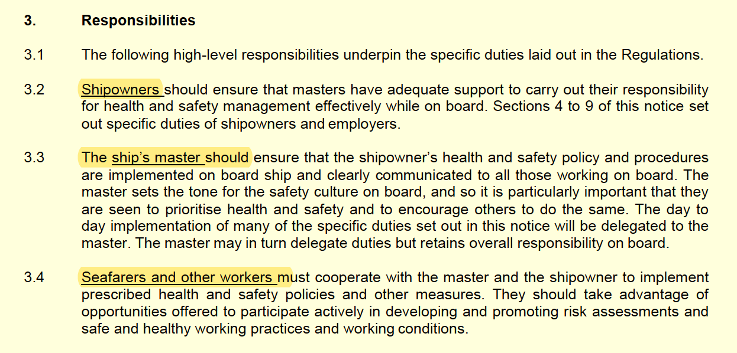

Slide 22
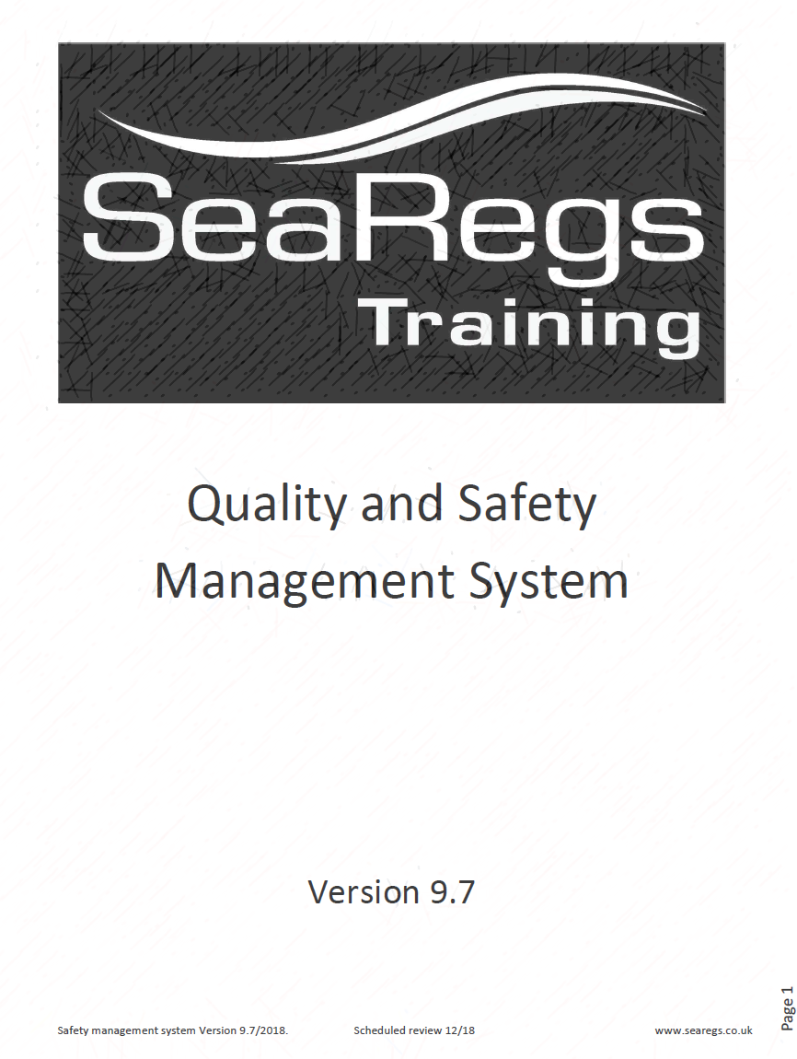
So
Check and ensure what you do is safe
Check you cover the requirements
Write it down
Do what it says
Check everyone does what it says

Slide 23
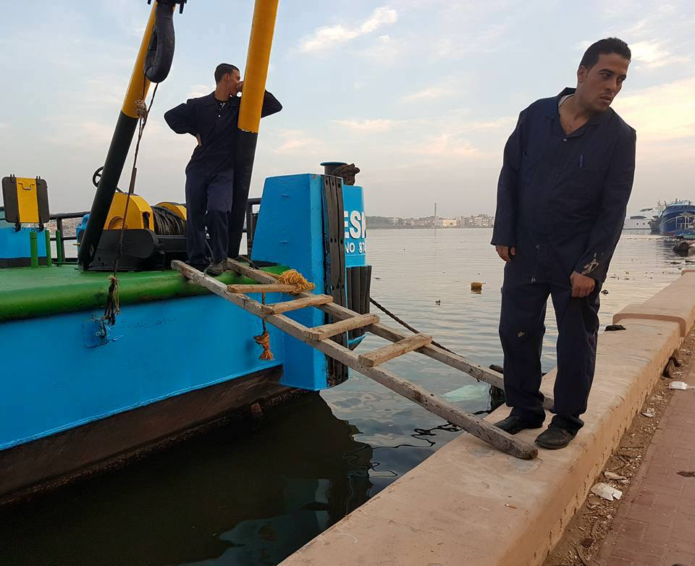
The hard bit - implementation
Safety Culture
….is the product of individual and group values, attitudes, perceptions, competencies and patterns of behaviour that determine the commitment to, and the style and proficiency of, an organisation’s health and safety management.
…..HSE…..

Slide 24
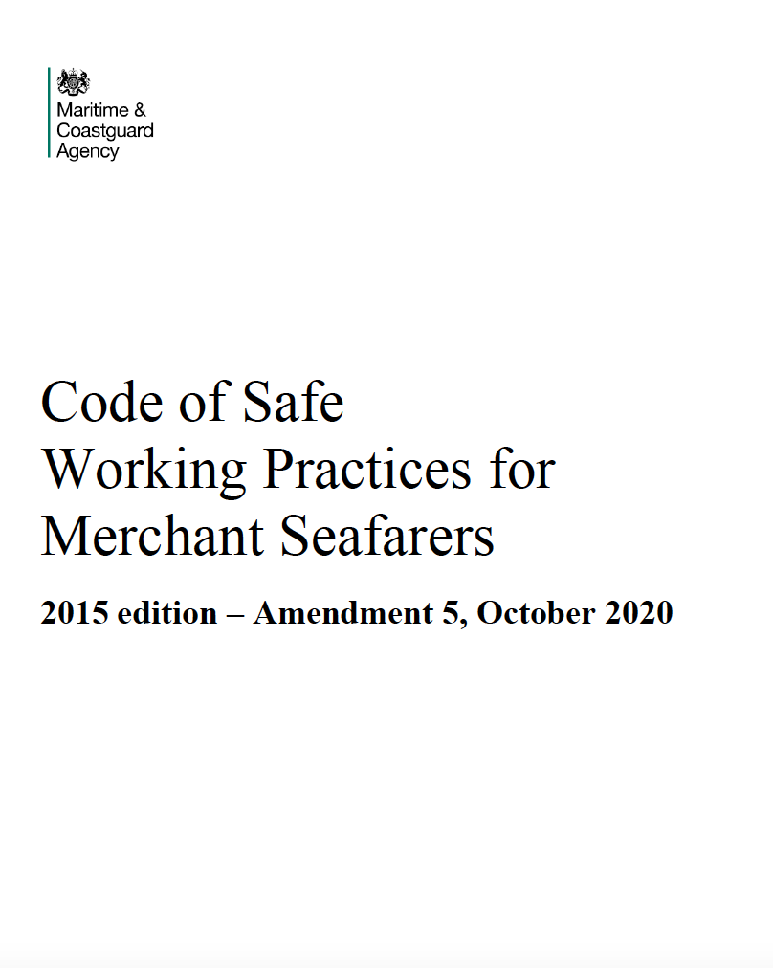
The hard bit - implementation
Inclusion
Responsibilities
Getting buy in

Slide 25
Maritime Cyber Risks in SMS
Detect
Protect
Identify
Respond
Recover
Taken from IMO - MSC-FAL.1/Circ.3
Notes:
Relatively new July 2017
Bridge systems
Cargo handling
Power control
Access control
Admin and crew welfare
Communication systems

Slide 26
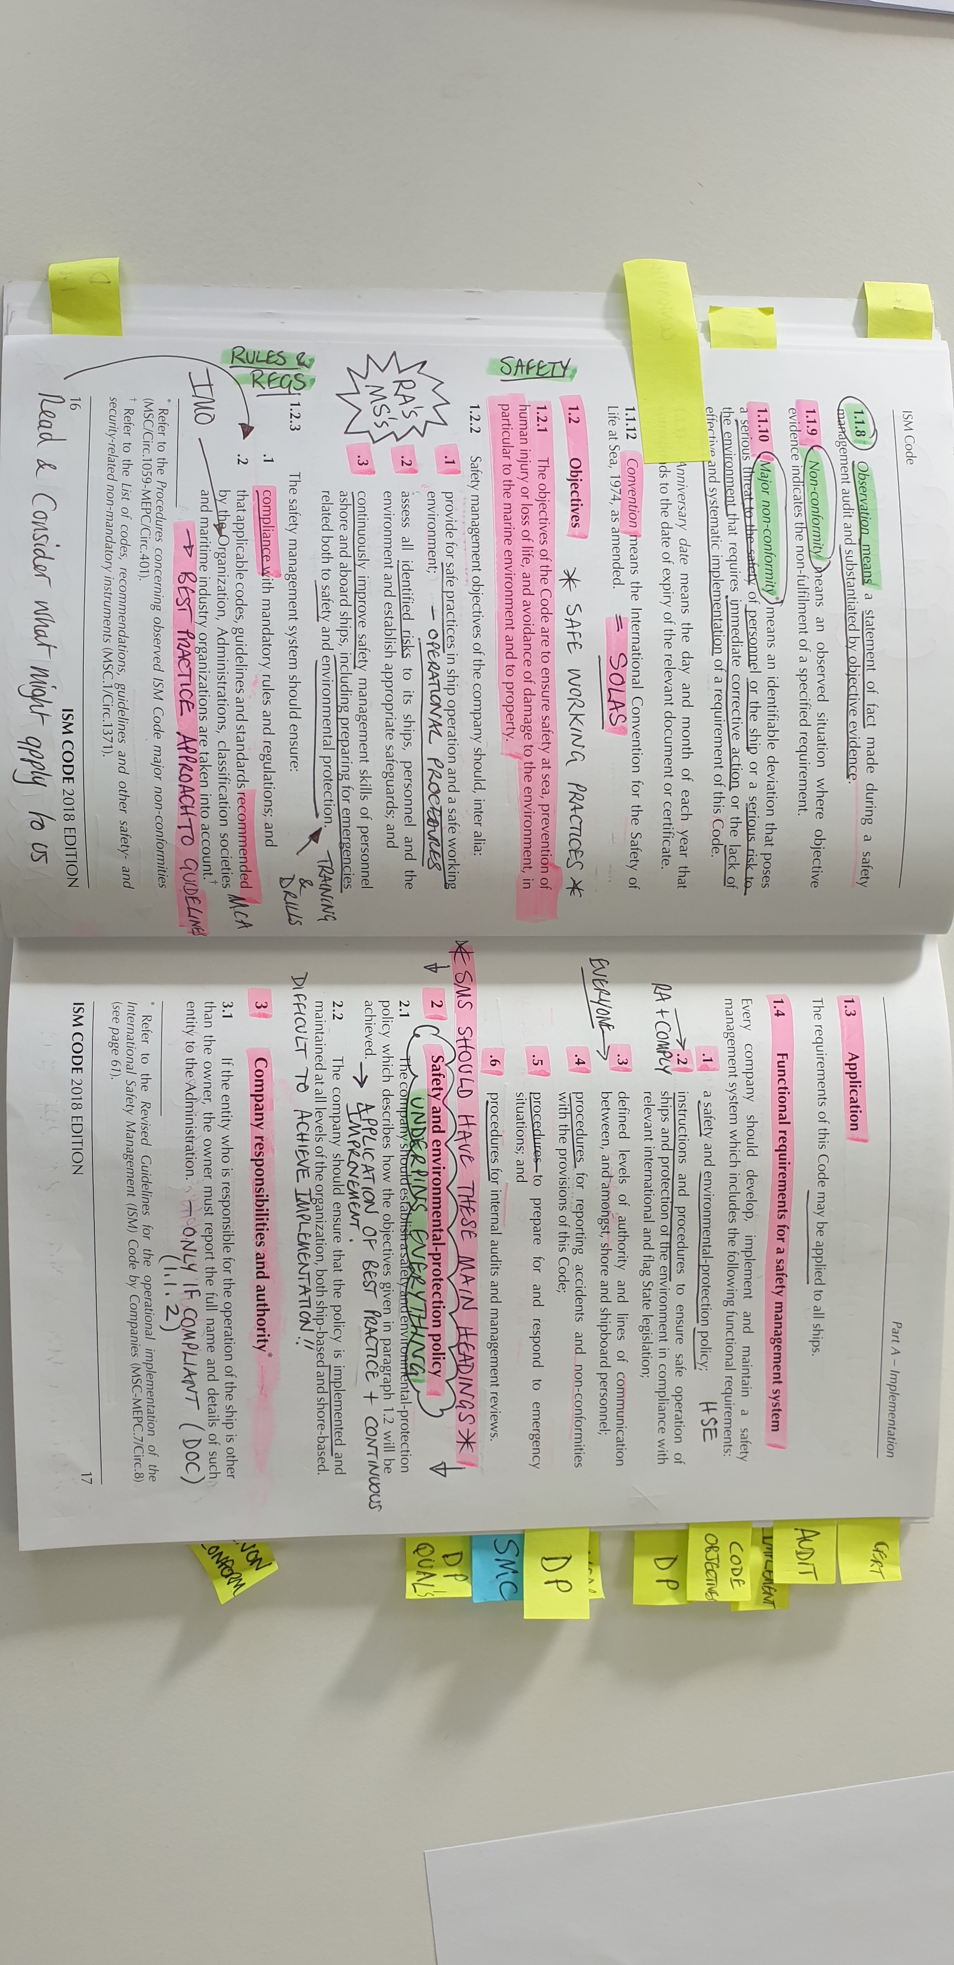
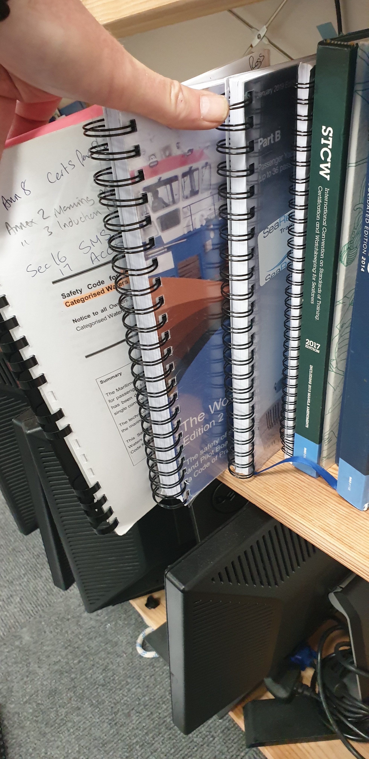
Training
Masters
DP
H&S
Int auditor
Small commercial vessel regulation

Slide 27
Thank you
Simon Jinks
SeaRegs Training
simon@searegs.co.uk

