Slide 1
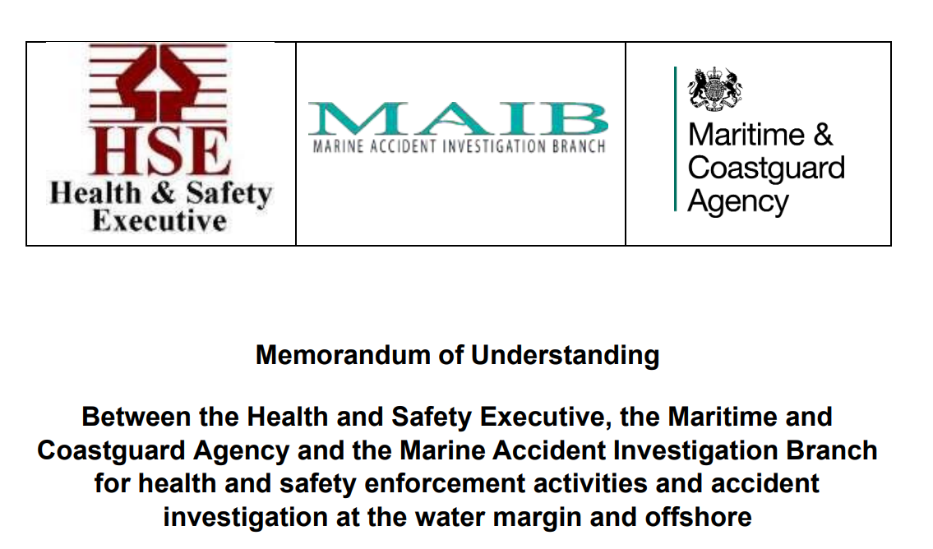
Notes:
Thank you to the workboat association for the invitation and opportunity to speak today and provide some insight into the cross over between MCA and the health and safety executive but , id quickly like to take the time to briefly discuss a third government body whos work also more often than not overlaps both HSE and MCA workstreams
MAIB co located with MCA , principle role is the investigation of incidents to UK ships globally, non UK ships within UK territorial limits , publish findings in a journal / report with recommendations , they do not apportion blame or seek to prosecute through the courts , two of the above bodies bodies are regulators ,

Slide 2
Where is the MOU held
Memorandum of understanding - HSE, MCA and MAIB for health and safety enforcement activities and accident investigation at the water margin and offshore
Operational working agreement between HSE, MCA and MAIB - GOV.UK (www.gov.uk)
Notes:
The MOU is the main agreement between the Chief Executives of the three bodies , and is a formal agreement to work together as and when required . However the fine detail of how each body will work together is held in a separate document referred to as an operational work agreement OWA

Slide 3
The MOU sets the overriding policy
The finer detail is contained within:
An OPERATIONAL WORK AGREEMENT
Operational working agreement between HSE, MCA and MAIB - GOV.UK (www.gov.uk)
Notes:
The OWA provides the finer detail on how each body will work together , and when necessary who will take the lead MORE LATER

Slide 4
What do MCA and HSE exist for ?
Historically MCA , and its historic names MSA , SGA, Ministry of transport , protected seafarers onboard ships through primary legislation THE MERCHANT SHIPPING ACT ( MSA ) and secondary legislation Sis
Health and safety executive protected workers in their workplace HEALTH AND SAFETY AT WORK ACT and Sis
Notes:
Going back to first principles
One body protects people and vessels . One protects people and places ,

Slide 5
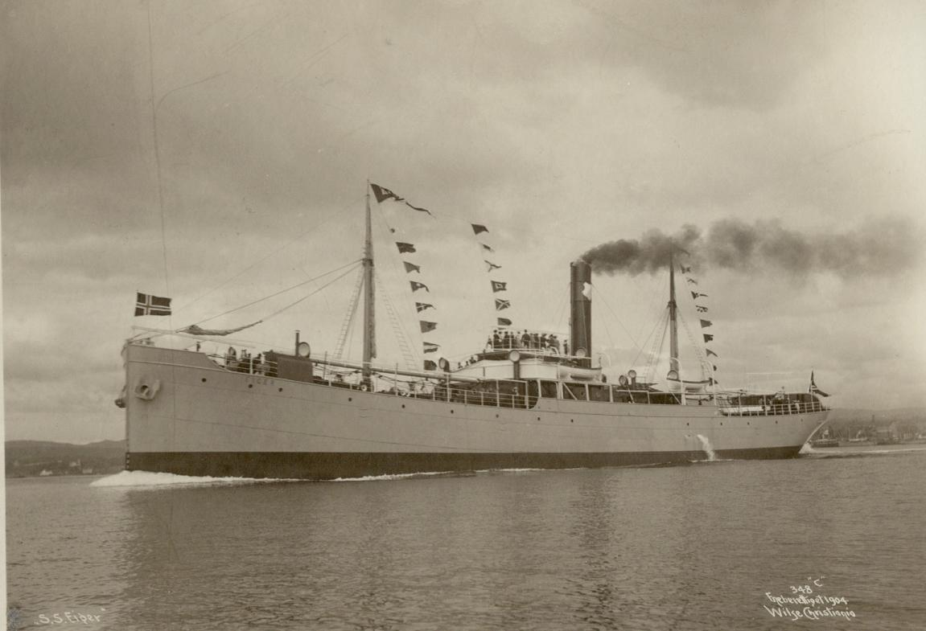
Things were easier when when ships sailed at sea :
Notes:
Secondary legislation Load line . Life saving and fire fighting , communications , training , safety management etc ,
Ship , a vessel to transport a cargo from one location to another …………… a workplace yes but also a space providing accommodation, food, power, leisure in various areas.

Slide 6
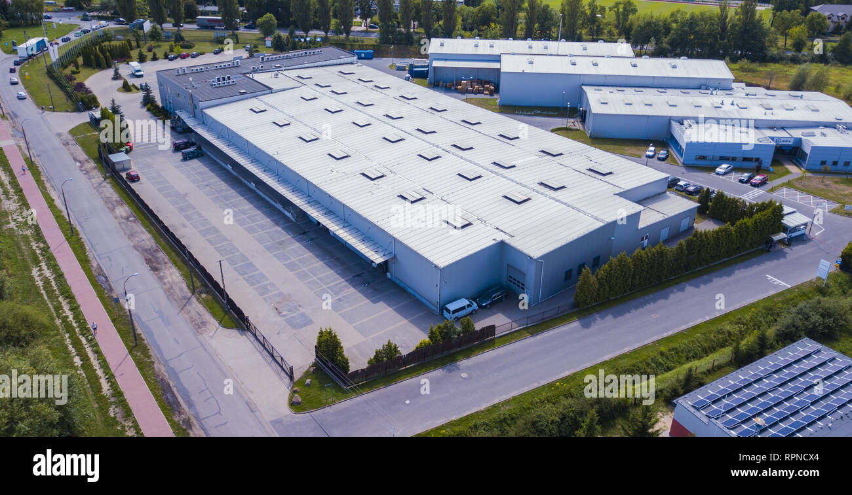
And workplaces were ashore on land :
Notes:
Health and safety at work, secondary RIDDOR , COSH , LOLER , etc etc etc

Slide 7
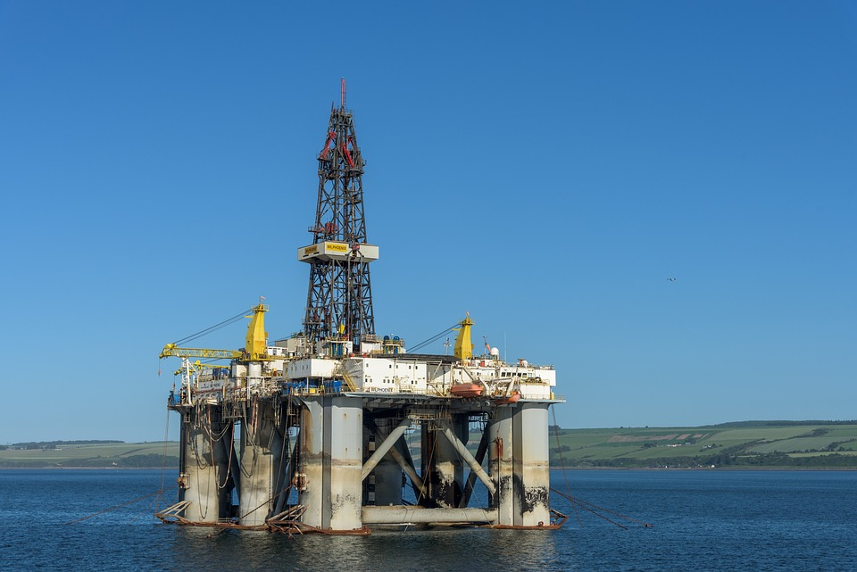
First biggest step change outside of military operations:
Notes:
Oil and gas things no longer simple, the boundary between workplace and simple transportation medium becomes confused

Slide 8
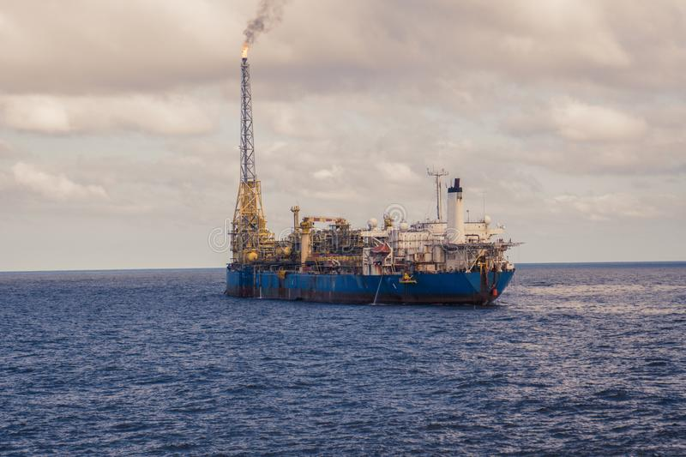
FPSOs:
Notes:
Oil and gas

Slide 9
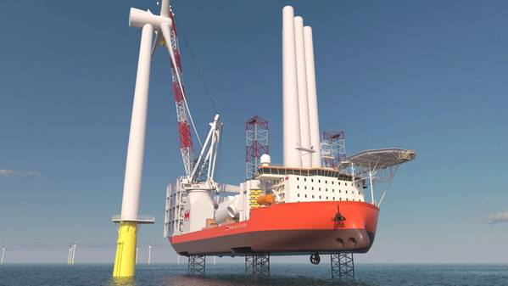
More Recently
Notes:
Offshore renewable / clean energy sources

Slide 10
The Operational Work Agreement
A fifteen page document outlining in general which government body can be recognised as the regulatory lead?
Example
Notes:
OPEN OWA Flowchart

Slide 11
Main Areas covered by the OWA
Ensure effective Collaborative work
Minimise Overlap
Provide a common understanding of each others roles
Share Knowledge
Agree consistent standards
Notes:
When is the OWA used for guidance and referral , to be honest this is more often than not as a result of an incident / accident onboard vessel UK or not . Within UK waters or to a seafarer or other person supernumerary onboard a vessel or work platform various BUZZ WORDS

Slide 12
Calculating the Regulatory Lead
The Main purpose of the OWA
Notes:
When is the OWA used for guidance and referral , to be honest this is more often than not as a result of an incident / accident onboard vessel UK or not . Within UK waters or to a seafarer or other person supernumerary onboard a vessel or work platform various BUZZ WORDS

Slide 13
Is it all about bad news?
One of the main aspects of the MOU is: avoiding so far as is possible conflicting requirements being put on dock operators, ships' masters, offshore duty-holders, other employers or people in control of or at work, thus minimising the burden on industry, particularly where there is overlapping legislation;

Slide 14
Recent Examples
Electro Razor Fish Trials ( manning )
Cruise ships / floating accommodation modules trained personal alarm locations etc
Temporary Living Quarters TLQs offshore SFP requirements and alarms

Slide 15
Summary
MCA and HSE are responsible for Health and safety offshore , in the littoral area , foreshore and onshore
We work together frequently taking guidance from the OWA
The OWA continues to evolve in line with marinized work practices
Notes:
Inland waters , passenger vessels , workboats in land etc

Slide 16
Questions ?
Thank you
Notes:
Inland waters , passenger vessels , workboats in land etc

Slide 17
Examples of

