Slide 1


Slide 2
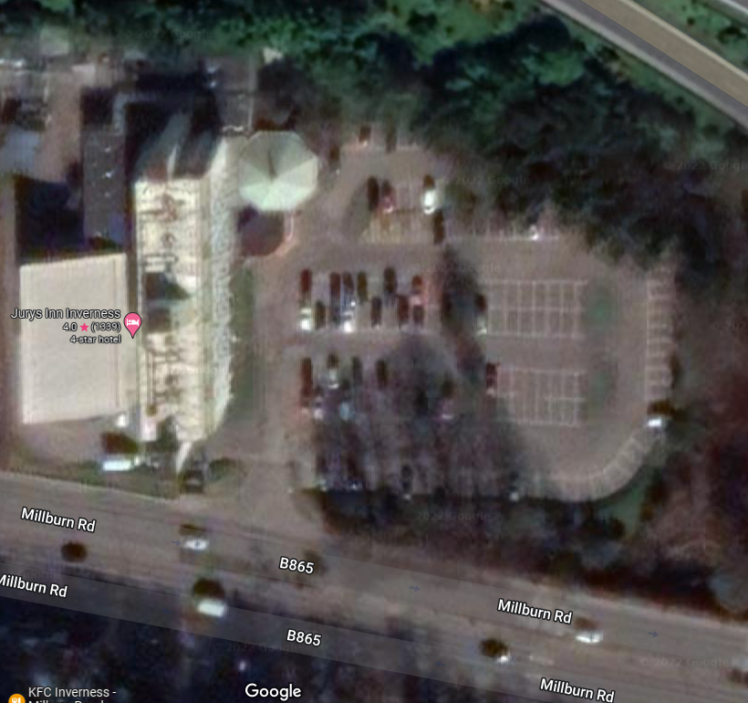
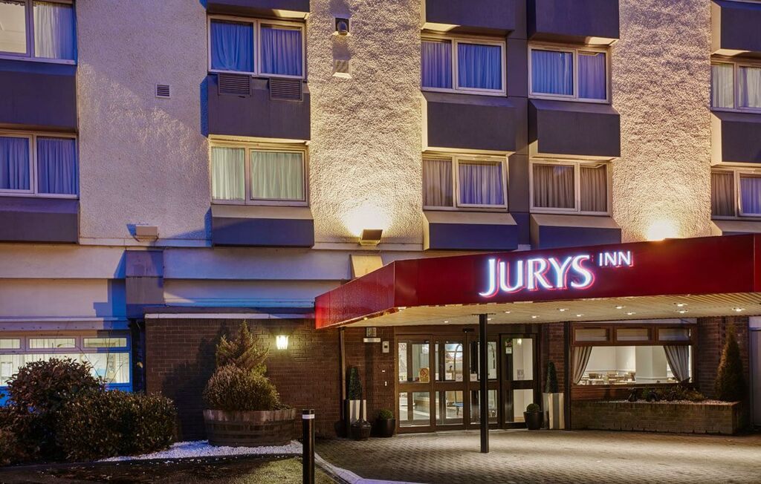
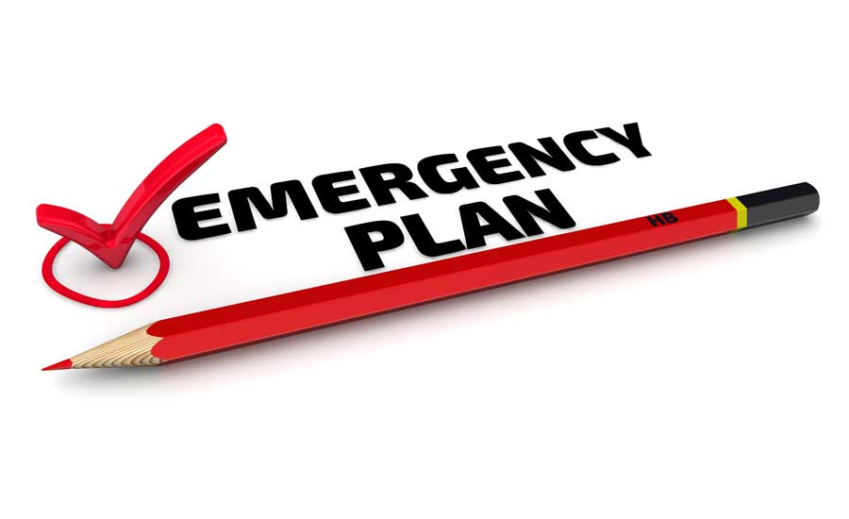
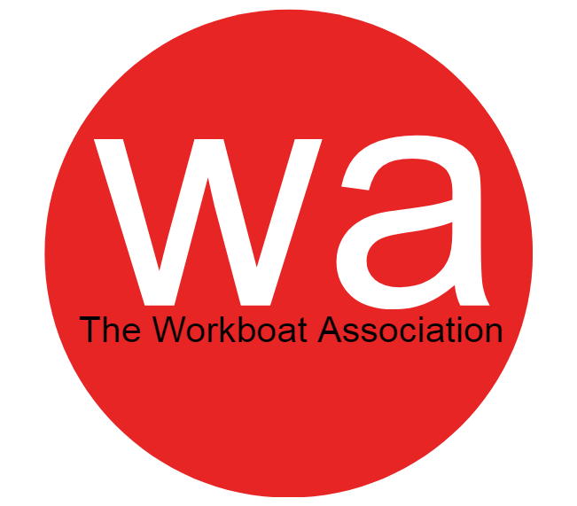
www.workboatassociation.org/aquatoolkit

Slide 3
www.workboatassociation.org/aquatoolkit
Introduction

Slide 4
www.workboatassociation.org/aquatoolkit
www.workboatassociation.org/aquatoolkit

Slide 5
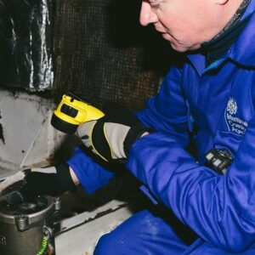
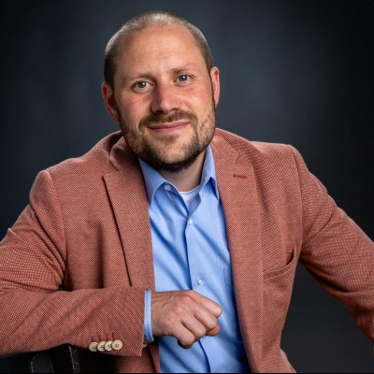
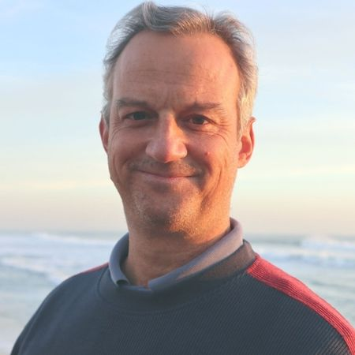
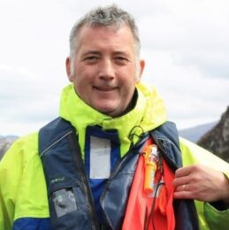
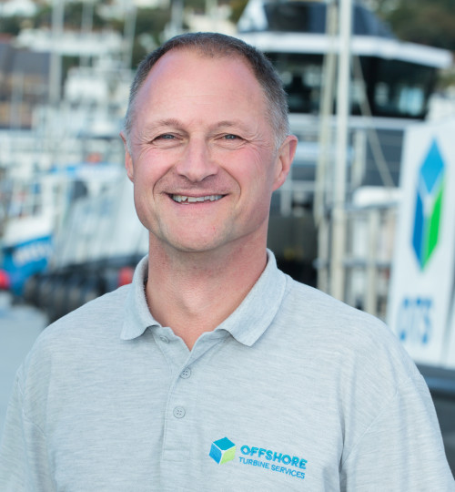
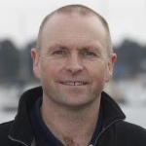
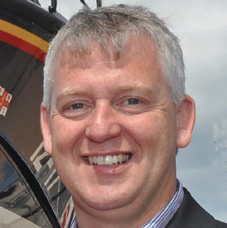
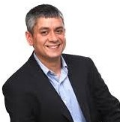
www.workboatassociation.org/aquatoolkit
Bill Forsyth
Marine Surveyor
Maritime and
Coastguard Agency
Kerrie Forster
CEO
The Workboat
Association
Pedro Ferreira
Chief Scientist
Novellus Solutions
David McKeown
Vice Chairman
Aquaculture Safety
Group
Mike Proudlove
Deputy Vice President
International Institute
of Marine Surveying
Simon Jinks
Founder
SeaRegs Training
Derek Cardno
Marine Safety and
Training Officer
Scottish Fisherman’s
Federation
Nippin Anand
Founder
Novellus Solutions

Slide 6
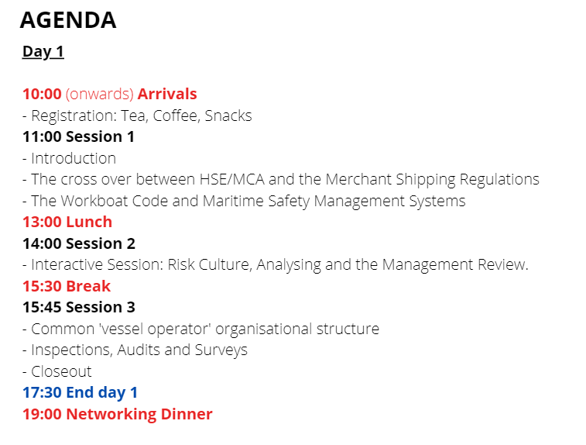
www.workboatassociation.org/aquatoolkit

Slide 7
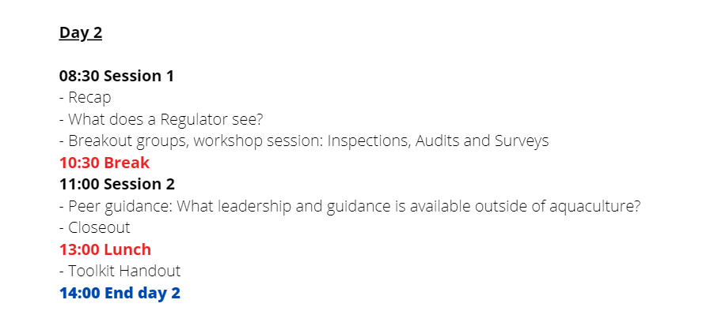
www.workboatassociation.org/aquatoolkit

Slide 8
www.workboatassociation.org/aquatoolkit
Warm up;
- Stand up
- Find somebody you have never met before

Slide 9
www.workboatassociation.org/aquatoolkit
Two Truths and a Lie…

Slide 10
www.workboatassociation.org/aquatoolkit
What is the most dangerous thing you have seen at work?
Explain something that you do at work that you (or your team) are the best at

Slide 11
www.workboatassociation.org/aquatoolkit

Slide 12
www.workboatassociation.org/aquatoolkit

Slide 14
www.workboatassociation.org/aquatoolkit

Slide 15
www.workboatassociation.org/aquatoolkit
Warm up;
Turn to your neighbour

Slide 16
www.workboatassociation.org/aquatoolkit
Most memorable time at work
where you made a mistake

Slide 17
www.workboatassociation.org/aquatoolkit
Group activities

Slide 18
www.workboatassociation.org/aquatoolkit
Task 1;
Hierarchy of Control
Task 2;
Inspection

Slide 19
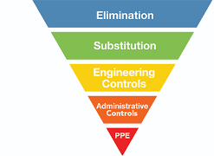
www.workboatassociation.org/aquatoolkit
Hierarchy of Control
The hierarchy of control is a system for controlling risks in the workplace.
It is a step-by-step approach to reducing risk, ranking controls from the highest level of protection and reliability through to the lowest and least reliable.

Slide 20
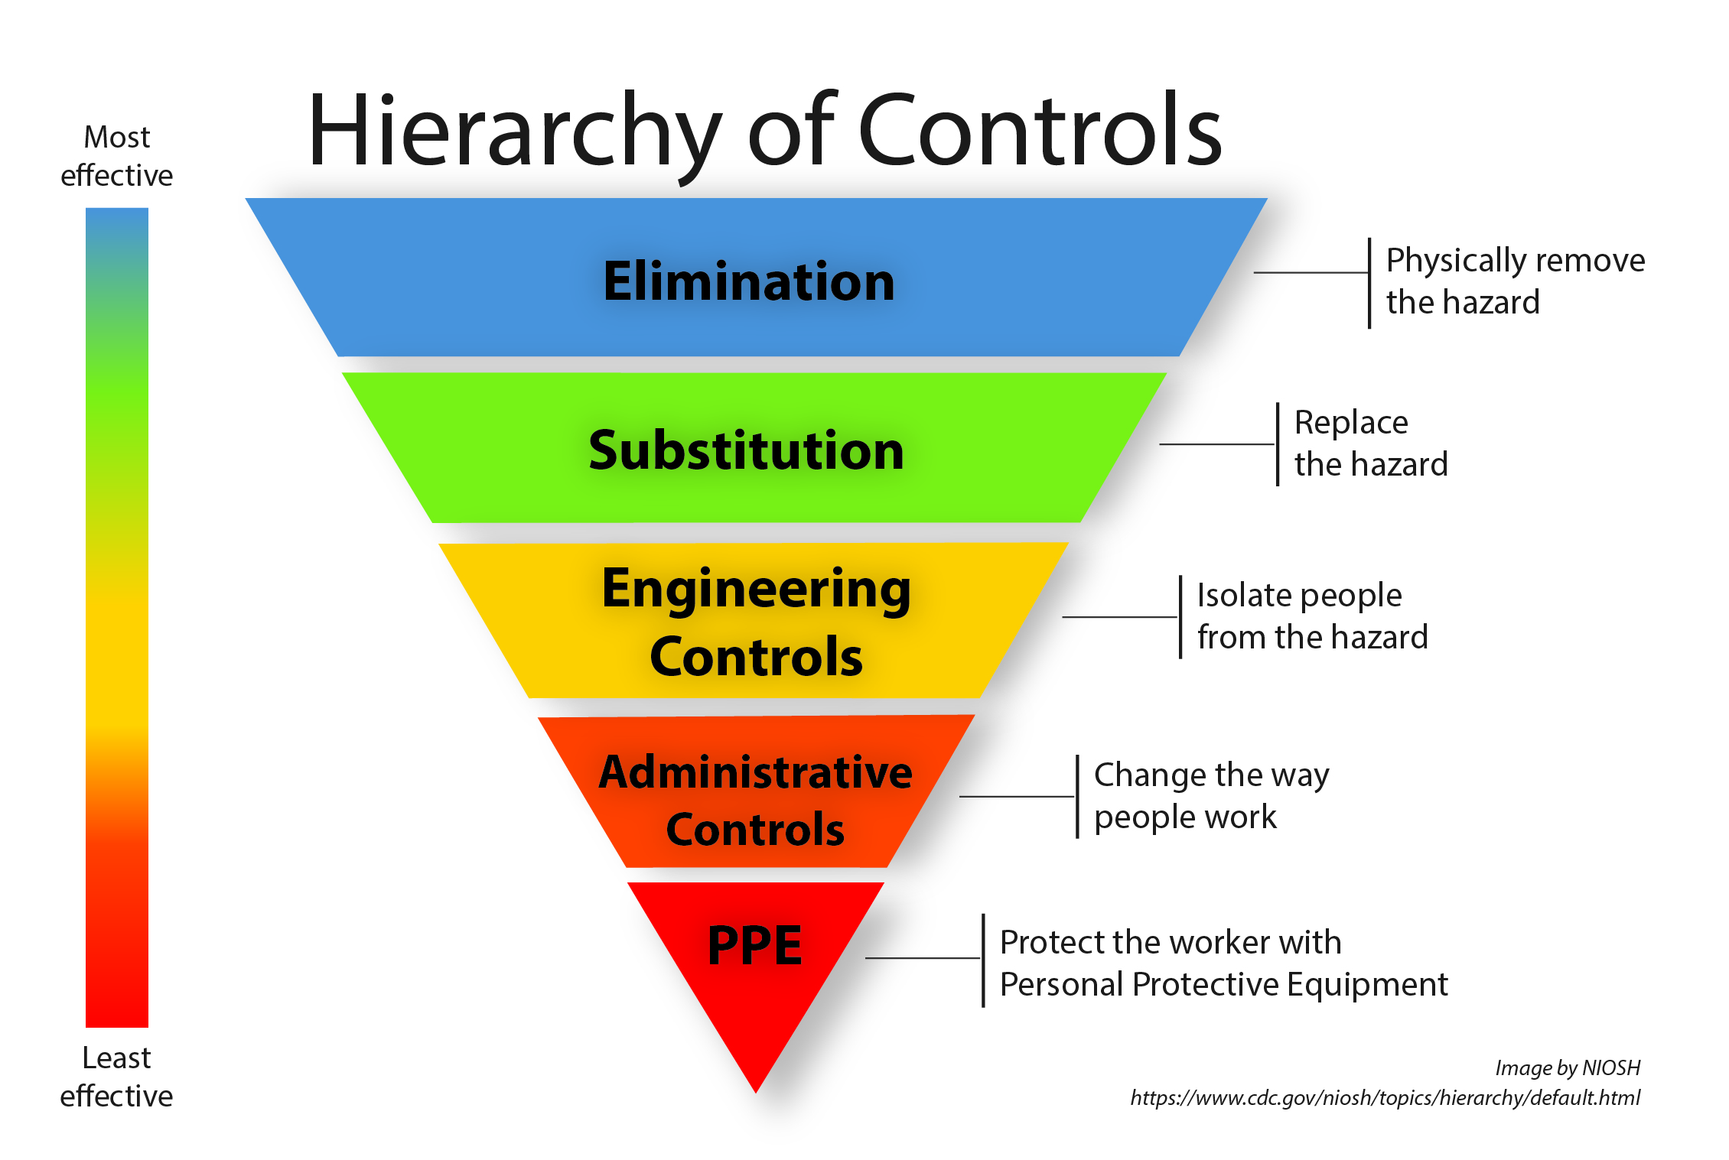
www.workboatassociation.org/aquatoolkit

Slide 21
www.workboatassociation.org/aquatoolkit
Activity
Based on 2 x Scenarios, create as many controls under the Hierarchy of control headings as you can (as a team) to make the scenario safer
Stick you post-its on the wall in the relevant groups

Slide 22

www.workboatassociation.org/aquatoolkit
PPE
Wear a hardhat

Slide 23
www.workboatassociation.org/aquatoolkit
Elimination
Do not enter the room unless you have to

Slide 24
www.workboatassociation.org/aquatoolkit
What are the 2 x Scenarios?

Slide 25
www.workboatassociation.org/aquatoolkit
Inspections

Slide 26
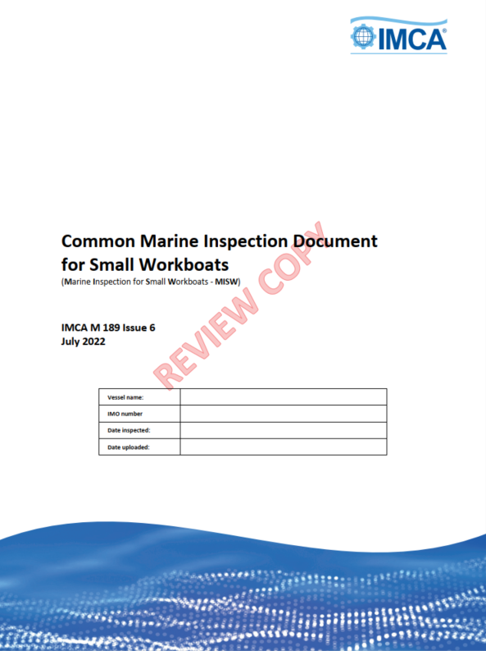
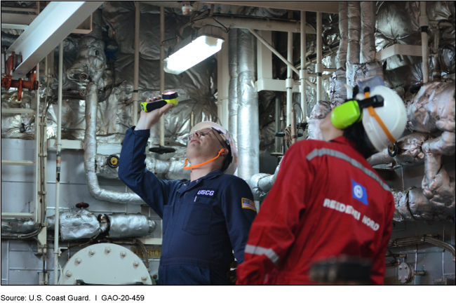
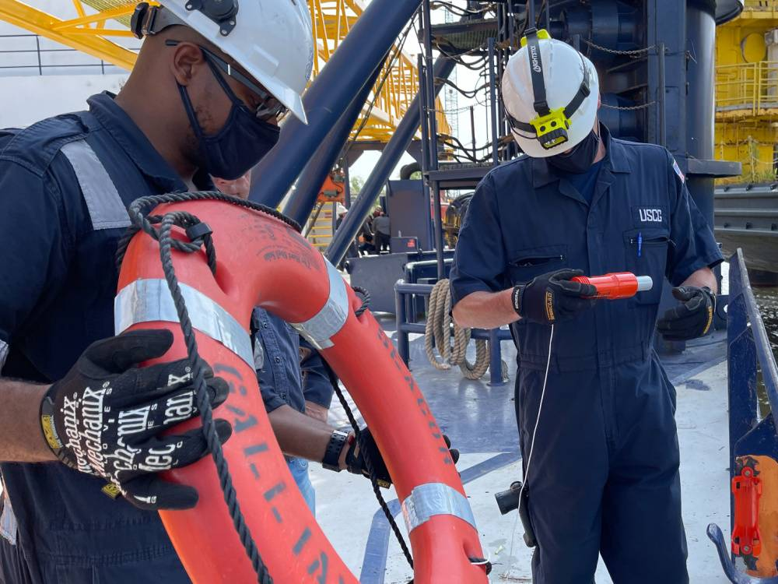
www.workboatassociation.org/aquatoolkit

Slide 27
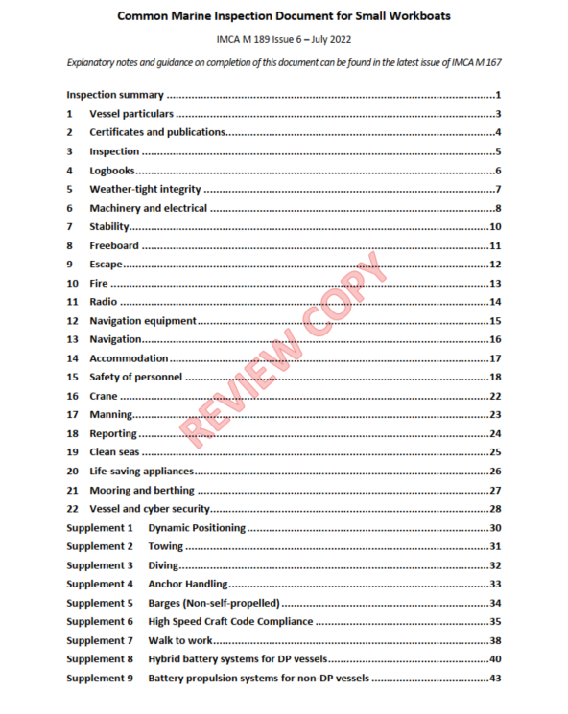
www.workboatassociation.org/aquatoolkit

Slide 28
www.workboatassociation.org/aquatoolkit
Activity
Based on your list of chapters, select the 5 most important inspection questions and the 3 least important.
Nominate a speaker for each group who will introduce your chapters and discuss your choices with the room

Slide 29
www.workboatassociation.org/aquatoolkit
Group 1: Sections 2,3,4,5,17
Group 2 Sections 6,7,8,18
Group 3 Sections 9,10,11,16
Group 4 Sections 12,13,14,20
Group 5 Sections 15,19,21
Choose the 5 most important inspection questions from your list
Choose the 3 least important inspection questions from your list

Slide 30
www.workboatassociation.org/aquatoolkit

