Slide 1


Slide 2
DEREK CARDNO MNM AFNI
MARINE SAFETY AND TRAINING OFFICER
+
FISHERMAN

Slide 4
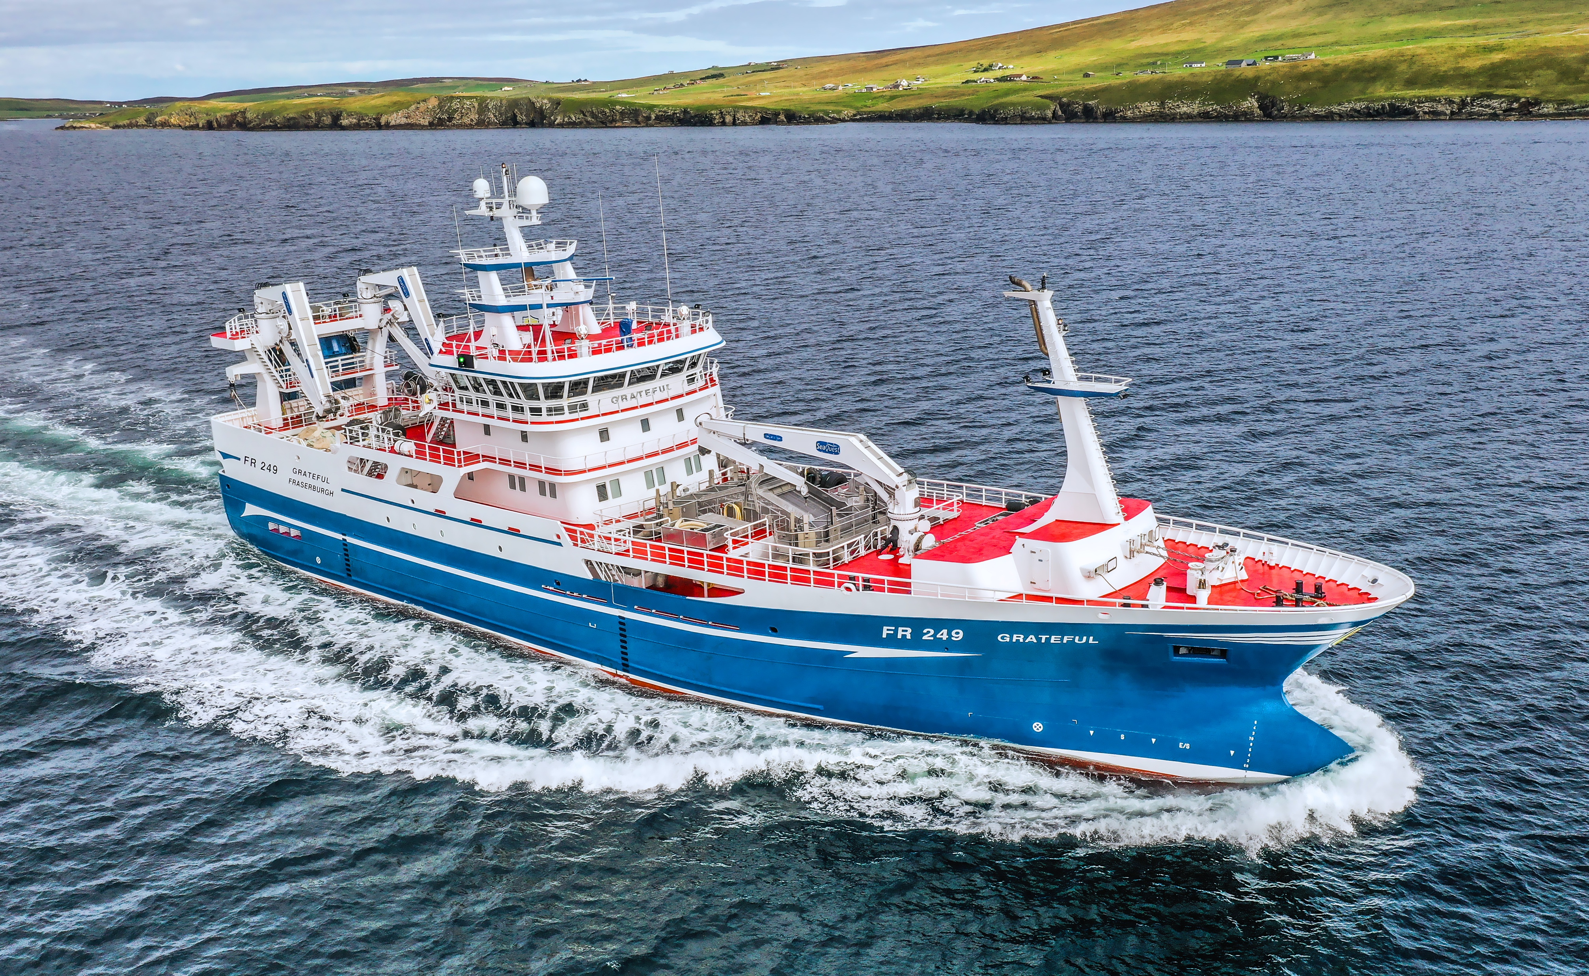

Slide 6
Support Projects
1. Onboard Support Scheme
2. PFD Project
3. International Labour Organisation (ILO) C 188
4. Survey and Inspection
5. Training and Certification

Slide 7
Onboard Support Scheme
1. Vessel Visit
2. Crew engagement
3. Follow up support
4. Network to disseminate new information
5. Safety Champions

Slide 8
PFD Project
1. A PFD to every fisherman in Scotland
2. Every handover was facilitated with a short instruction
3. The project shaped future policy
4. Instigated a culture change
5. Is it all about safety kit??

Slide 9
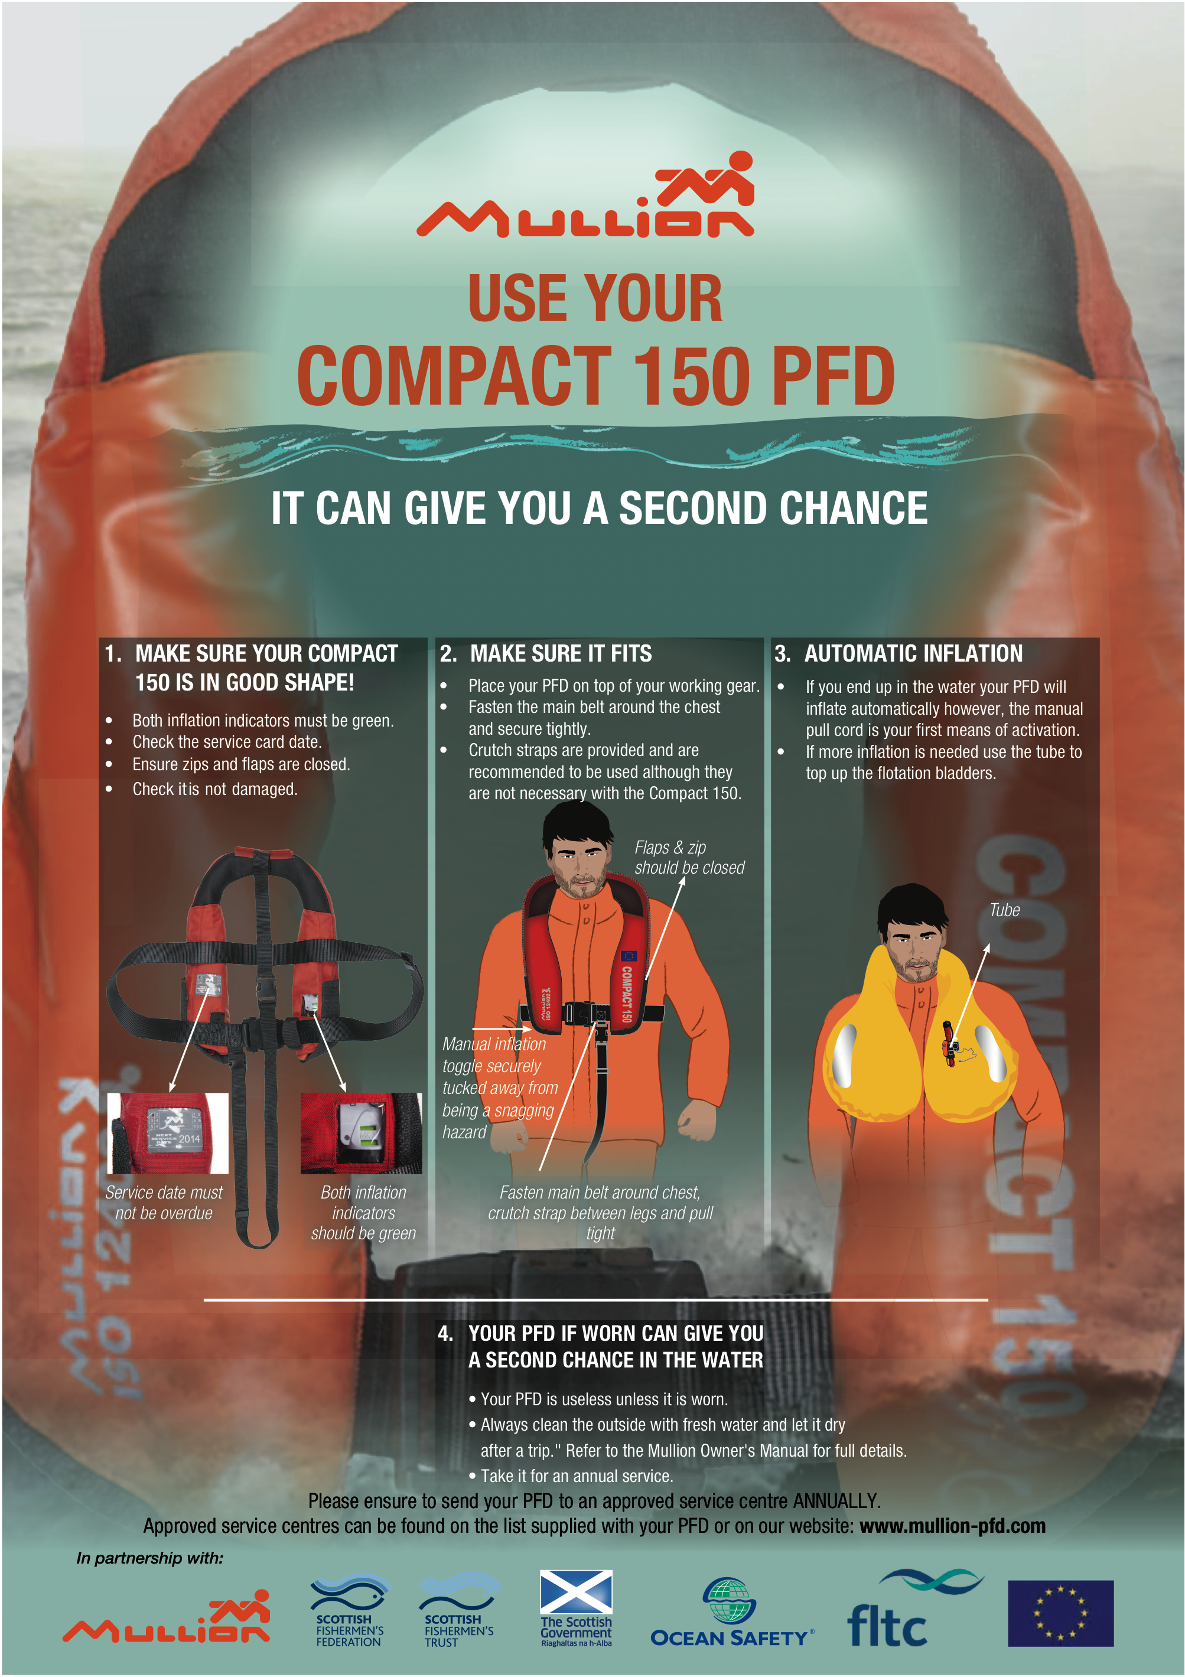


Slide 10
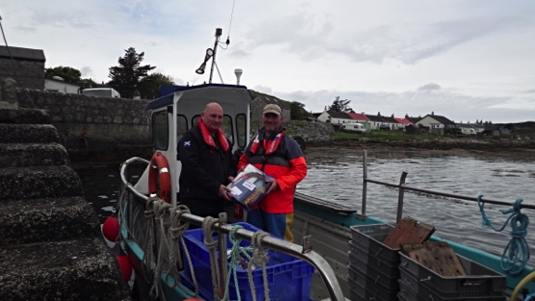
Dougie Brown lived to tell the tale
“I am certain that without that buoyancy I wouldn’t have had the presence of mind to look around and grab the buoy rope as my attention would otherwise have been engaged in frantically trying to remain afloat and losing vital body heat and energy in the process,” said Dougie.

Slide 11
ILO C 188
1. Biggest change in Fishing Health and safety for decades
2. Industry needed lots of support and guidance to be compliant
3. Still a work in progress with medical coming in for the remaining fishermen in the UK November 2023

Slide 12
Survey and Inspection
1. MCA carried out a Concentrated Inspection Campaign during 2021 and the beginning of 2022
2. Service and Consistence
3. Important to work with the regulator and have constant dialogue

Slide 13
Training and Certification
1. Training Fund
2. New Entrant Training
3. New Training Regulations

Slide 14
Meeting members Face to Face
This last 12 months
Regular contact with members based in the NE
Shetland
Orkney
Eyemouth
Malliag

Slide 15
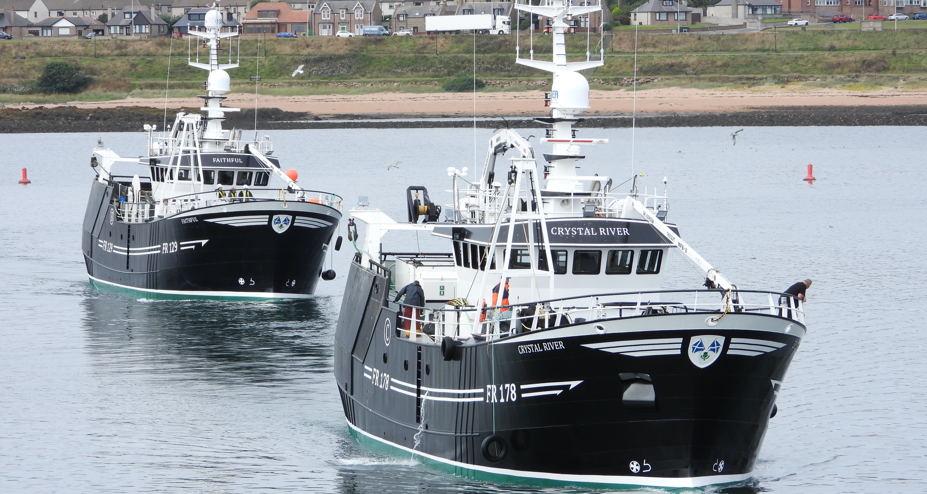
Future for Fishing safety

Slide 16
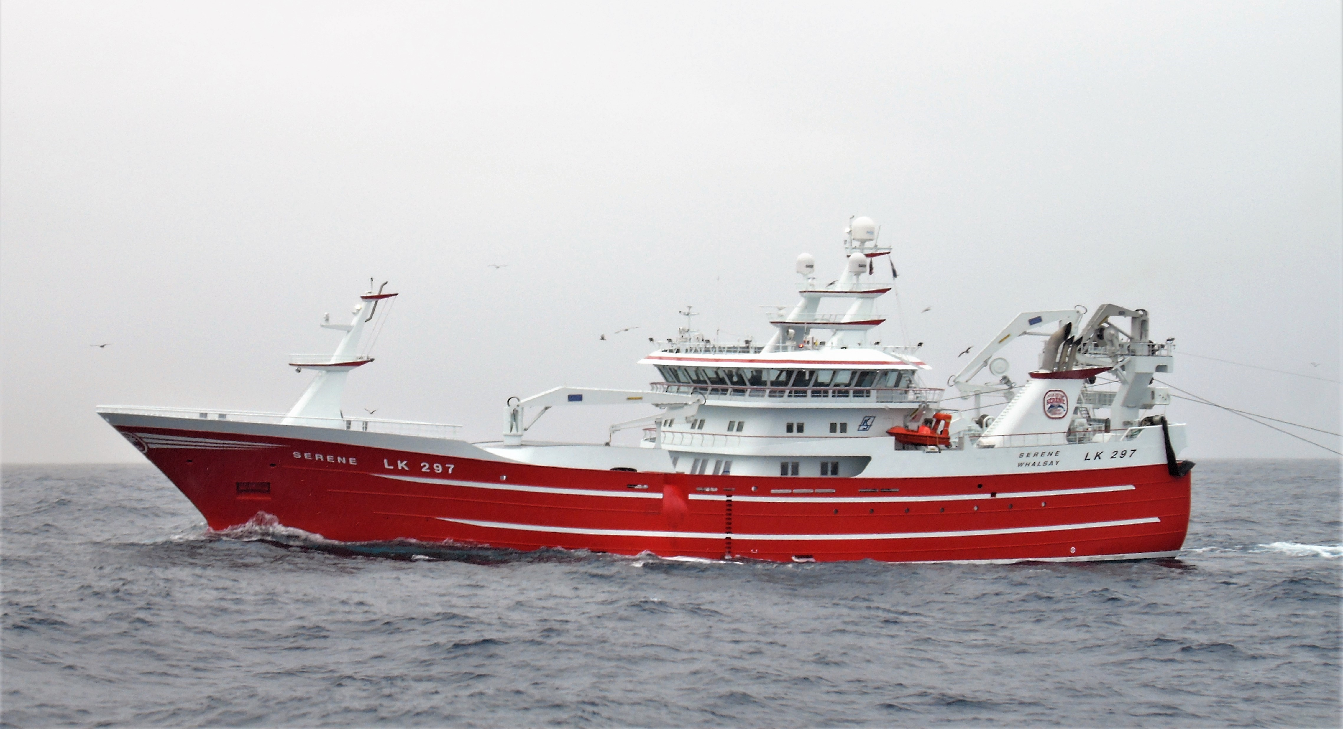

Slide 17
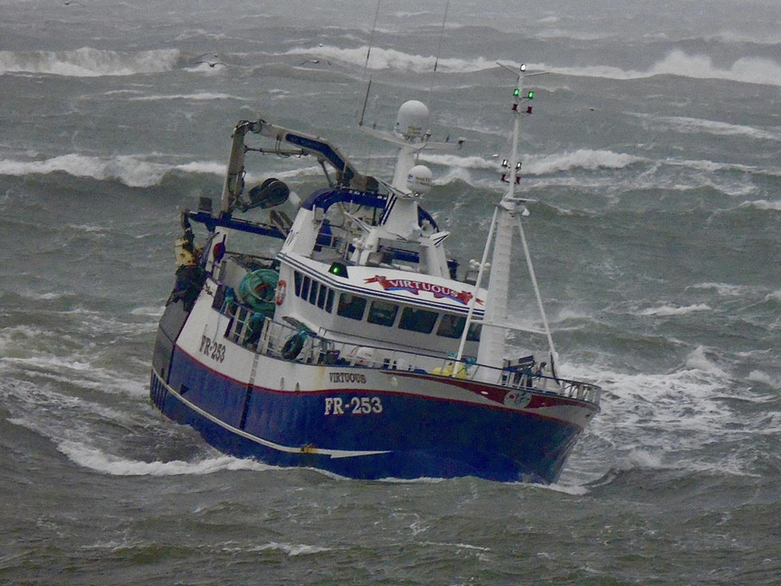

Slide 18
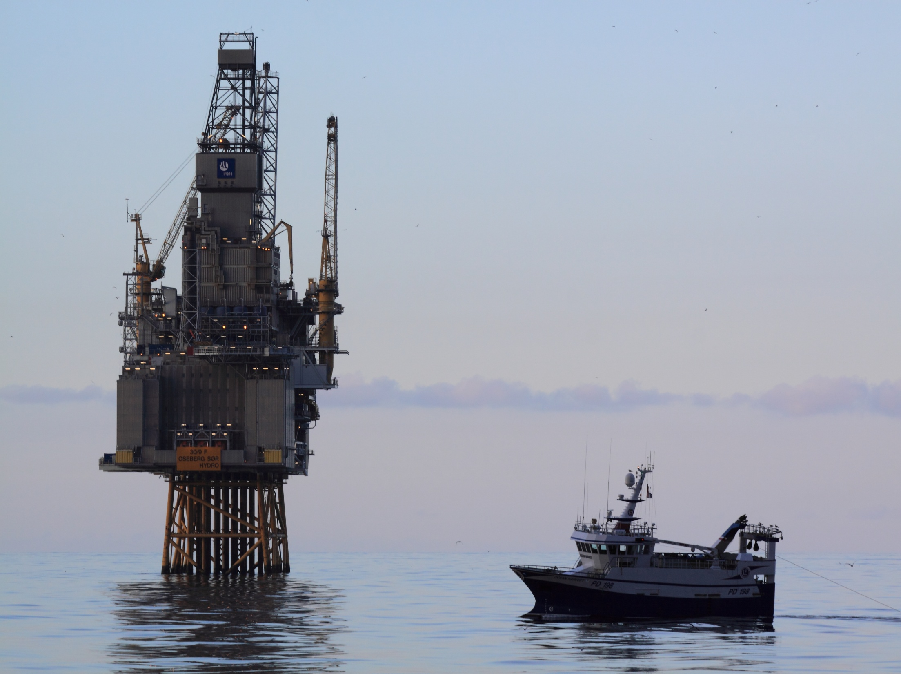

Slide 19
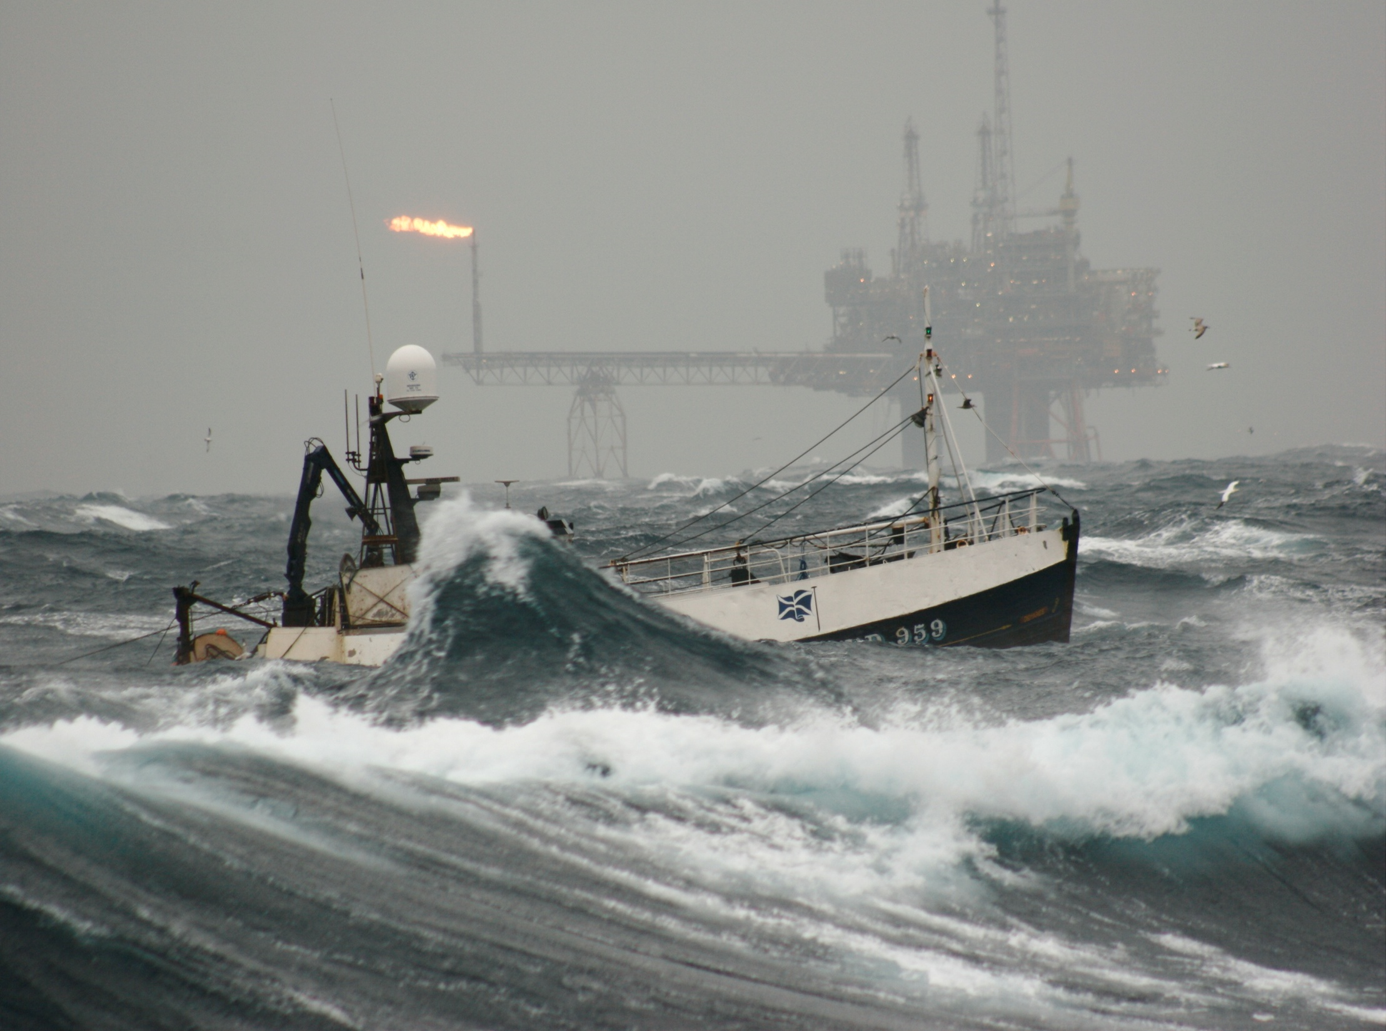


Slide 20
MOB Awareness Events
Started rolling out the events in November 2019
31 Events to date
335 fishermen given the experience

Slide 21
Thank You
Questions?

