Slide 1
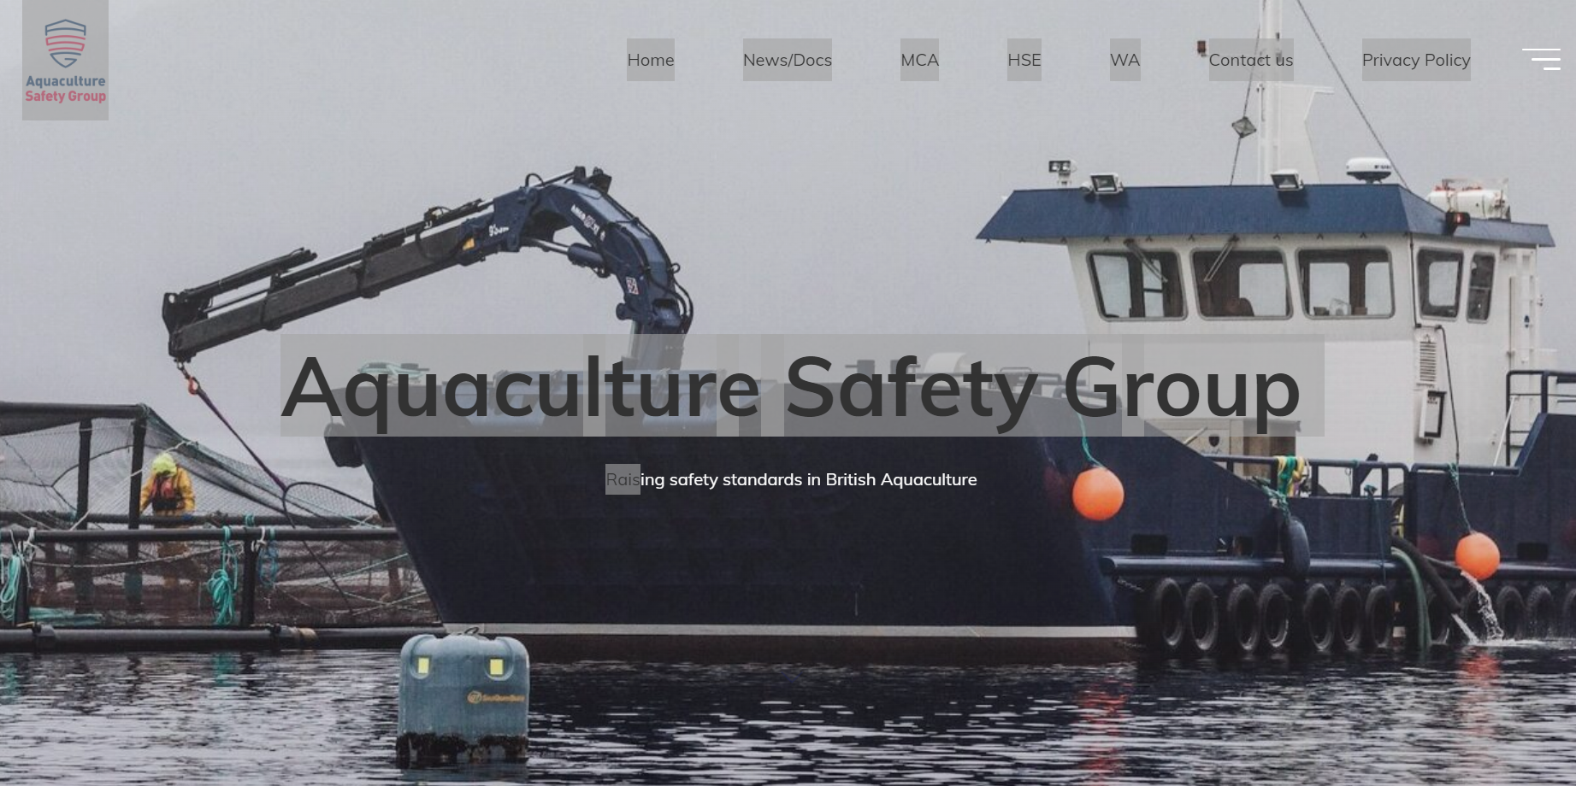
Aquaculture Safety Group

Slide 2
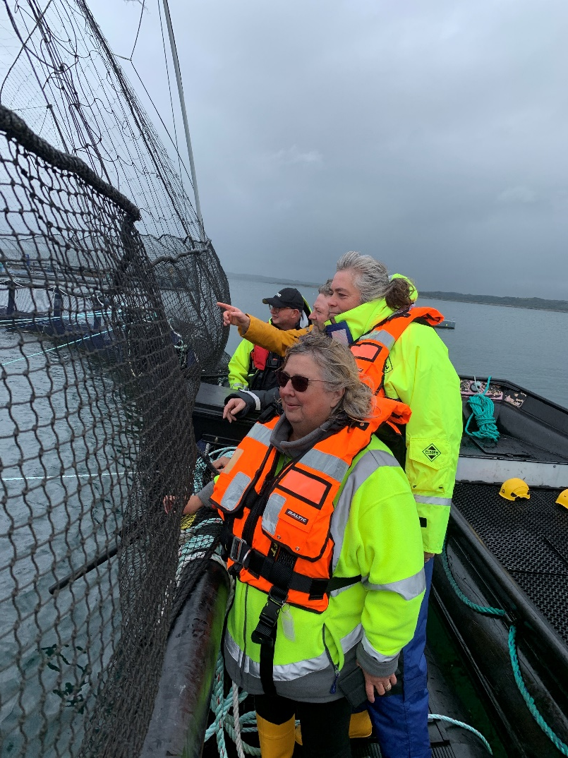
Aquaculture Safety Focus 2022
National Sector lead: Kathy Gostick

Slide 3
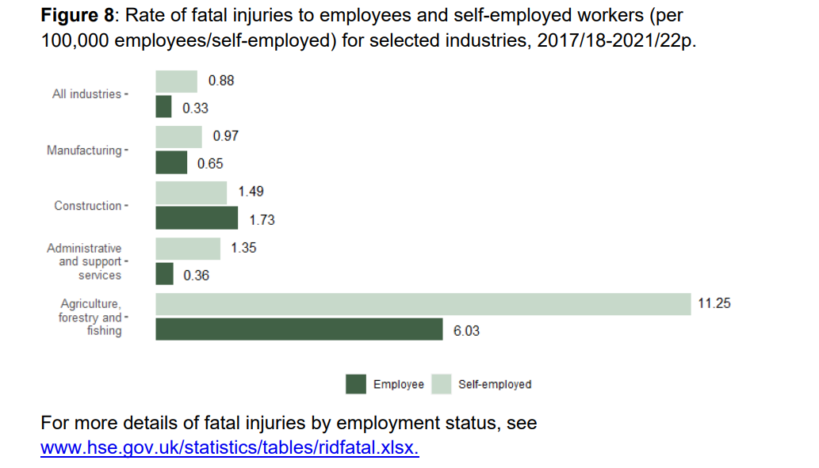
Aquaculture: A Risky Business
One of the highest fatal injury rates (over 6x that of construction)

Slide 4
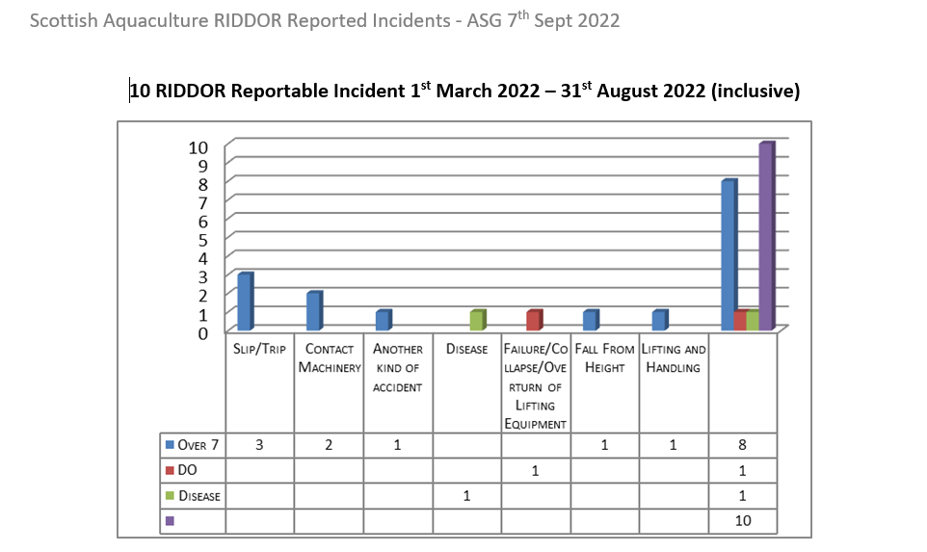
Aquaculture: A Risky Business

Slide 5
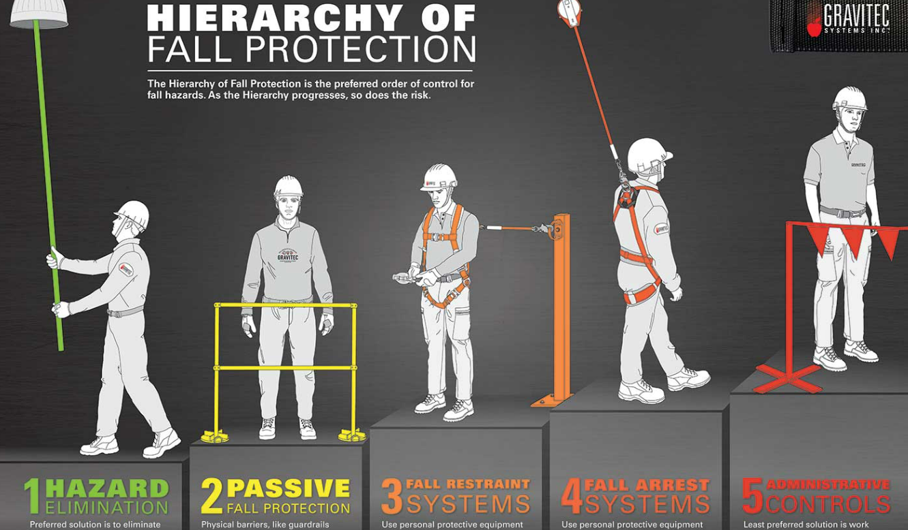
Hierarchy of fall protection

Slide 6
MOU
Forwarder
Chainsaw operator
Memorandum of understanding between HSE, MCA and MAIB - GOV.UK (www.gov.uk)
Harvester
Hauliers
Harvester

Slide 7
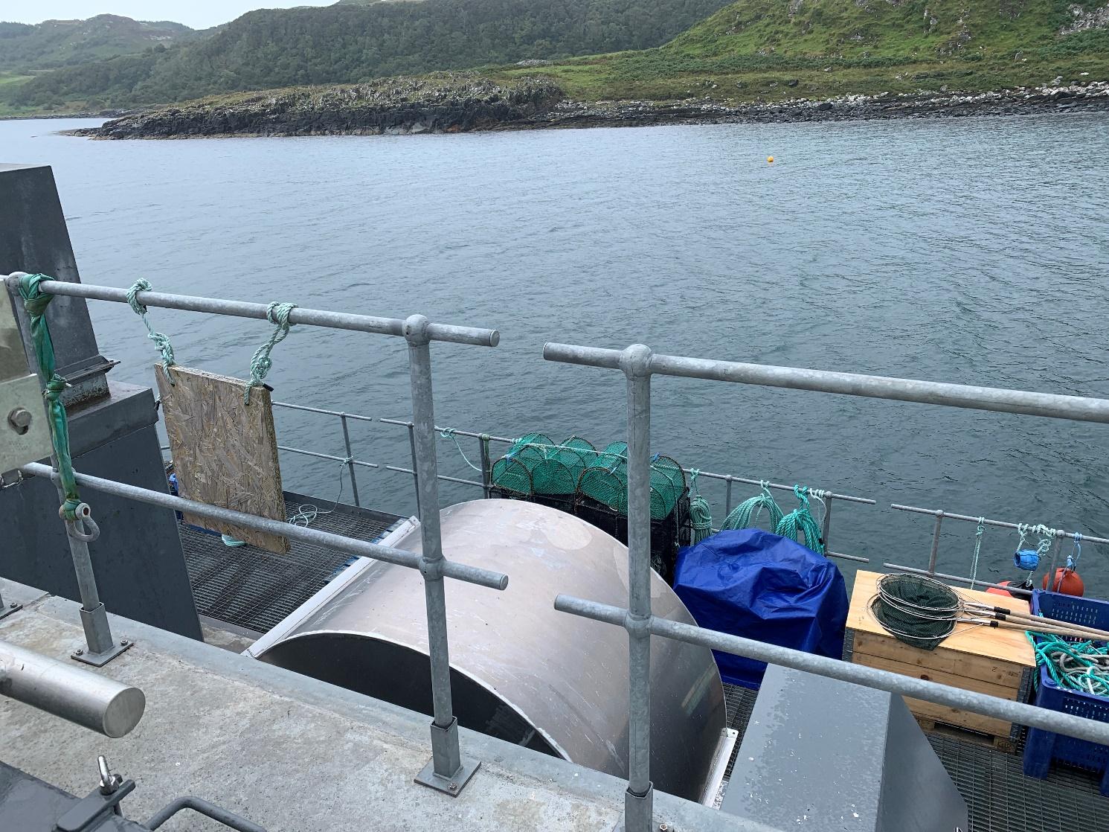
Protection from falling into water
Edge protection

Slide 8
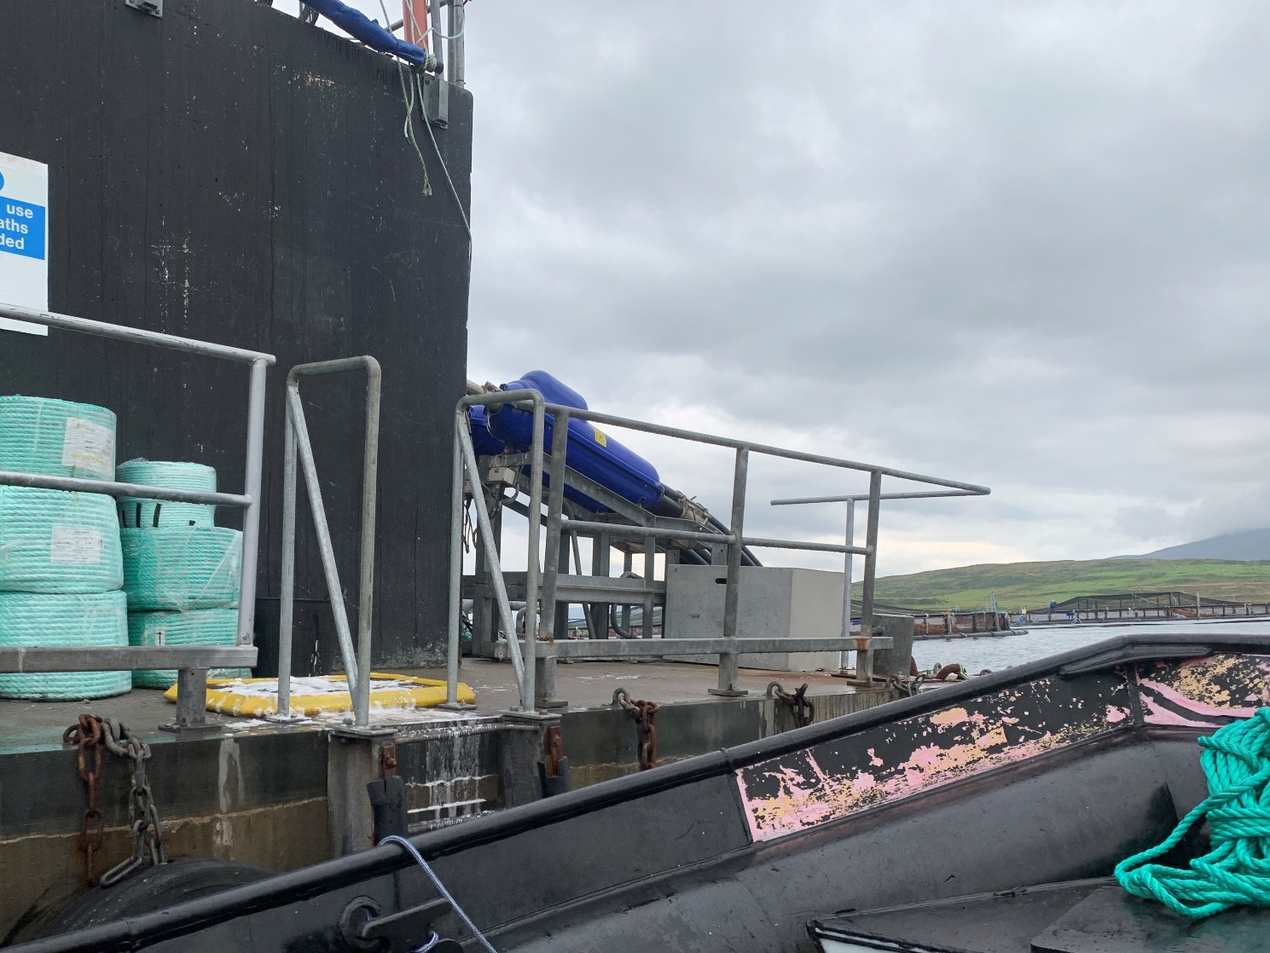
Protection from falling into water
Edge protection

Slide 9
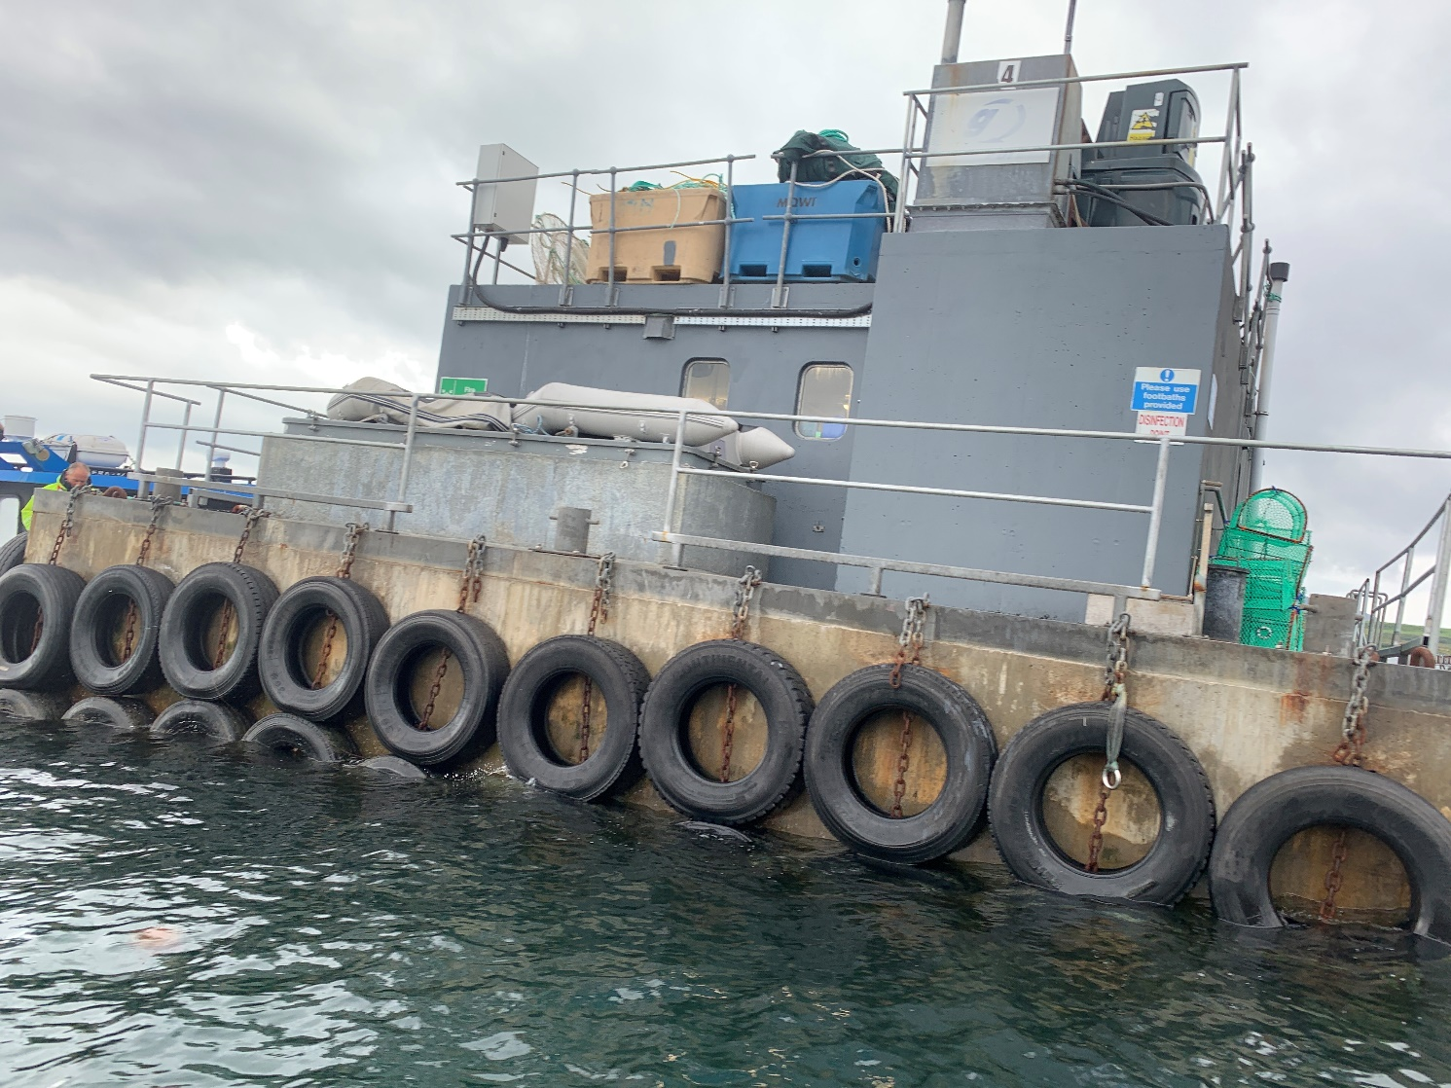
Protection from falling into water
Edge protection

Slide 10
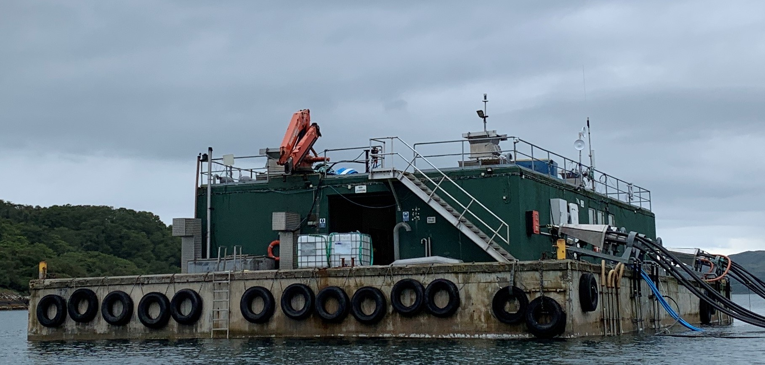
Protection from falling into water
Edge protection?
Notes:
Different standard – none on main level and is there a justifiable reason now ie: the old reason was large boat damage however with GPS positioning they don’t tie on

Slide 11
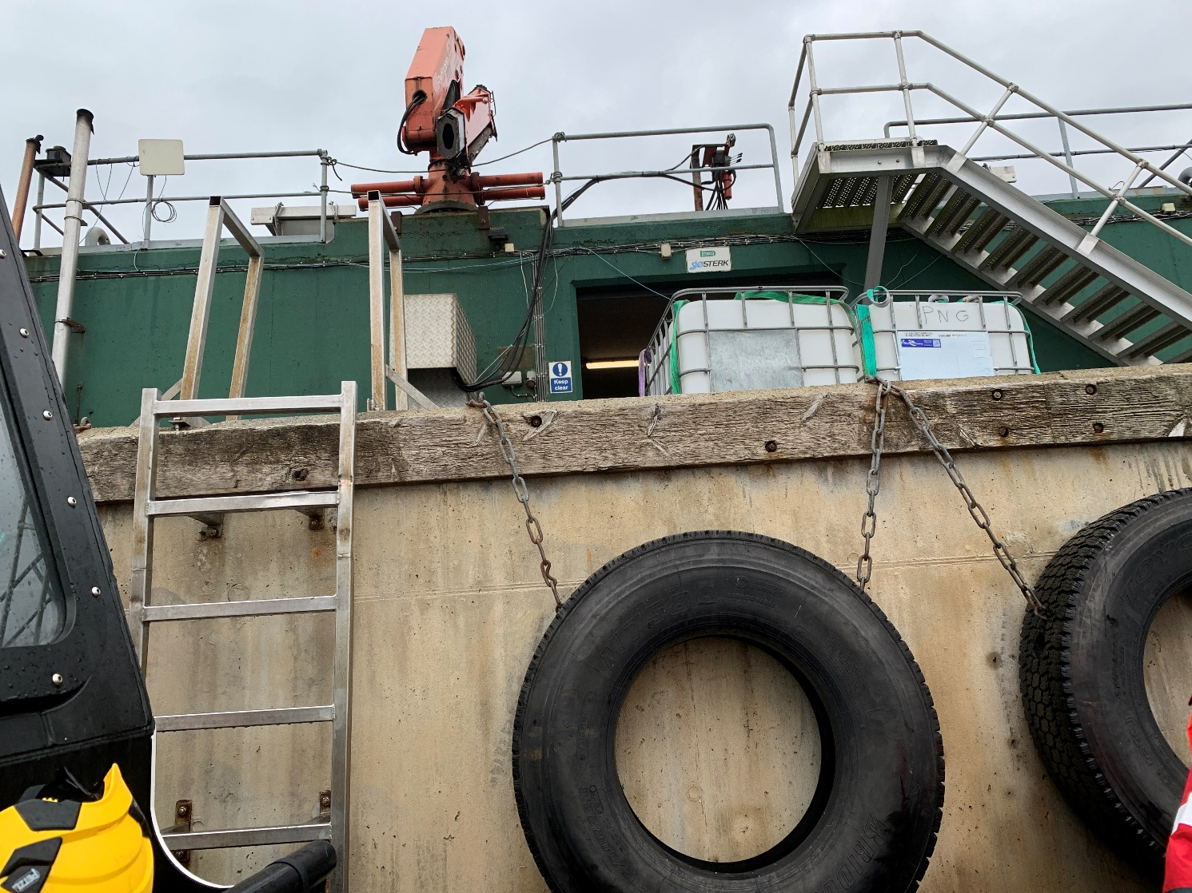
Protection from falling into water
Edge protection?
Notes:
Good fendering and ladder access

Slide 12

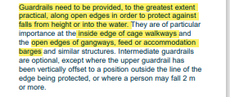


Protection from falling into water
Legal requirements and guidance Edge protection?
Notes:
INDS128
WAHR2005 3(4)(a) excludes master and crew in respect of the normal ship board activities ….carried out under the direction of the master 3(6)c ‘ship’ vessel used in navigation Schedule 2 (guard rails / barriers etc)
WHSWR1992 NB exclusion ship vessel bar para 22 ‘fixed in position’. Reg 5 Maintenance 14 Falls into dangerous substances As a minimum, barriers should consist of two guardrails (a top rail and a mid-rail) at suitable heights. The top of the barrier should be at least 1100 mm above the surface from which a person might fall. (6) For the purposes of this regulation – (a) “dock premises” means any dock, wharf, quay, jetty or other place at which ships load or unload goods or embark or disembark passengers, together with neighbouring land or water which is used or occupied, or intended to be used or occupied, for those or incidental activities, and any part of a ship when used for those or incidental activities; (b) “relevant operations” means, in relation to a ship, its repairing, refitting, painting and finishing, the scaling, scurfing or cleaning of its boilers (including combustion chambers or smoke boxes) and the cleaning of its bilges or oil-fuel tanks or any of its tanks last used for carrying oil; (c) “ship” includes all vessels and hovercraft which operate on water or land and water; (d) “shipyard” means any yard or dry dock (including the precincts thereof) in which ships or vessels are constructed, reconstructed, repaired, refitted or finished; and (e) “vessel” means any description of craft used for the transport of goods or passengers or the storage of goods or the accommodation of passengers on water, whether used in navigation or not.(d) (d) Regulation 3(6) was added by the Health and Safety (Miscellaneous Repeals, Revocations and Amendments) Regulations 2013 (SI 2013/448) regulation 4(3)

Slide 13
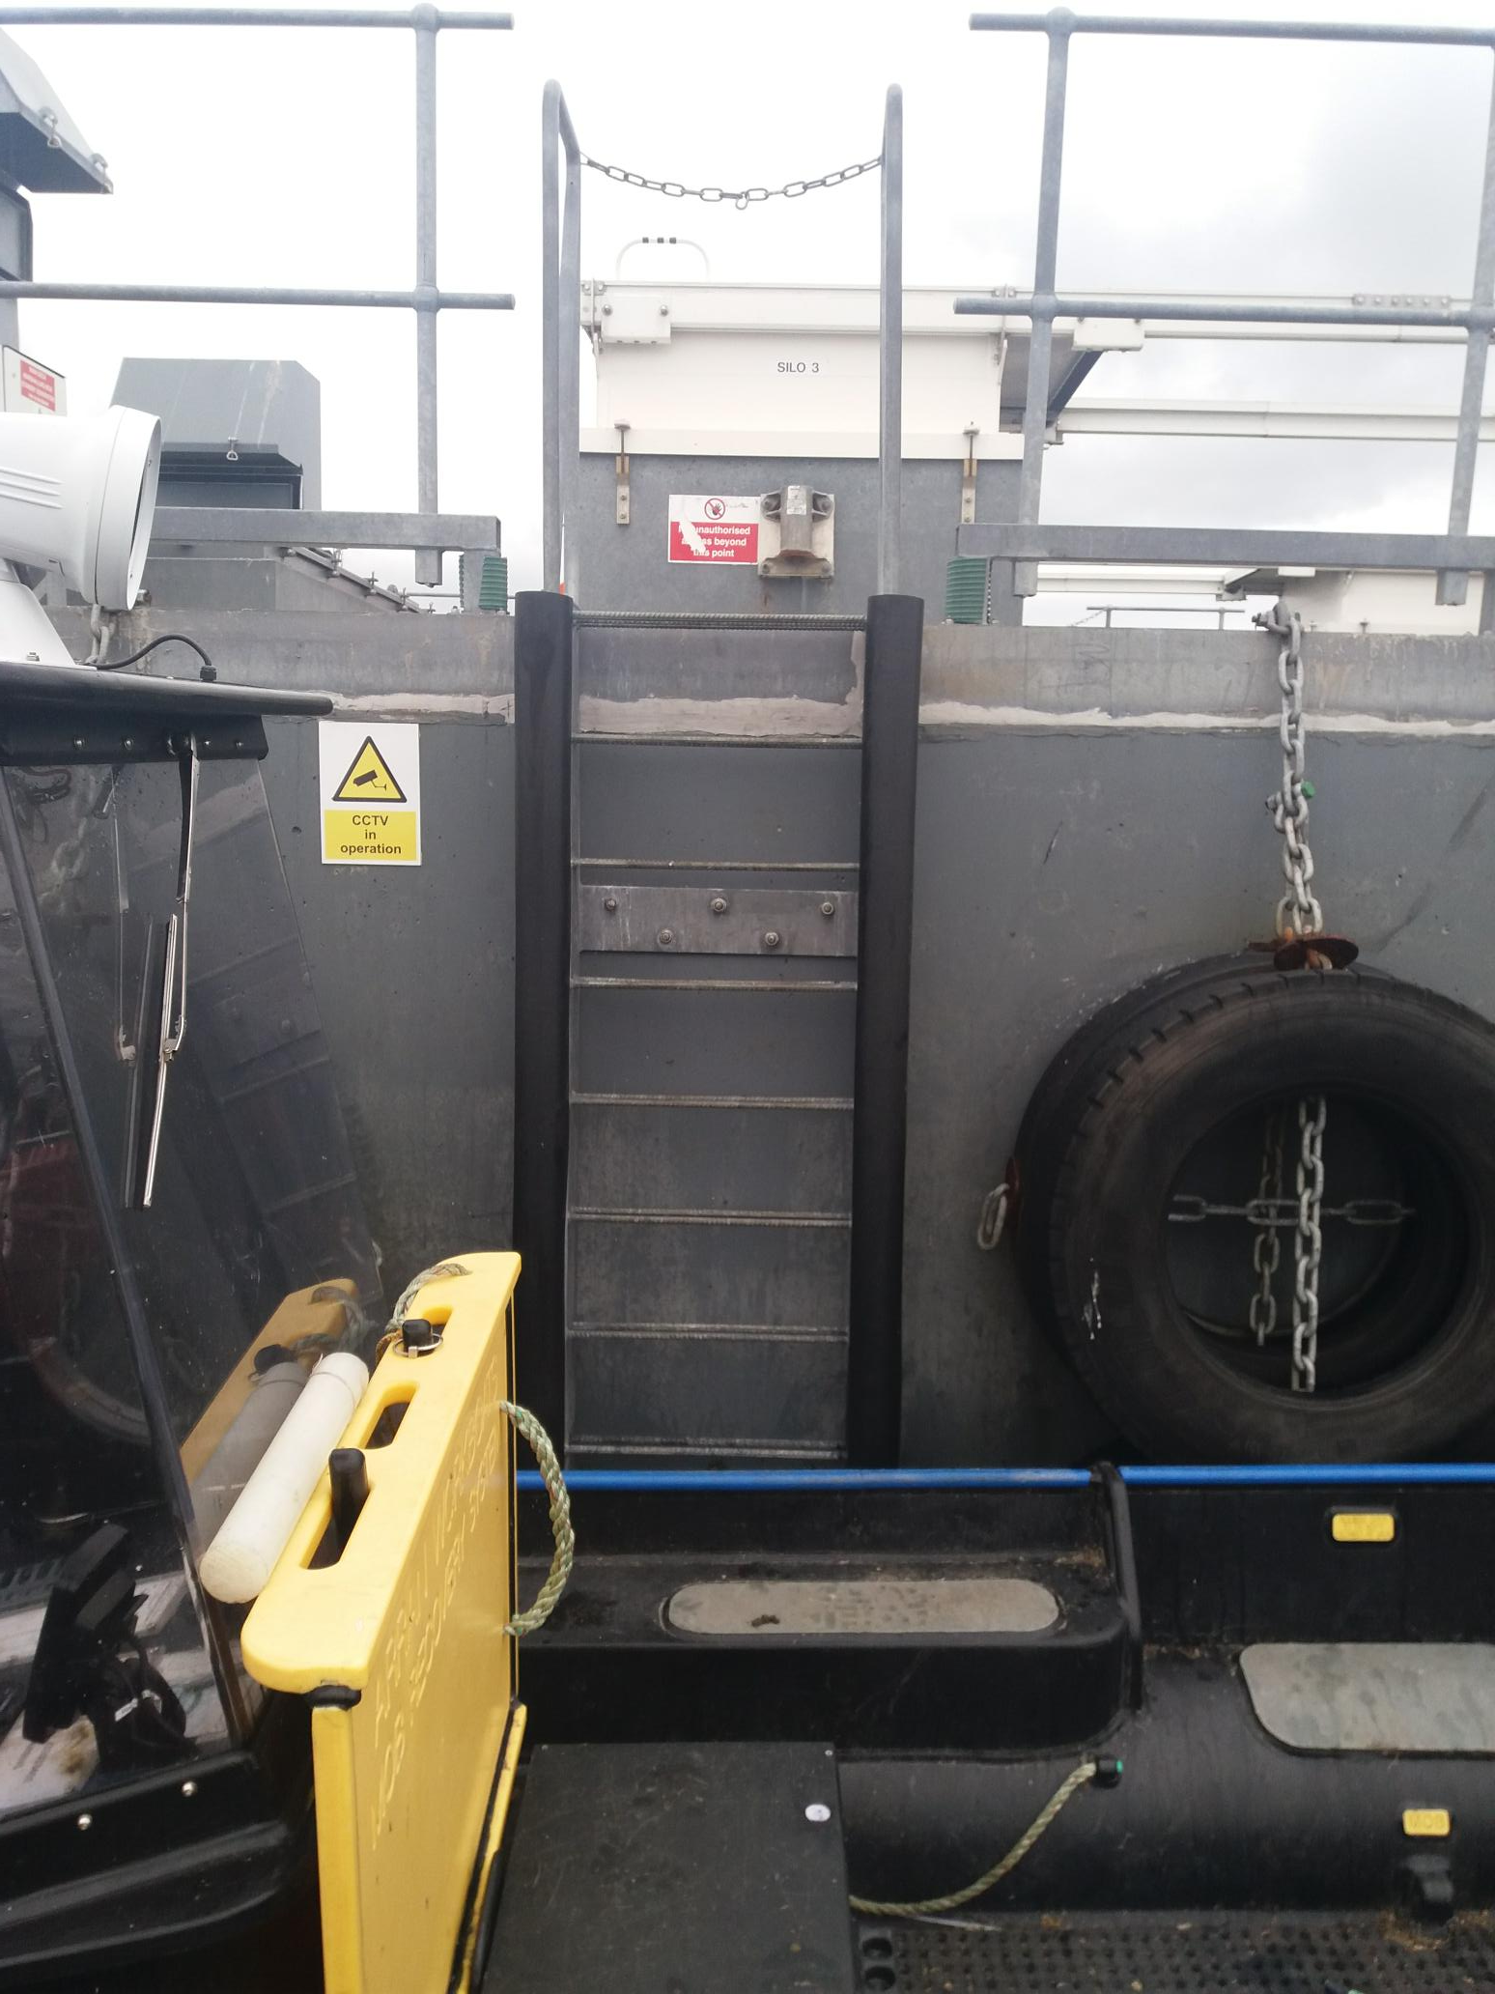
Edge/fender protection
Notes:
Good fendering and ladder access

Slide 14
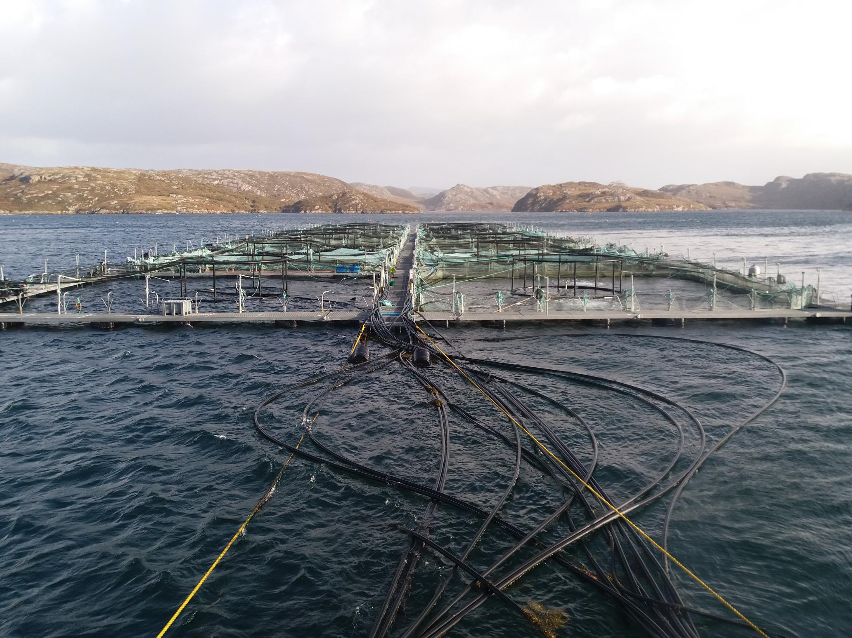
Edge protection
Notes:
Good fendering and ladder access

Slide 15
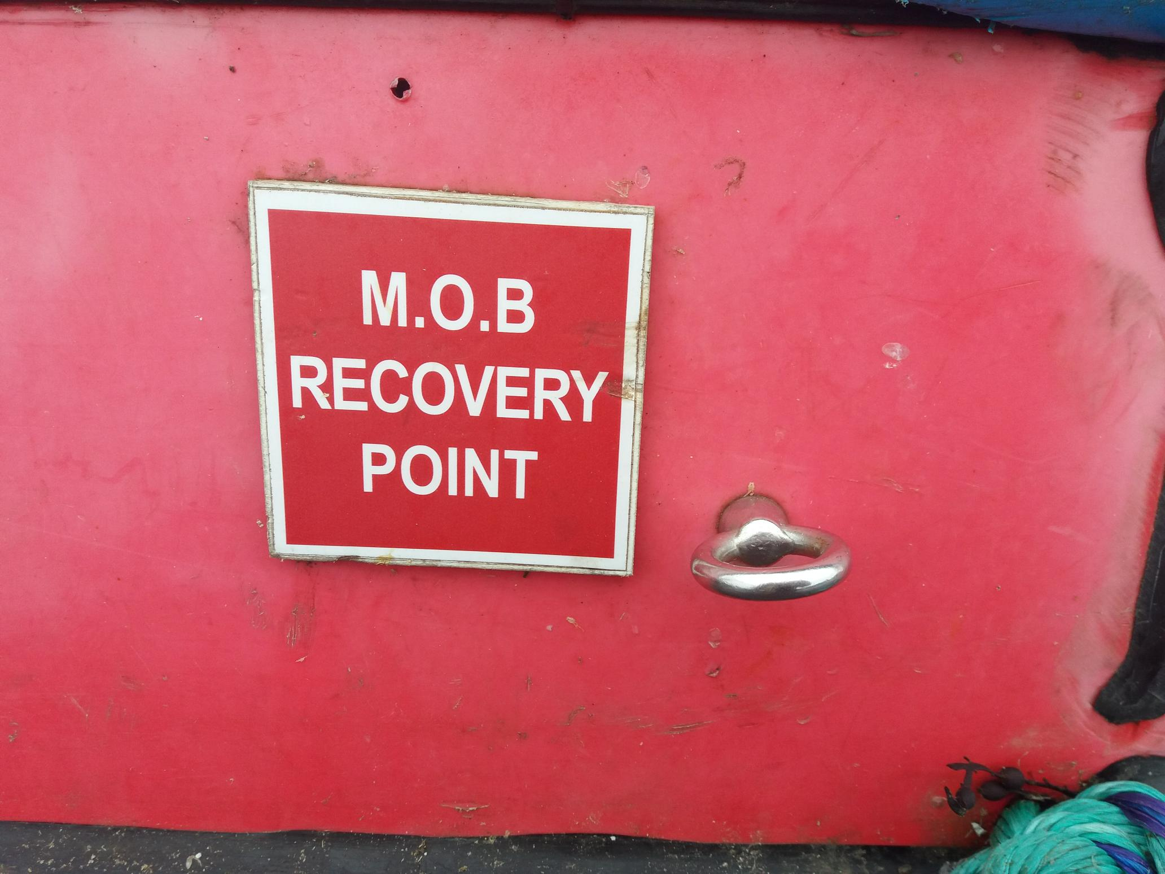
Man over board
Notes:
MOB drills

Slide 16

Personal location device
Notes:
PLD and flotation devices, PPE

Slide 17
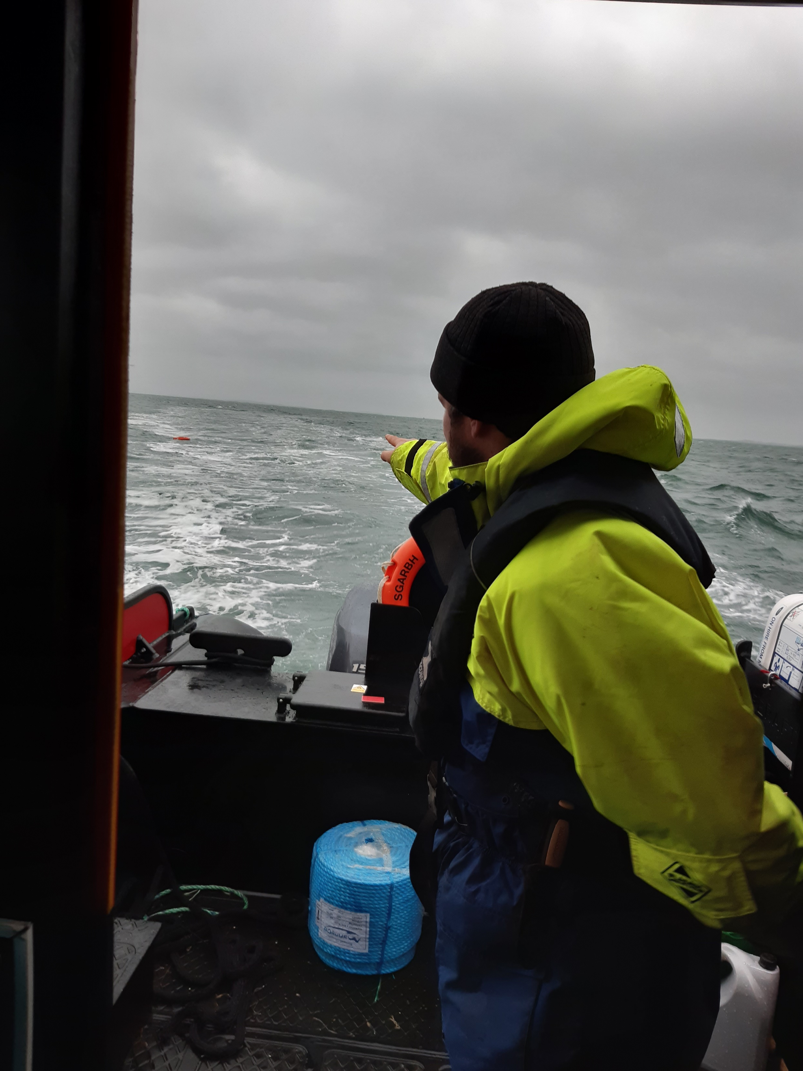
Drills
Notes:
Drill Drill Drill

Slide 18
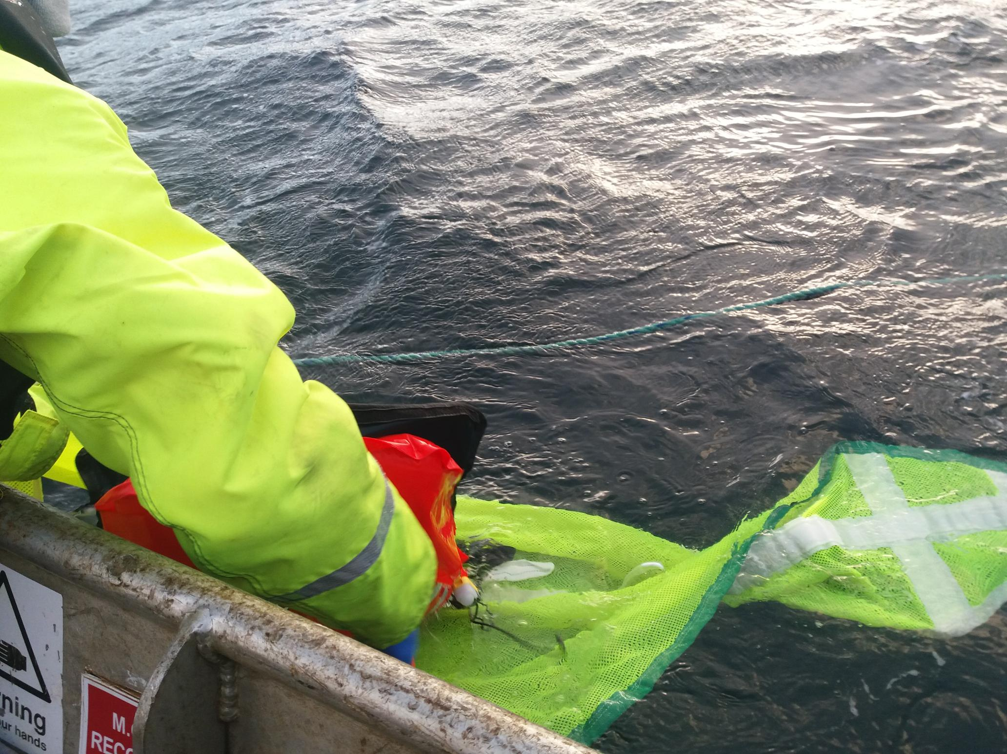
Recovery
Notes:
Recovery

Slide 19
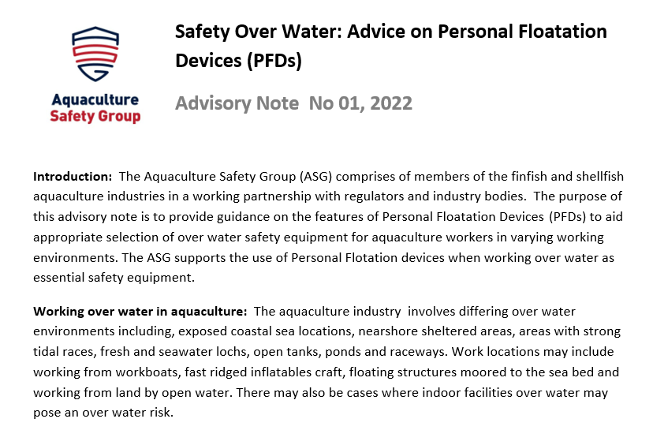
RA/work instruction/procedures and industry guidance
Notes:
Guidance

