Slide 1
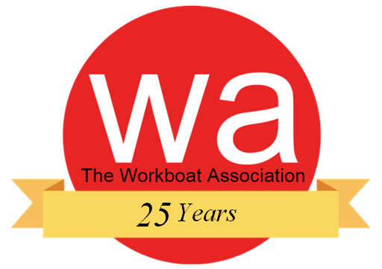
How to achieve a Master 500gt near coastal STCW II/3 CoC?

Slide 2
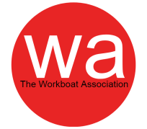
As you may be aware, the German and British flag states have made an agreement that holders of a UK issued ‘Master 500gt near coastal CoC’ STCW II/3 can operate in German waters, but how do you get one?

Slide 3
Select your starting situation;
Master 200gt CoC
Master 500gt Workboats CoC
UK Fishing Class 1 certificate

Slide 4
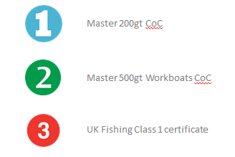
More information can be requested via;
Seafarer Training and Certification Branch
Maritime and Coastguard Agency
Spring Place
105 Commercial Road
Southampton
SO15 1EG
UK.
Tel +44 (0)20381 72000
e-mail: deck@mcga.gov.uk
Want to see the alternatives?

Slide 5
End

Slide 6
Necessary Sea time and Certification
36 months sea service in vessels of any size, including 12 months sea service and 120 days watchkeeping service onboard vessels 15 metres or over in load line length (6 months must be a workboat), whilst holding a Master 200gt CoC.
Completed a Master 500gt Training Record Book
Hold a valid ENG1 medical certificate
Training Record Book
MCA 500GT Master modules:
- Seamanship and Meteorology
- Masters Stability
- Business and Law
- Masters Navigation, Radar and ARPA
- Master Workboat Oral
STCW short course modules
- GMDSS General Operators Certificate (STCW IV/2)
- Efficient Deck Hand EDH (STCW II/5)
- PSC&RB (STCW Code A-VI/2)
- Advanced Fire Fighting (STCW Code A-VI/3)
- Medical First Aid (STCW Code A-VI/4-1)
- Medical Care on Board Ship (STCW Code A-VI/4-2)
- HELM(m)
- ECDIS (STCW Code A II/1 and II/2)
Master 200gt CoC

Slide 7
Necessary Certification
MCA Cargo Module from an MCA approved Nautical College
(it may be possible to complete this course retrospectively)
All further certificates must be valid at the time of application;
Personal Survival Techniques (STCW A-VI/1-1),
Fire Prevention & Fire Fighting (STCW A-VI/1-2),
Proficiency in Survival Craft and Rescue Boats (STCW A-VI/2-1),
Advanced Fire Fighting (STCW A-VI/3),
ENG1 medical fitness certificate
Master 500gt Workboats CoC

Slide 8
Necessary Sea time and Certification
12 months seagoing service whilst holding an STCW UK CoC onboard a vessel over 15 metres in loadline length
MCA Cargo Module from an MCA approved Nautical College
MCA oral examination ‘D’
(for the syllabus see MGN 69 or any subsequent publication)
NARAS/NAEST(O), or MN ENS, Radar, ARPA and ECDIS,
or Fishing NCC, Fishing ENS and ECDIS
All further certificates must be valid at the time of application;
Personal Survival Techniques (STCW A-VI/1-1),
Fire Prevention & Fire Fighting (STCW A-VI/1-2),
Proficiency in Survival Craft and Rescue Boats (STCW A-VI/2-1),
Advanced Fire Fighting (STCW A-VI/3),
ENG1 medical fitness certificate
MGN 69
UK Fishing Class 1 certificate

