Slide 1
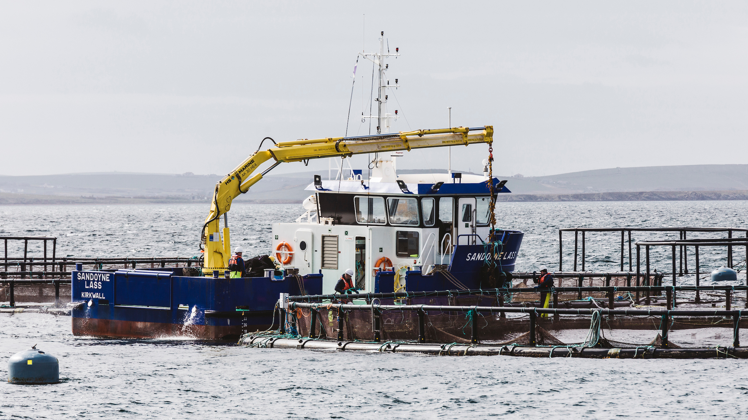
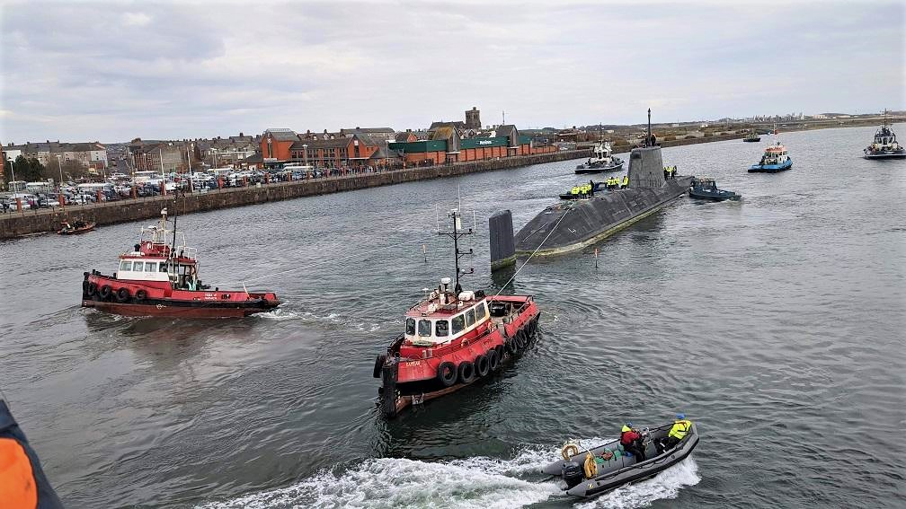
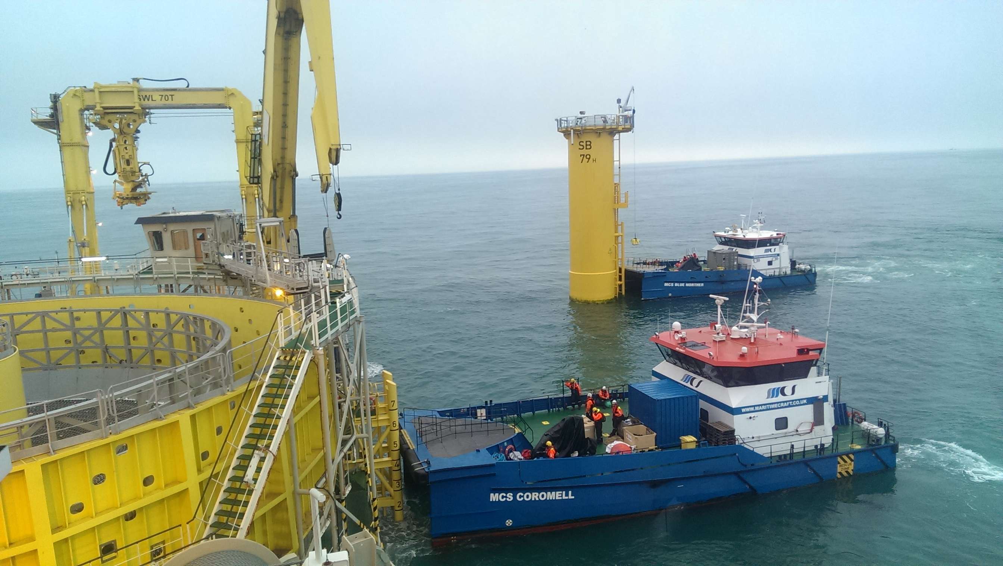
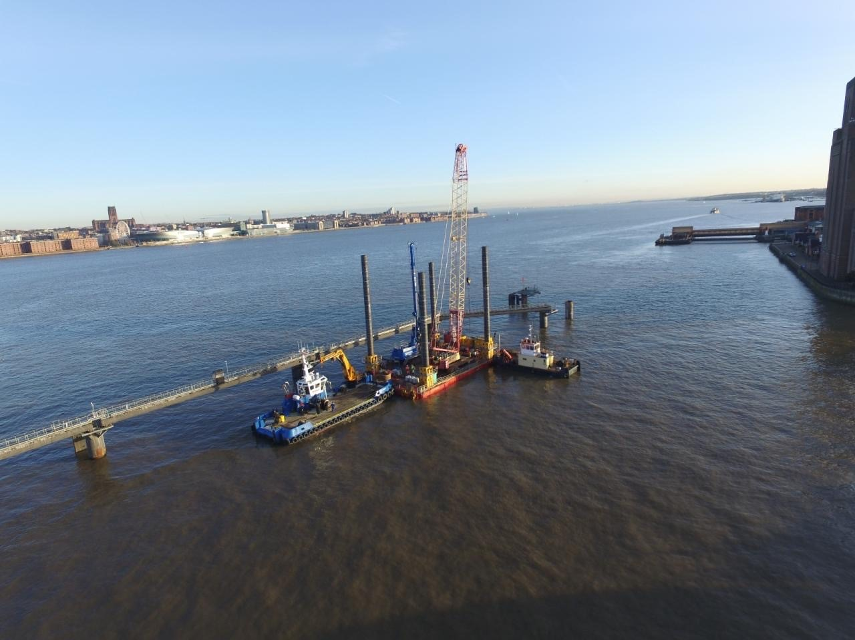
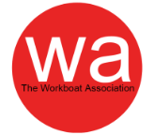
Understanding the UK Workboat Code

Slide 2
Topics
(Select a topic to continue)
Why do the UK have a Workboat Code?
Development of the Workboat Code
Other relevant codes supporting the Workboat Code
What is different in Workboat Code edition 2 compared to the previous versions?
I have a question

Slide 3
Why do the UK have a Workboat Code?

Slide 4
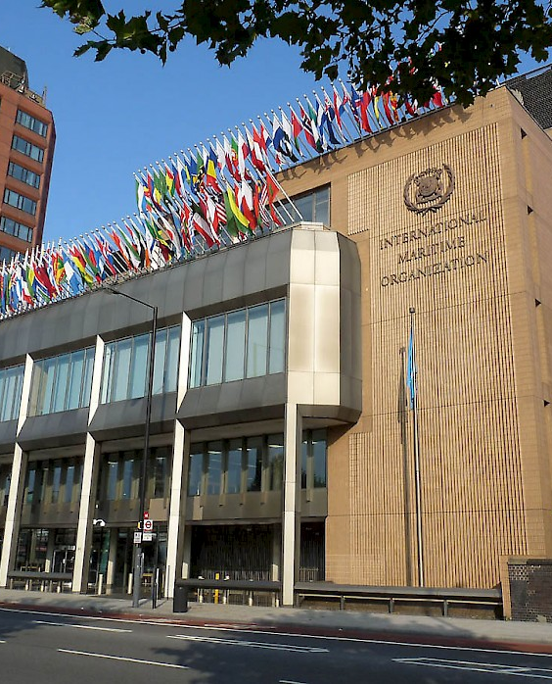
It has always been recognized that the best way of improving safety at sea is by developing international regulations that are followed by all shipping nations and from the mid-19th century onwards a number of such treaties were adopted.
Several countries proposed that a permanent international body should be established to promote maritime safety more effectively, but it was not until the establishment of the United Nations itself that these hopes were realised.
In 1948 an international conference in Geneva adopted a convention formally establishing IMO (the original name was the Inter-Governmental Maritime Consultative Organization, or IMCO, but the name was changed in 1982 to IMO).
The IMO Convention entered into force in 1958 and the new Organization met for the first time the following year.
IMO

Slide 5
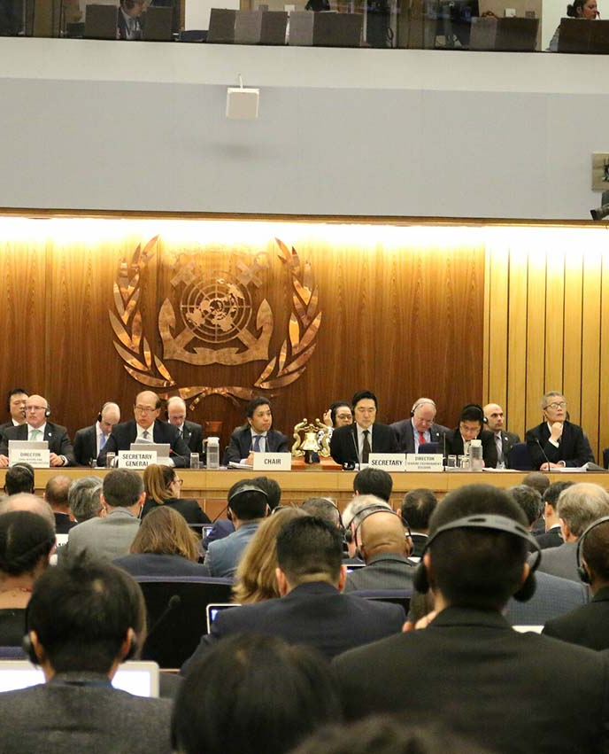
By the time IMO came into existence in 1958, several important international conventions had already been developed, including the International Convention for the Safety of Life at Sea of 1948, the International Convention for the Prevention of Pollution of the Sea by Oil of 1954 and treaties dealing with load lines and the prevention of collisions at sea.
IMO was made responsible for ensuring that the majority of these conventions were kept up to date. It was also given the task of developing new conventions as and when the need arose.
The creation of IMO coincided with a period of tremendous change in world shipping and the Organization was kept busy from the start developing new conventions and ensuring that existing instruments kept pace with changes in shipping technology. It is now responsible for more than 50 international conventions and agreements and has adopted numerous protocols and amendments.
The majority of conventions adopted under the auspices of IMO or for which the Organization is otherwise responsible, fall into three main categories;
- maritime safety
- prevention of marine pollution
- liability and compensation,
Outside these major groupings are a number of other conventions dealing with facilitation, tonnage measurement, unlawful acts against shipping and salvage, etc.
IMO

Slide 6
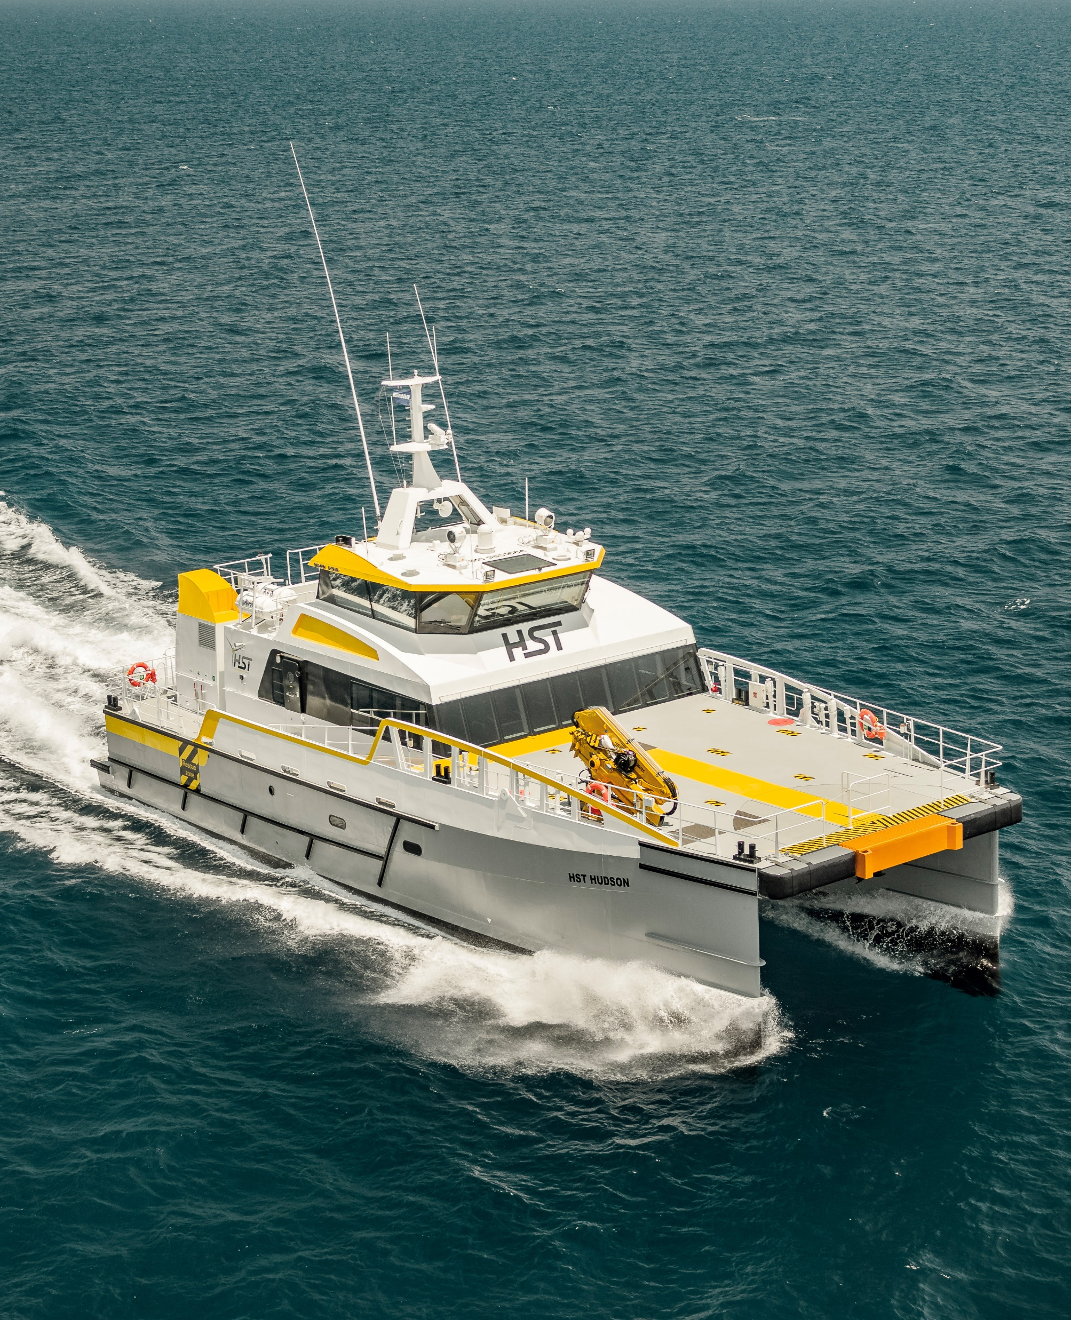
Some of the Key IMO Conventions relative to Workboats;
- International Convention for the Safety of Life at Sea 1974, as amended (SOLAS),
- International Convention for the Prevention of Pollution from Ships, 1973, as modified by the Protocol of 1978 relating thereto and by the Protocol of 1997 (MARPOL)
- International Convention on Standards of Training, Certification and Watchkeeping for Seafarers as amended, including the 1995 and 2010 Manila Amendments (STCW)
- Convention on the International Regulations for Preventing Collisions at Sea 1972 (COLREGs)
- Convention on Facilitation of International Maritime Traffic 1965 (FAL)
- International Convention on Load Lines 1966 (LL)
- International Convention on Maritime Search and Rescue 1979 (SAR)

Slide 7
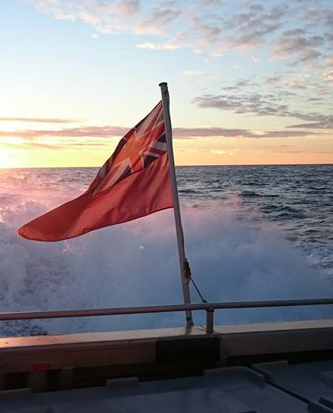
When a [member country] government accepts an IMO Convention it agrees to make it part of its own national law and to enforce it - just like any other law.
The UK flag state administration [Maritime and Coastguard Agency - MCA] implements these laws via the UK’s Merchant Shipping Regulations.
Further information on how the UK specifically implements the Merchant Shipping Regulations can be found in the MCA’s handbook: A Masters guide to the UK flag
Due to the fact that full implementation of these regulations on small vessels would not be achievable, there are many minimum size applicational limits within the MSRs, specific codes were created by the MCA to offer smaller vessels clarity and tailored guidance to their implementation.
Small commercial vessels operating under the UK flag and in UK waters must comply with the merchant shipping regulations or an MCA Code of Practice.
The codes apply to:
- small motor vessels
- small sailing vessels
- small workboats and pilot boats
- small commercial vessels used for sport/pleasure
IMO
MCA

Slide 8
Section complete
Click anywhere to go back to the topics menu

Slide 9
Development of the Workboat Code

Slide 10
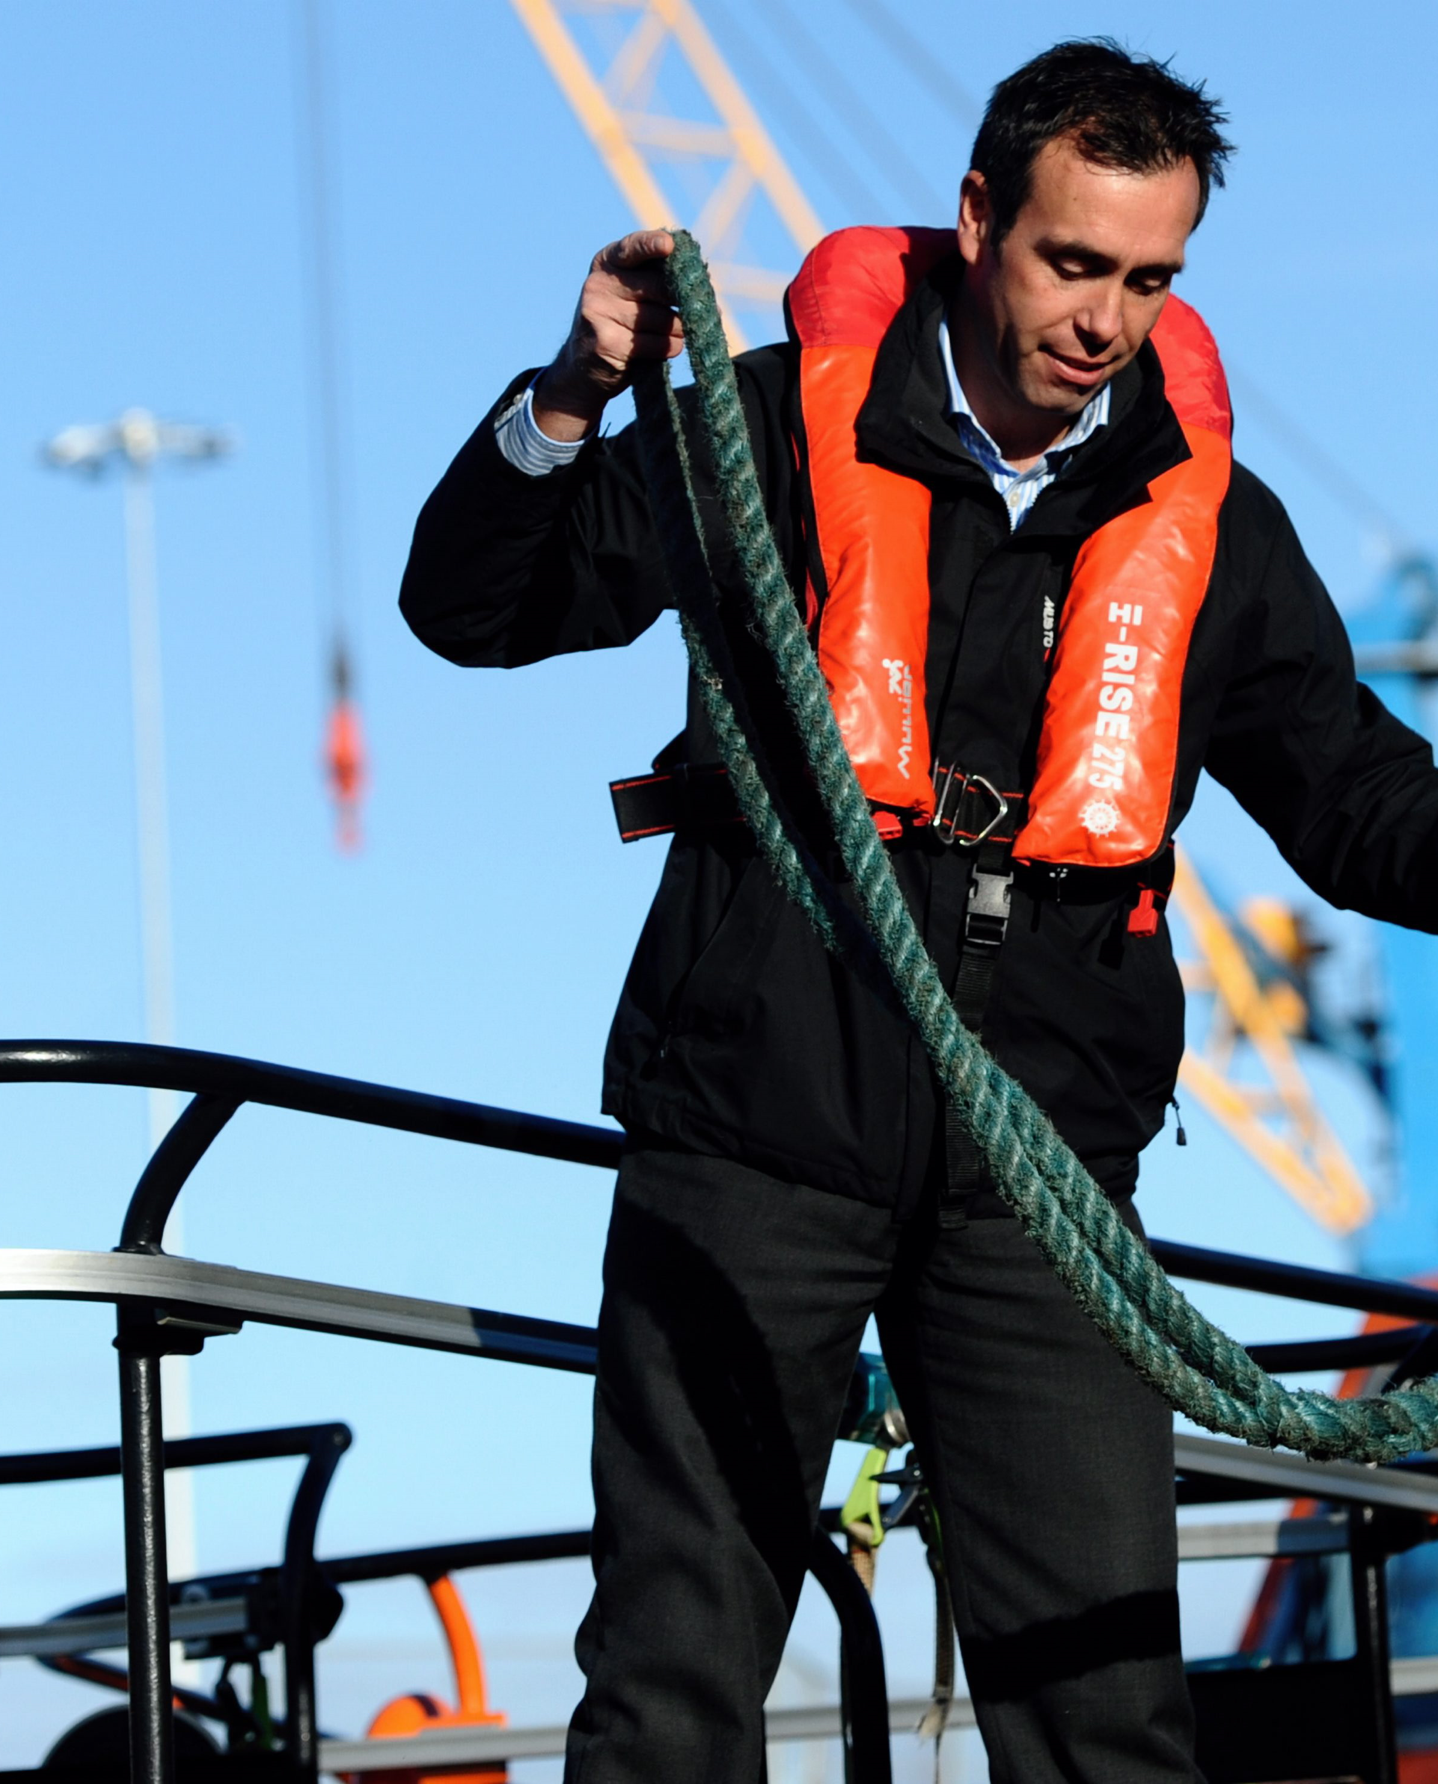
The MCA completed the original Codes of Practice for commercial pleasure boats – the Blue and Yellow codes (1993)
In 1994 the MCA began work on a Code of Practice for Workboats, to be known as the Brown code.
“The code will be a combination of the best workboat practice, combined with safe and sensible legislation.” - Tom Allen, MCA
A small representative group of UK workboat operators together with a team from the MCA provided the original input and development of the Workboat Code, though mandatory application of the Code would not follow for a few more years…
This small representative group of UK workboat operators became what we now know as the Workboat Association – more information on this story can be found here
After the Workboat [Brown] Code had been applied voluntarily to a proportion of the registered fleet with successful results, the Code was made mandatory compliance in 1998.

Slide 11

In 2004 under the Brown Code a new Marine Guidance Notice (MGN 280) was created.
MGN 280 was a sub-chapter of the Brown Code, it did not have its own legal footing (Statutory Instrument – SI), therefore it was not independently known as the Workboat Code.
The reason for its development was to close-out and give guidance to some of the concerns and operational challenges faced by conforming to the original Brown Code that had been experienced since its creation.
Due to this, it has been known that some Recognised Organisations able to Survey on behalf of the MCA (ROs) and Class Societies (CAs) remained surveying to the original Brown Code rather than the latter MGN 280 guidance.

Slide 12
1994
2019
<2024
1998
2004
2014
MGN 280 ->
Brown Code conception ->
Brown Code becomes mandatory ->

Slide 13
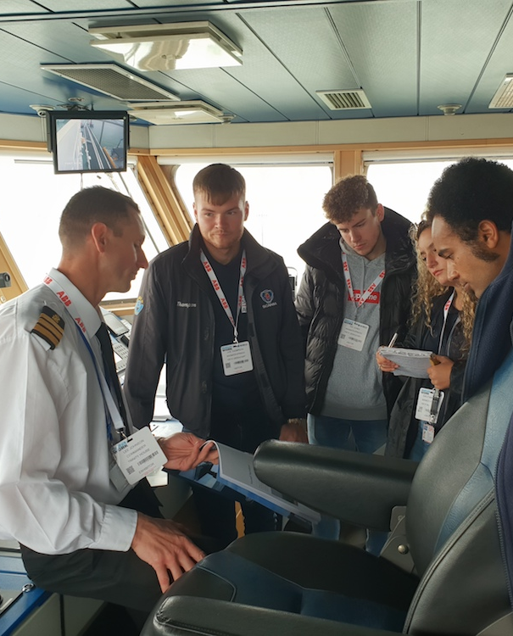
Popular industry demand to review the Workboat Code and bring it in-line with current trends and vessel designs, industry best practice and operational [market] requirements instigated the re-formation of the industry representatives this time including the wider stakeholders actively working with the Code to work towards a Workboat Code 2.
Challenges faced in getting the Workboat Code 2 to finalisation caused significant delays in its completion, in 2014 the MCA agreed that without its own legal backing (SI) the industry could start voluntarily applying the current version of the Workboat Code 2 draft – this draft was concluded and named; the “Workboat Code: Industry Work Group Technical Standard 2014” (IWGTS)
Between the years of 2014 - 2019 Workboats could be voluntarily surveyed and operating to the IWGTS, though all vessels built to this voluntary code must within one full survey cycle after the completion of Workboat Code 2 meet the requirements of the new code (including Crew).
The Workboat Code 2 was formally introduced on Jan 1st 2019, all vessels built following this date must comply.

Slide 14
1994
2019
<2024
1998
2004
2014
MGN 280 ->
Workboat Code 2 ->
Brown Code conception ->
Brown Code becomes mandatory ->
Voluntary application of the IWGTS ->

Slide 15
1994
2019
<2024
1998
2004
2014
MGN 280 ->
Workboat Code 2 ->
Brown Code conception ->
Brown Code becomes mandatory ->
The future (as can be foreseen) ->
Voluntary application of the IWGTS ->

Slide 16
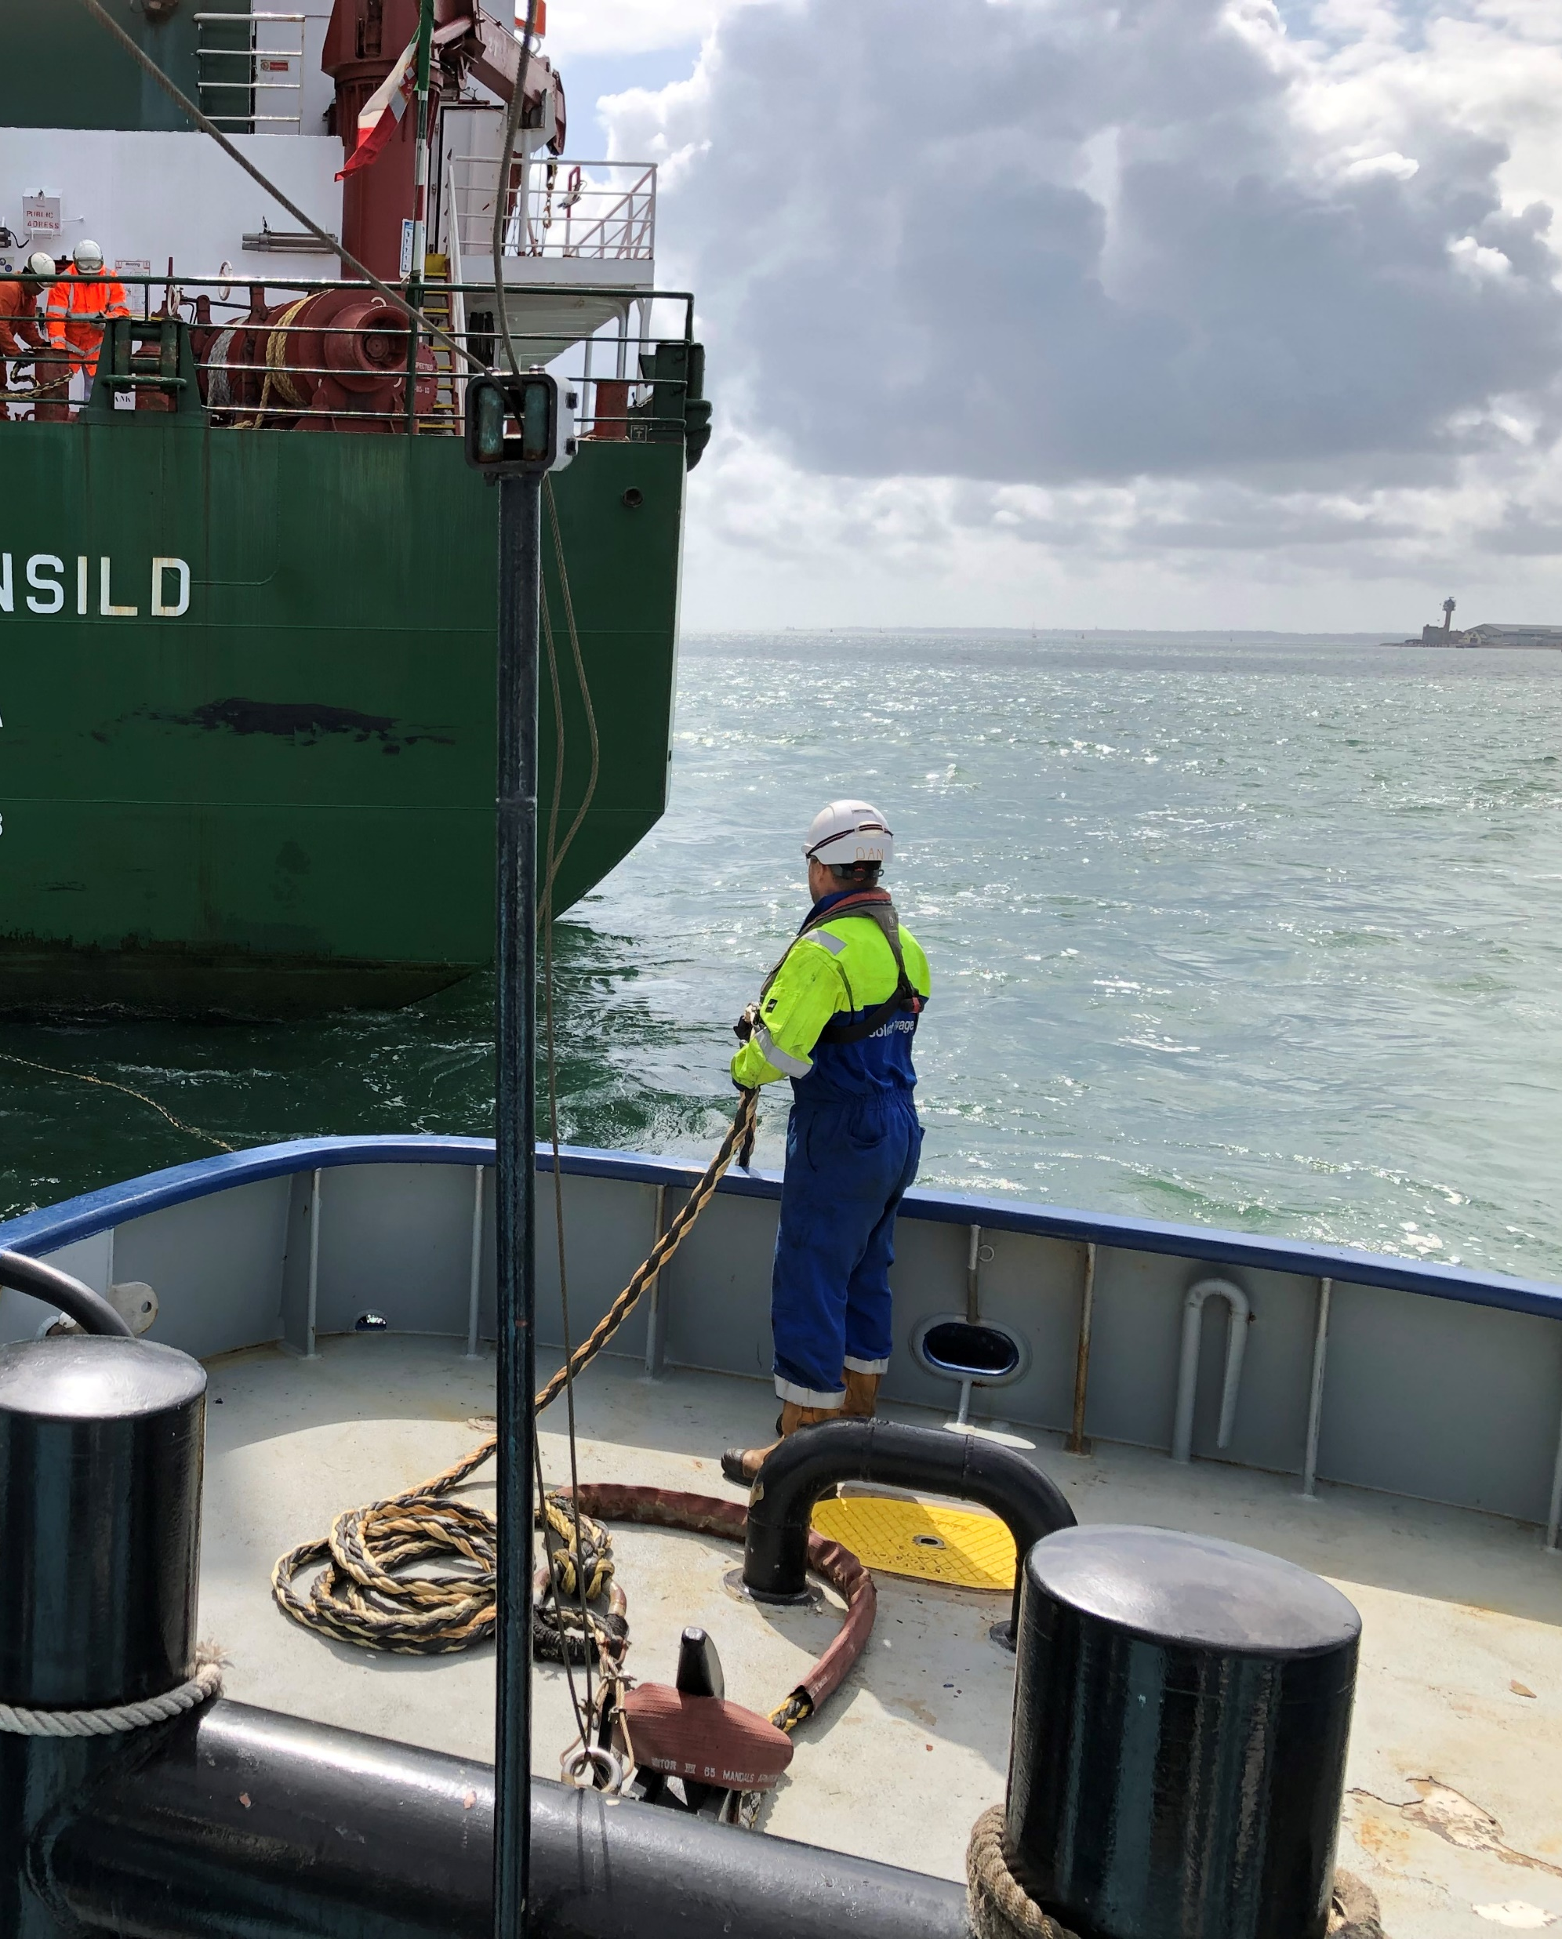
Learning from the challenges faced during the development of Workboat Code 2, the MCA have already begun the development of Workboat Code 3.
It is currently projected that the next Workboat Code will be bought into use before 2024 (within 5 years of its predecessor).
The intention of the new code will be to cover the following;
- As previously, close-out and update guidance to cover the concerns and operational challenges faced by conforming to the previous Codes
- Update the code to cover the current industry practices and technical development, whilst also future proofing the Code for easier review as technologies and methods develop in the coming years.
- and significantly, to bridge all previous Codes (where practicable) to make a raised safety benchmark for the industry within a single document – mirroring the original desire for the Brown Code.

Slide 17
Section complete
Click anywhere to go back to the topics menu

Slide 18
What is different in Workboat Code edition 2 compared to the previous versions?
Note: Brown Code and MGN 280 are now effectively annexes to Workboat Code Edition 2

Slide 19
To make this easier let’s separate this into 3 categories;
Construction
and Equipment
Crew Certification
and Training
What else do I need to know?

Slide 20
Construction
and Equipment

Slide 21
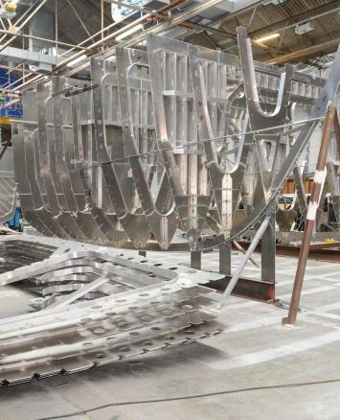
Pre-build risk assessment
Removal of history of safe operation and
Verification of structure caveat to use ISO 12215
(Allows for more practical phase in of existing vessels)
Ventilation for battery spaces and hazardous spaces
Uplifts in Structural fire protection
In-build verification of structure
Uplifts in DG carriage allowance from MGN 280
Regulated transfer of fuel permitted but, no fuel pipes running through the accommodation
Construction

Slide 22
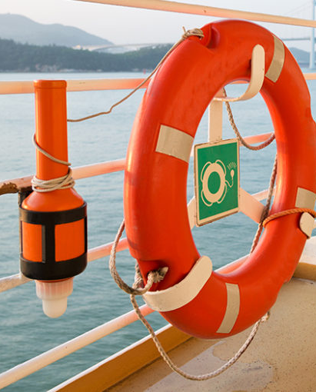
One crew member to wear a 406 MHz with GPS PLB and all other crew members to wear a Class M VHF DSC with AIS PLB is strongly recommended – 13.9.1
The owner should demonstrate to the CA by physical deployment moved from its stowed position/stowed state to launched in the water in the shortest practicable time – 13.2.1.1.5
The owner should undertake a regular training drill of the physical deployment of each liferaft – 13.17.1
Safety Equipment

Slide 23
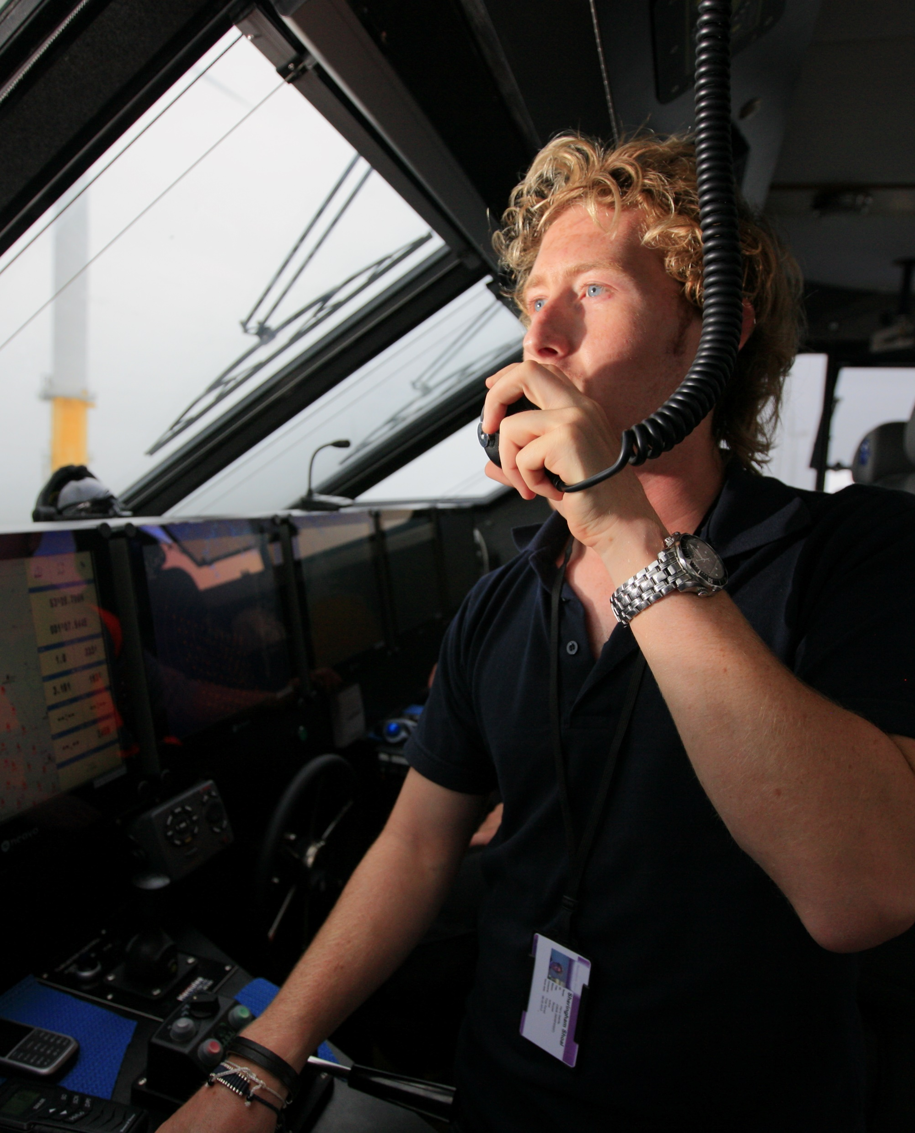
MF radio installation with DSC – 16.7.1 + Navtex receiver – 16.7.1 + EPIRB 16.7.1
A vessel should carry at least one person qualified for distress and safety radio communication purposes who should hold a CoC – 16.9.1
Owners are recommended to undertake a survey of the vessel’s radio installation every 5 years and hold a radio survey Statement of Compliance – 16.12.1
GMDSS Equipment

Slide 24

AIS subject to routine testing (annual) – 18.4.3
Electronic aids to navigation routinely tested – 18.5
Testing Bridge Equipment

Slide 25
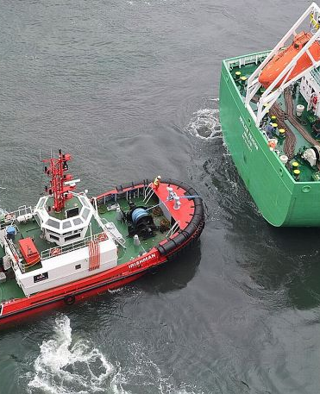
A towage survey should be carried out where practicable by a competent person – 25.2.2.10.10
Towed objects should not be manned at sea unless they have accommodation designed to be occupied at sea with appropriate LSA – 25.2.4.3
A safe means of access from the vessel engaged in towing should be provided to the tow – 25.2.4.5
Two lifebuoys and lines shall be provided on the towed object – 25.2.4.7
The towed vessel (vessel not classed as a barge, pontoon or towed object – see 25.2.4.1) should have an anchor/cable suitable for simple deployment and for holding the tow in an emergency – 25.2.4.8
Towing Operations

Slide 26
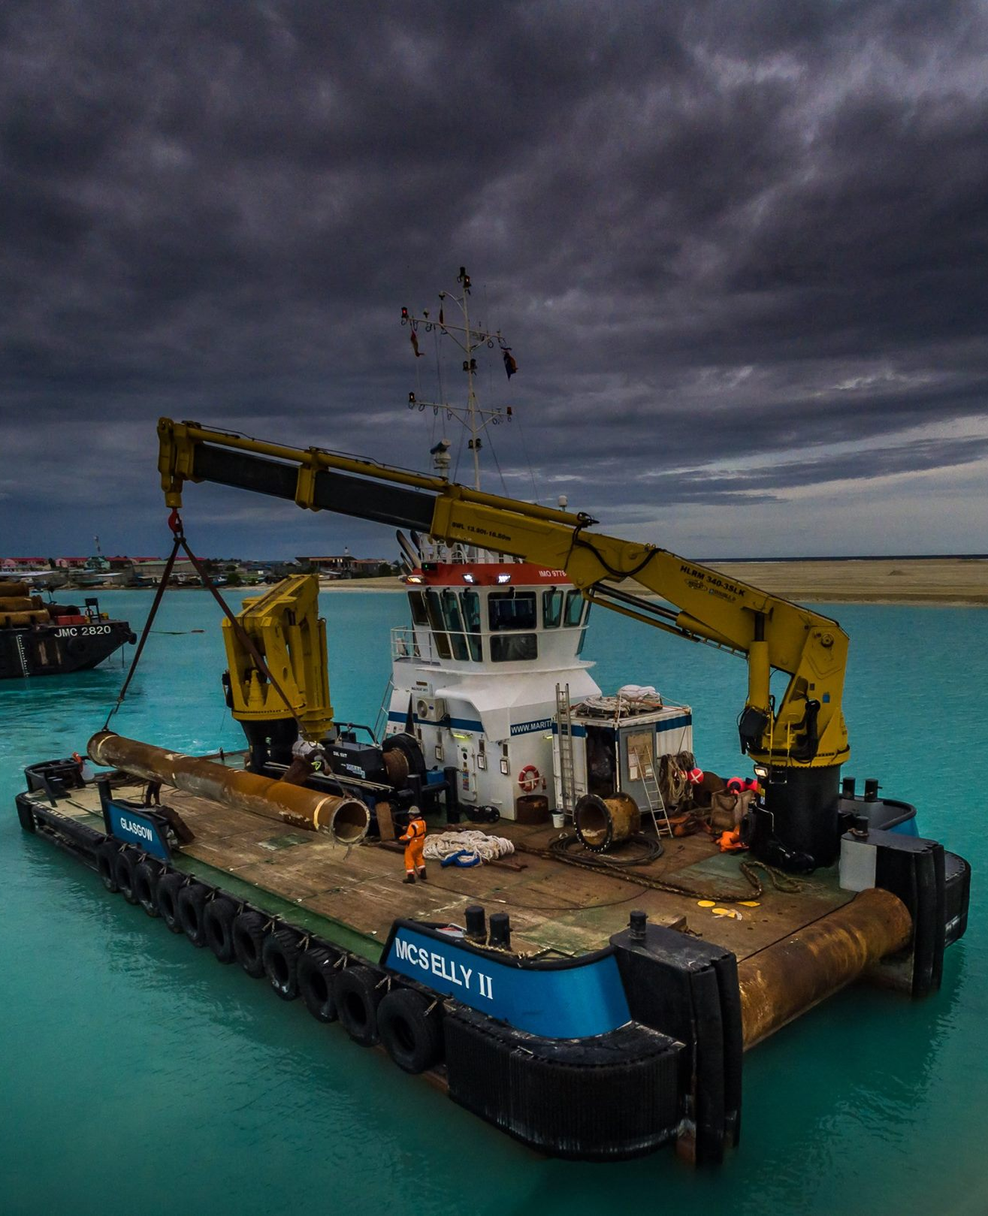
Maintenance should be carried out as per manufacturers’ instruction manual. Repair and maintenance should only use parts made or recommended by the crane manufacturer – 25.4.2.5
Overload tests of cranes should be carried out after the crane has been in service 4 years, 8 years, 10 years, 12 years and annually thereafter if the crane has not been marinised – 25.4.2.6
Consideration should be given by owners of a land based hydraulic crane that is not supplied with marine environment features and is fitted to a workboat, to an enhanced maintenance schedule and more frequent inspection regime and should include inspecting electrical connectors and components, drive train, structural components, fasteners and wire ropes – 25.4.2.7
Crane Maintenance

Slide 27
All engines with a power output of greater than 130kW, installed on a vessel which is a workboat of any size, constructed after 1st January 2000 should be issued with an Engine International Air Pollution Prevention (EIAPP) Certificate and a Technical File
– 28.2.5.1
Portable fuel tanks carried onboard for use by the vessel is considered cargo (not ship’s stores) so come under carriage of dangerous goods arrangements
– 29.8.1.5
All vessels operating under this code are recommended to implement a Safety Management System which complies with the principles of the ISM Code, but is commensurate with the size and complexity of the vessels and company’s operations.
Appendix 7 details the areas which should be addressed by a SMS – 30.1
Additional considerations

Slide 28
Crew Certification
and Training

Slide 29
Where a Stability Information Booklet (SIB) is required to be carried on board, the Master should complete an
MCA approved stability course - 2.4
Every small workboat or pilot boat should have on board at least one crew member who has attended an MCA approved one day fire fighting course – 2.9.1
In any vessel that carries radar, the Master and any member of the crew who is likely to use the radar is strongly recommended to undertake appropriate training - 2.11.1
All seafarers engaged in the preparation of food will be required to undertake a 'Basic Food Hygiene’ or ‘Food Safety' course, level 2, as listed in MIN 559 - 2.12.1
Seafarer Certification and Training

Slide 30
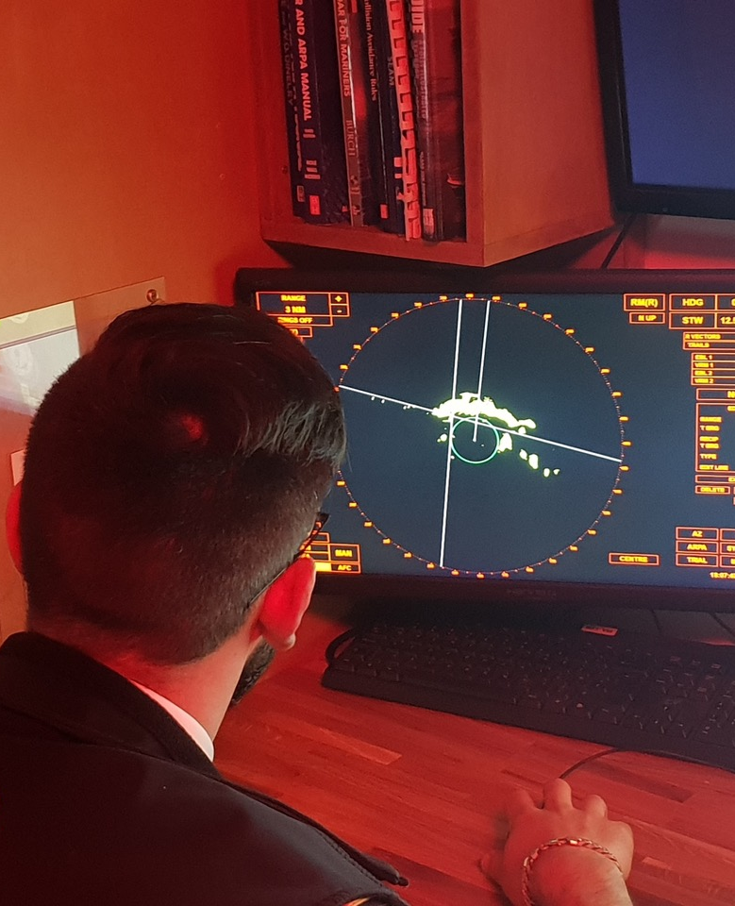
It is strongly recommended that training appropriate to the type of [Electronic Chart Plotter] equipment on the vessel must be undertaken by the Master and any other crew member responsible for navigation.
This strong recommendation becomes a requirement 3 years after publication of this code - 2.13 and
Where navigation equipment is carried in excess of the code requirements, the Master and any member of the crew likely to use the equipment should undertake appropriate training in the use of that equipment. e.g. ECDIS, see MIN 503(M) as amended. – 2.14
Jan 1st, 2022
Seafarer Certification and Training continued…
This strong recommendation becomes a requirement 3
years after publication of this code - 2.13

Slide 31
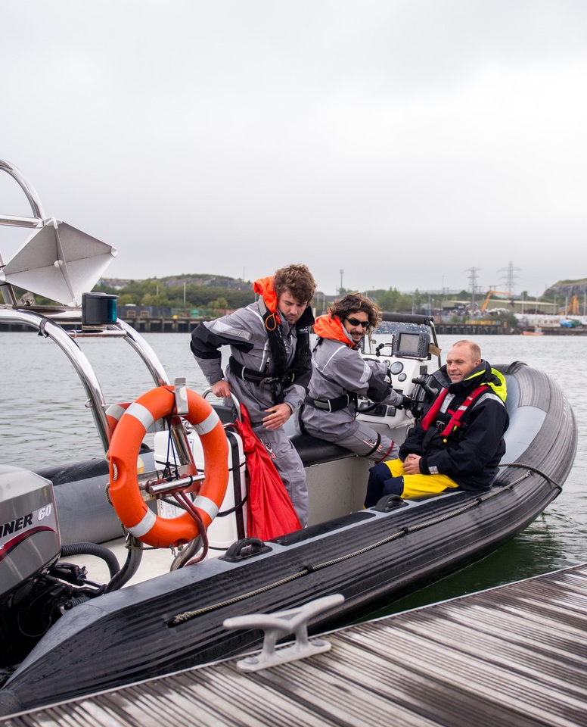
From 1st January 2017 any seafarer holding certain STCW short courses will require to have these refreshed, information can be found on the MCA website (www.gov.uk/mca) and in MIN 535(M) (and any subsequent amendment) and MSN 1865 (as amended).
The owner/manager of the vessel is responsible for ensuring that any on board training and other training is refreshed as necessary. – 3.1
RYA Powerboat Level 2, has been removed from the Minimum Deck Manning Requirements for Small Workboats – Table A3.1
Seafarer Certification and Training continued…

Slide 32
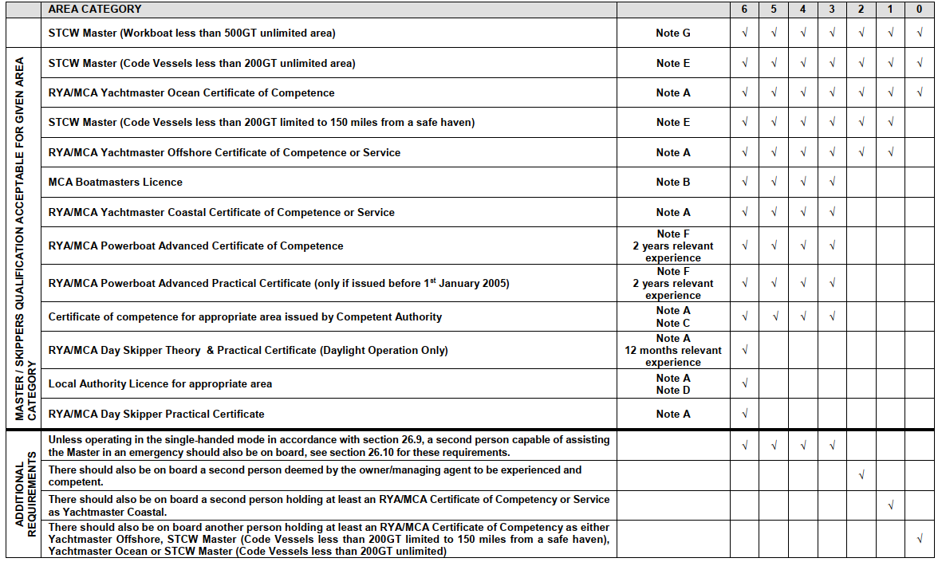
Sea area category
All notes are referenced on the next page;
Click anywhere to remove

Slide 33
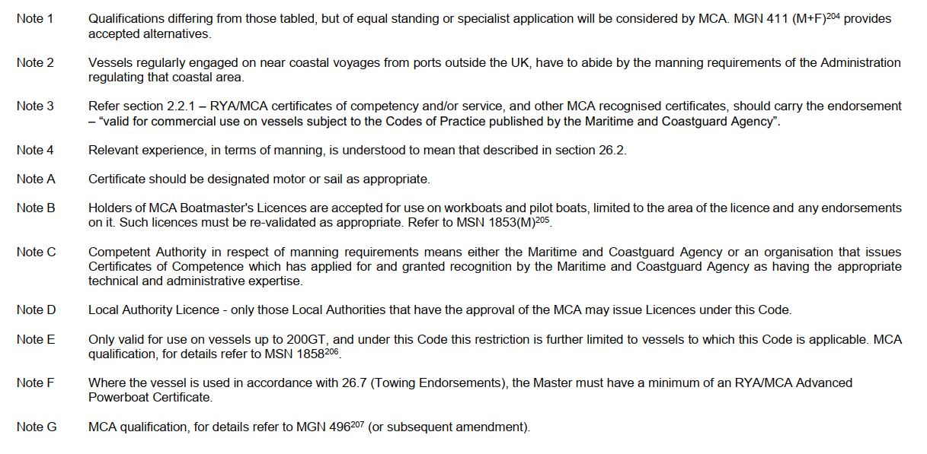

Slide 34
What else do I need to know?

Slide 35
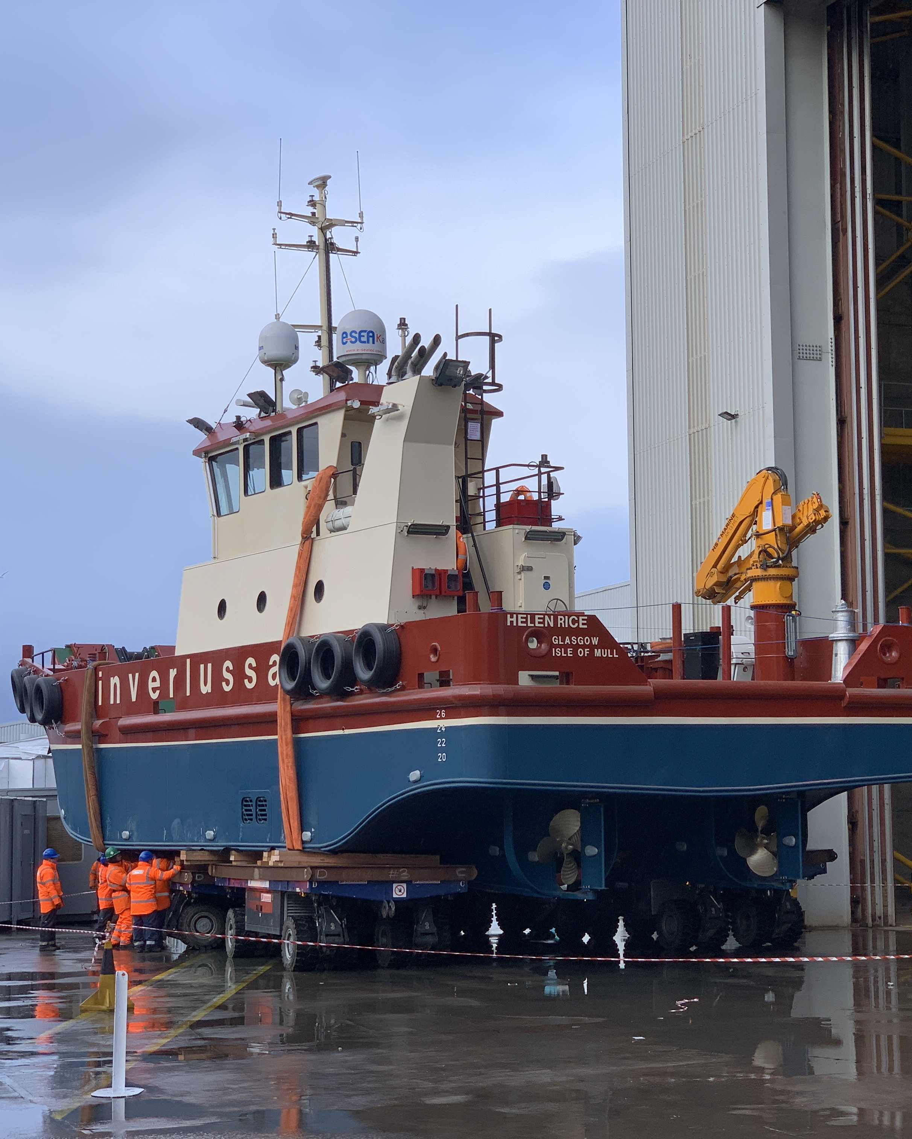
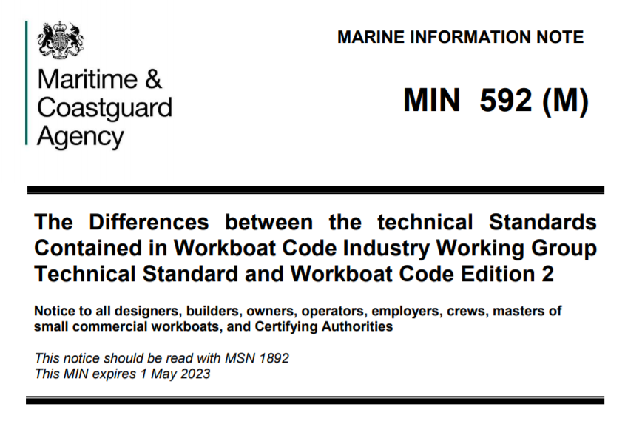
Change of Ownership does not mean a vessel needs to apply to the new code as long as it is kept to its original code standards
Existing workboats that have lapsed certification within the last 5 years can continue under the same code following a periodical or renewal survey
Existing non-coded workboats will be treated as a new build and will need to meet the coding requirements of Workboat Code 2 irrelevant of age

Slide 36

Feedback is important for the MCA to manage and steer future developments of the Code, for example there are some identified issues with Workboat Code 2;
Technical example;
Bilge Pumping - Open Boats, Inflatable Boats and Boats with Buoyant Collars, requires a 6.3m RIB to have two bilge pumps and a bucket – 10.4
Fire Appliances - Vessels Less than 15m in Length, and Carrying 15 or Fewer Persons, Not Covered by Section 15.2 or 15.3, requires a 12m RIB to have a fire pump - 15.4
Editorial example;
Minimum Freeboard, text error in reference 'vessel should comply with 12.2.2.1'. This should be read '12.2.3.1'. The paragraph 12.2.2.1 does not exist - 12.2.3.2
Feedback should be made via your Certifying Authority

Slide 37
Section complete
Click anywhere to go back to the topics menu

Slide 38
Other relevant codes supporting the Workboat Code

Slide 39
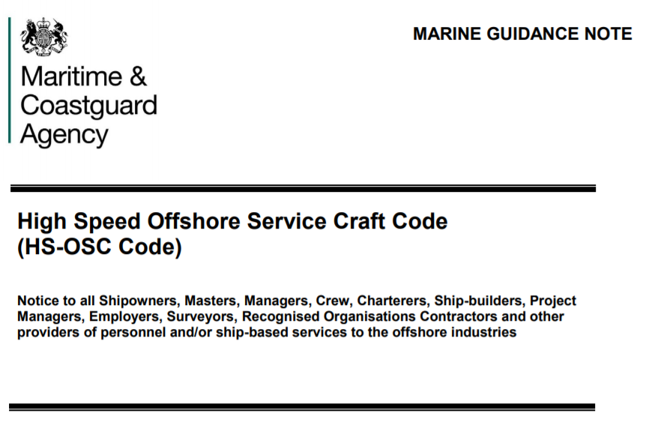
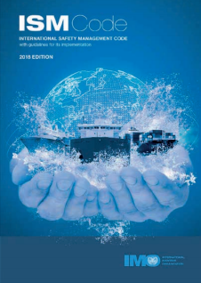
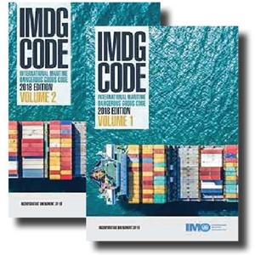
Click on one
Take me back to the topic menu

Slide 40
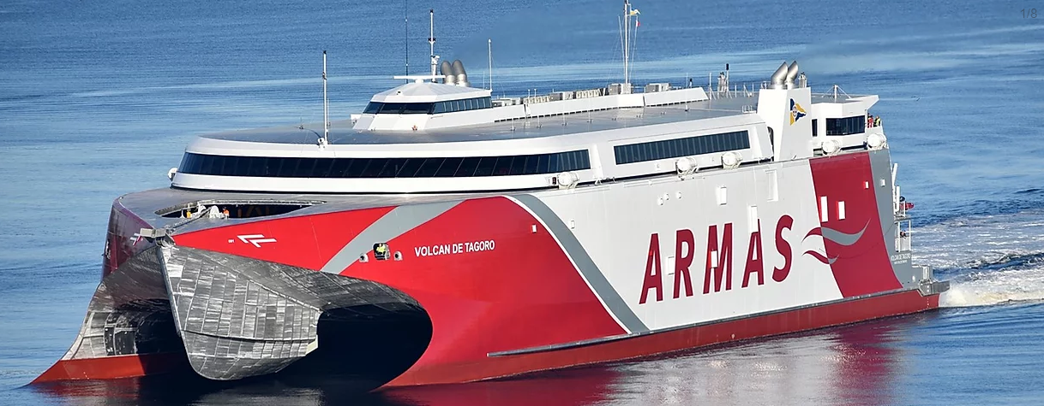
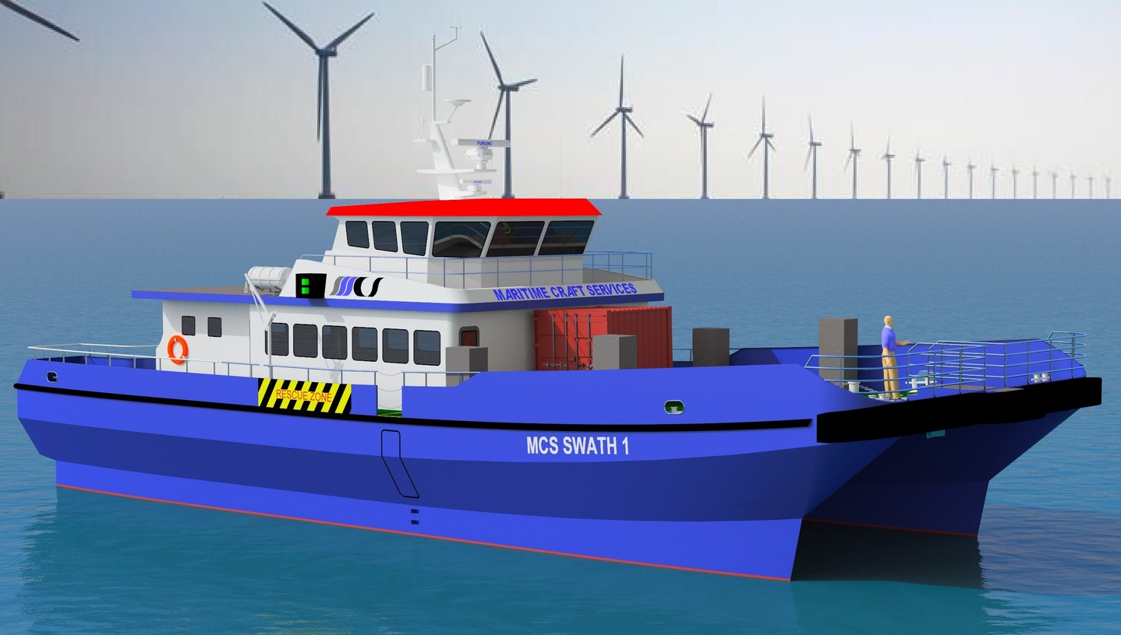
UK Code for High Speed Offshore Service Craft (HS-OSC)
(of less than 500GT carrying up to 60 persons)
The Code was been developed in cooperation with industry, adopting the principles of the Special Purpose Ships (SPS) Code published by the International Maritime Organization (IMO) and Section 9 of Marine Guidance Note MGN 515 for “Walk to Work type operations”, taking into consideration the particular characteristics of transporting trained and fit personnel for their transfer at sea.
The applicable, United Kingdom (UK) regulations on which certification is based are the Merchant Shipping (High Speed Craft) Regulations 2004, SI 2004 No. 302. Regulation 4 of the Regulations provides for the granting of exemptions, such as reference to Application limits in sub-paragraph 1.3.4.2 of the HSC Code 2000, Chapter X Regulation 2.1.2 of SOLAS and Regulation 3 of the Regulations. The UK legislation takes precedence over any requirement in SOLAS or in the HSC Code.
The standards in the Code have been developed to provide levels of safety in personnel, ship construction, equipment and operation, equivalent to that of SOLAS, facilitating the operation of such craft with the required numbers of persons onboard. They are applied as far as reasonable and practical given that the craft are of less than 500 Tons and giving due recognition to the specific abilities of the personnel being carried.
Defining Industrial Personnel is key to enabling the certification for this type of craft using the currently indicated direction for the development of similar standards at the IMO and out of discussions on technical standards and regulations for “Offshore Service Vessels” between maritime administrations around the North Sea.
The High Speed Craft code; written for vessels much like this on the left, has been written into a context relevant for vessels like this on the right.
This is called the High Speed – Offshore Service Craft code, and it is domestic.
(not internationally adopted)

Slide 41
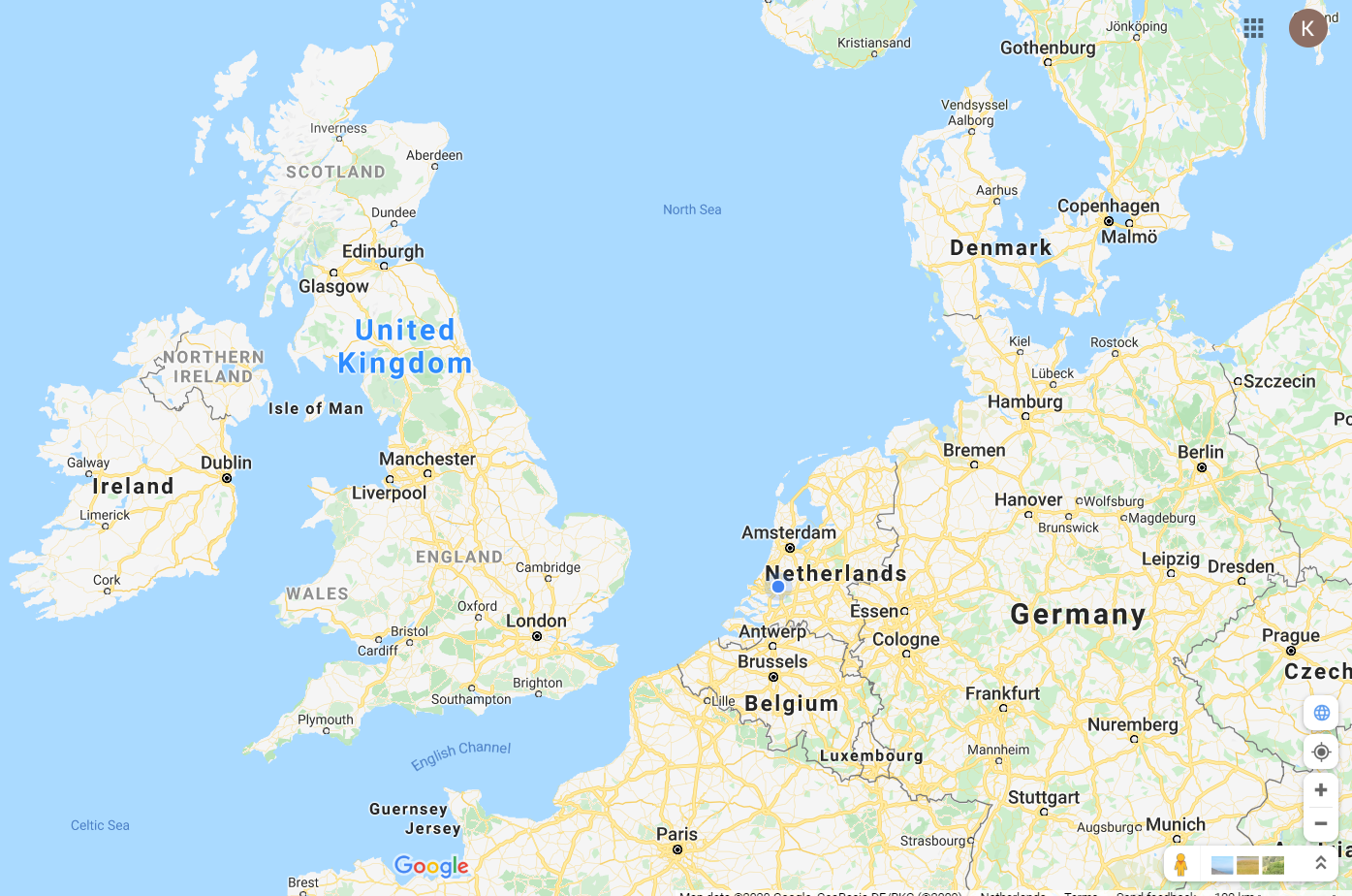
Only a small number of countries have currently adopted
to accept each other’s versions of the code.
Germany, Denmark and the UK
Both the Netherlands and Belgium are currently in the process to make
an agreement to allow for vessels to use the HS-OSC code in their waters.

Slide 43
30.1 All vessels operating under this code are recommended to implement a Safety Management System which complies with the principles of the ISM Code, but is commensurate with the size and complexity of the vessels and company’s operations.
Appendix 7 details the areas which should be addressed by a SMS
1.INTRODUCTION
The purpose of this Appendix is to provide guidance on how to develop and
implement an effective safety management system for coded vessels up to
500GT, where full certification to the International Safety Management Code is
not a requirement.
2. GENERAL
2.1 A Safety and Environmental Protection Policy.
2.2 Risk Assessment
2.3 Shipboard Oil Pollution Emergency Plan (SOPEP)
2.4 Procedures for operations and compliance.
2.5 Communication Plan.
2.6 Procedures for reporting accidents.
2.7 Procedures for responding to emergency situations.
3. HEALTH AND SAFETY PROTECTION POLICY
4. RESPONSIBILITIES
5. PERSONNEL AND TRAINING
6. ON BOARD PROCEDURES
7. PREPARATION FOR EMERGENCIES
8. REPORTING OF ACCIDENTS
9. MAINTENANCE OF THE VESSEL AND EQUIPMENT
10. REVIEW

Slide 45
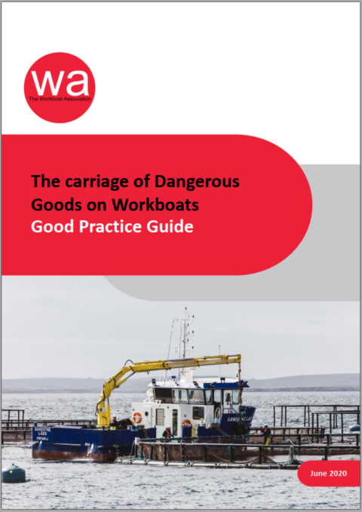
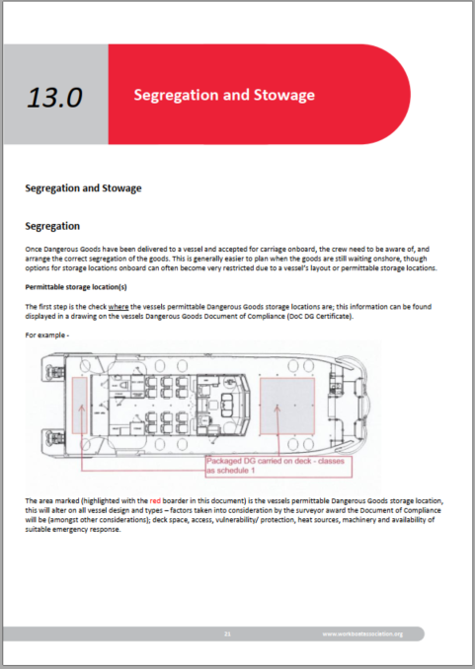
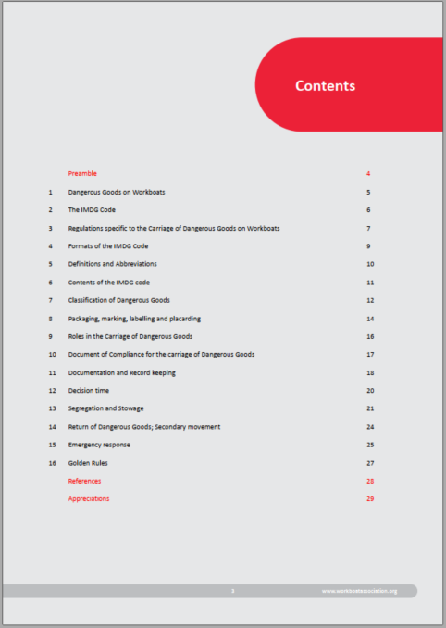
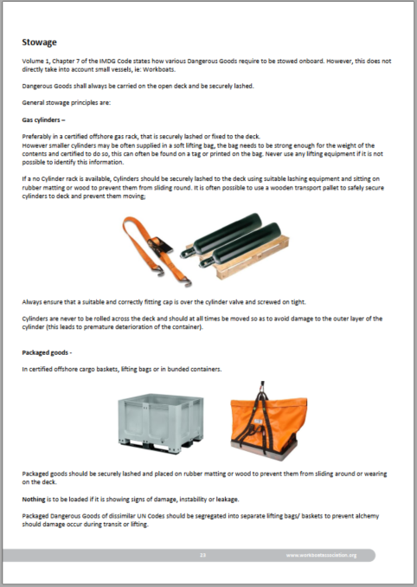
Yes, Workboats do carry Dangerous Goods (often) and No, the Workboat Code does not exempt them from complying with the IMDG Code!
There has been much confusion to the application and implementation of the IMDG Code on board Workboats over the years, but the message is clear IT APPLIES IN FULL
Though there are some working solutions operators of small commercial vessels can apply to ensure compliance is both met and fit-for-purpose for the expectations and needs of the sector.
The WA’s “The Carriage of Dangerous Goods on Workboats”
Good Practice Guide is due for release in June 2020

